Slide 2
FINA 1303 INTRODUCTION TO FINANCIAL MARKETS
Veronique Lafon-Vinais
Associate Professor of Business Education - Department of Finance

Slide 3
Zoom Protocol for Students
Create a clear, friendly profile photo of yourself; make sure it appears when you are present but your video is muted.
Switch on your video for the entire Zoom session; this is key to creating a more inviting and normal classroom environment.
Unmute your audio on entering the Zoom session; greet the instructor and your class mates then mute audio until called.
Each instructor will have protocols on handling questions, etc. but they will be expecting you to follow these best practices.
Your collective effort on this will maximize your enjoyment and what you get out of the program

Slide 4
Course Objective
Knowledge is nothing without understanding
Understanding
Fundamentals of DCF and interest rates
Basic asset pricing and stock valuations
What are the major types of financial institutions
What they do in practice
How they overlap with each other
How they are regulated (if time allows)
Special focus on the Asian markets as much as possible
The approach will be very practical
Drawn from real life experience
Exposure to market practice

Slide 5

Grading
Assessment:
The final grading will be determined as follows:
Participation | 8%
4 Online Quizzes | 32%
Group Assignment | 20%
Exam I | 20%
Exam II | 20%
Notes:
5

Slide 6
Participation
Despite the large class size I intend to make this course as interactive as possible
I expect students to engage actively in class and online with each other and with me and our TA.
Participation represents 8% of the grade
Points will be awarded based on active involvement in class, and participation in class through iPRS/polling/chat and Canvas discussion board.

Slide 7

Personal Response System (PRS)
We will be using iPRS in every class so you can participate in class exercises and earn participation credit
You must use iPRS app on your smartphone.
Make sure you login to iPRS apps (HKUST I learn) every time, as participation counts!

Slide 8
Online Quizzes
Are designed to check that you have mastered the key concepts from the class
Will help prepare you for the exams
Will be spaced out through the course
Will be taken online in a limited time
Will cover materials covered in class
Will take the form of MCQ and T/F questions
Represent 32% of the grade (8% each)

Slide 9
Group assignment
You will be formed into groups of 6-7 students (final number TBC)
Assignment 1:
Each group will be assigned a topic from the course content by lucky draw
Each group has to submit one (short) video and one (short) article that I can use for this course and will be called upon to present their topic
Your submission for assignment 1 is due in Week 4.
Assignment 2:
Each group will be called upon to give a digest of significant financial news in the week assigned to them by lucky draw, and submit a PowerPoint presentation with voice over ppt.
These submissions accounts for 20% of the grade (10% each)
Grading will be based on the relevance of the submissions to the course and maximum points will be obtained for videos and articles that will be integrated in the course.
You will be asked to do peer evaluation at the end of the course.
Introduction

Slide 10
Exams
There will be 2 exams, one roughly half-way through the course and one at the end during the final exam period.
Midterm will be during class time. Time for Final exams will be scheduled by the school. Both Exams will be online. Please do not plan to travel during the exam periods as there will be no make ups
You MUST report to TA any time conflict for the Midterm no later than the add-drop period
Make yourself familiar with the exam rules of the school and HKUST. Be reminded that academic integrity is taken extremely seriously at HKUST.
The mid-term will represent 20% of the grade and the final 20%. Exams will include mostly MCQ and T/F questions but may also include some open questions.

Slide 11
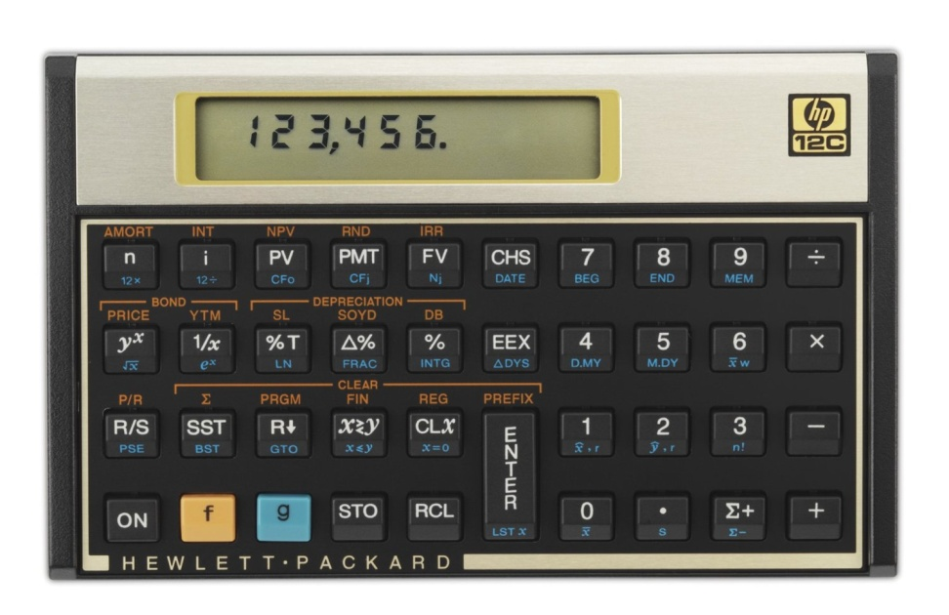
Financial Calculator
Financial calculators have built-in functions that save time in solving time value of money problems, and their use is permitted in examinations. We will also work on examples in lectures.
It is suggested that you procure a financial calculator and become proficient in using its time value of money functions. You should refer to the user manual for instructions.
Financial calculator: recommended models – TI BA II Plus or HP 12C
NOTE: Programmable calculators and calculators with text display functions are NOT allowed during examinations. All HKEAA approved calculators are allowed during examinations.

Slide 12


Textbook
There are two suggested textbooks:
Fabozzi/Modigliani/Jones
Mishkin/Eakins
Both are available in the library and the bookstore
Neither are required, and the course does not strictly
follow either
However the textbooks may be useful for your own
study, for example end of chapter questions

Slide 13
How to study for this class
All parts of the grade count: prepare all assignments on time
Attend all classes, and review the video if you have missed it. Not everything is on the slides!
Review the slides and your notes carefully before the exams
PRS questions and quizzes are designed to help you prepare for the exams, which will follow a similar format (MCQ and T/F). Review those carefully before the exams.
Ask questions if you don’t understand! Raise your hand in class. Catch me or Benson after class, make an appointment, email….
Participate

Slide 14
Course Map
Overview
If time allows
Foundations of
Interest Rates
Financial Institutions
Pricing of Financial Assets
Regulations
DCF
Sell Side
Buy Side
Stock
Valuation
Banking Regulation
Basics of
Interest Rates
Commercial Banking
Traditional Institutional Investors
Monetary Policy
Investment Banking
Alternative Investors
14

Slide 15

Copyright Issues
The lectures will be recorded by UST
Videos will be made available on CANVAS and are subject to copyright; students are not allowed to copy, duplicate or disseminate the videos without prior written consent
No other recording or taping is allowed
The lectures notes are provided to you for single use. You may not copy or distribute all or any part of the notes without the written consent of the Lecturer.
Please be aware of intellectual property issues in all your work and presentations. Take care to indicate the source of your quotes and include a reference list at the end of your presentations.
Plagiarism is not tolerated at HKUST. Plagiarism software may be used in evaluating homework and clear cases of plagiarism will impact your grade significantly.

Slide 16
Contact Info
Instructor: Prof. Veronique Lafon-Vinais
Email HKUST: vlafon@ust.hk
Telephone: office: 2358-7686 (please do NOT leave voice mail)
Mail to: Department of Finance, HKUST
Meeting by appointment only
TA: Benson Leung
E-mail: bbsleung@ust.hk
Meeting by appointment only
Notes:
My office on campus is in room 2445 (2 floor, close to lifts 25/26). If you need to contact me, the best way is by email, as I will be checking my email account daily. If you need to see me, I will generally be available after class, or you can make an appointment to see me (to avoid disappointment).
In case of emergency only, you can call me on my mobile.
For practical and UST related questions, please contact the MBA office or the Department of Finance staff.
Teaching Assistant: Mr. Siming TIAN Email: simingtian@ust.hk; Room 3392 (Lifts 17-18) Phone: 2358 7689
Office Hours: Tue 10:00-12:00, Wed 10:00-11:00 and by appointment
Mail: address to Department of Finance at HKUST, clearly indicating course reference and instructor’s name.

Slide 17

Ask Questions
Definitions, terminology & jargon
Never take anything for granted
Nothing new under the sun
No stupid questions
No one has all the answers …not even me!
Notes:
Some terminology index will be provided.

Slide 18
Course Map
Overview
If time allows
Foundations of
Interest Rates
Financial Institutions
Pricing of Financial Assets
Regulations
DCF
Sell Side
Buy Side
Stock
Valuation
Banking Regulation
Basics of
Interest Rates
Commercial Banking
Traditional Institutional Investors
Monetary Policy
Investment Banking
Alternative Investors
18

Slide 19
Course Map
Overview
The Language of Business
What is finance? Why do we need a financial system?
Who are the players?
How does it work?

Slide 20
Quick reminder on types of firms
When setting up a business, you have to decide which type of legal structure to use
There are many different types of legal structures ranging from sole proprietorship to listed limited liabilities corporations.
The choices available to you depend on the country of incorporation’s legal system.
For example, Hong Kong’s legal system is based on English law and is quite different from the US which has both federal law and different state laws
New York law is different from Delaware law, for example
The firm and its structure

Slide 21
Some examples of corporate organization in the financial industry
Mutual funds: mutual organization: the investors are also the shareholders (in a mutual organization, customers are the shareholders)
Banks: typically listed corporations (limited liability companies) but some are cooperatives or credit unions ( a form of mutual organization)
Insurance: can be limited liability companies or mutual organizations
Hedge Funds and Private Equity Funds: limited partnerships, with General Partners and Limited Partners
In the economy there are all forms of organizations, including many sole proprietorships, but the organizations we discuss in class are mainly limited liability companies (generally publicly listed)

Slide 22
The corporation
In business and finance classes, we generally focus on publicly listed corporations, which are limited liability companies.
A corporation is a legal entity in its own right. It has rights and obligations under the relevant legal system.
In such entities, the owners are the shareholders, but their liability is limited to the amount they have invested to buy the shares.
The corporation has a governance structure, whereby the shareholders appoint a board of directors to represent their interests, and the board appoints a management team headed by a CEO.

Slide 23
Why does it matter?
The choice of legal structure has important implications:
Risk for the different parties
Tax
Conflicts of interest
Possibility to raise capital
Survival of business

Slide 24
Pop Quiz!
What makes mutual organizations different?
If my friend and I are lawyers and we want to set up our own law firm, what legal structure should we use?
If you are a shareholder in a publicly listed corporation, are you responsible for the debt of the company?

Slide 25
Financial Statements
Financial statements are accounting reports issued periodically to present past performance and a snapshot of the firm’s assets and the financing of those assets
Regulations generally require publicly listed companies to file their annual financial statements with listing authorities; they must send an annual report together with their financial statements to their shareholders. The annual report is a yearly summary of the business. It must generally be verified by an auditor.
Example: CX annual report https://www.cathaypacific.com/content/dam/cx/about-us/investor-relations/interim-annual-reports/en/annual_report_2019_eng.pdf
Investors, financial analysts, managers, and other interested parties such as creditors rely on financial statements to obtain reliable information about a corporation
Financial Statements
Copyright ©2015 Pearson Education, Inc. All rights reserved.

Slide 26
Accounting standards
Accounting standards provide the “language” of financial statements.
There are different types of standards, like there are many languages – in the old days, each country had its own set of Generally Accepted Accounting Principles “GAAP”.
Two main global standards nowadays, which are broadly converging:
IFRS (International Financial Reporting Standards) which are increasingly adopted worldwide (currently > 100 countries)
US GAAP in the US only, but companies who want to issue securities in the US market have to convert their statements to US GAAP (unless they use IFRS)

Slide 27
Quick Search!
Find out which accounting standards are used in your country

Slide 28
Role of the auditor
Financial statements generally must be reviewed and certified by an auditor.
The auditor must check that the financial statements present a true picture of the financial health of the company, and must sign off on the statements by providing a statement to the shareholders
Problem: conflicts of interest.

Slide 29
Pop Quiz!
Why do firms have to publish financial reports?
Why does it matter that there are different accounting standards?
What is the role of auditors?

Slide 30
Types of Financial Statements
The main types of financial statements are:
Balance sheet (statement of financial position)
Income statement (profits and loss account)
Cash flow statement
Statement of changes in shareholders equity
Financial Statements
Copyright ©2015 Pearson Education, Inc. All rights reserved.

Slide 31
The Balance Sheet
Also called “Statement of Financial Position”
Lists the firm’s assets and liabilities, as well as shareholders’ equity
Provides a snapshot of the firm’s financial position at a given point in time
In simple terms, a balance sheet presents a picture of what the firm OWNS (assets) and OWES (liabilities) at a specific point of time.
Financial Statements
Copyright ©2015 Pearson Education, Inc. All rights reserved.

Slide 32
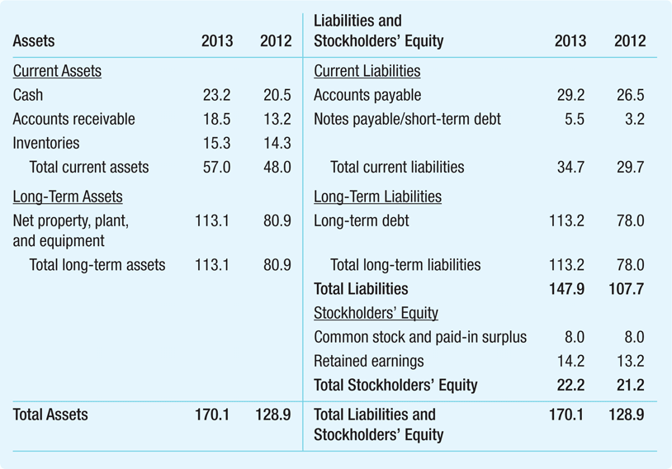
Illustration: Global Corporation Balance Sheet for 2012 and 2013
ASSETS
LIABILITIES
Uses of Capital
-
What we OWN
Sources of Capital –
What we OWE
The difference between assets and liabilities is the shareholders’ equity
The firm’s net worth
Financial Statements
Copyright ©2015 Pearson Education, Inc. All rights reserved.

Slide 33
The Balance Sheet
The Balance Sheet Identity
The two sides of the balance sheet must balance
If we OWE more than we OWN we have negative equity
It should not be possible and is generally not desirable but we will see that the book value and the market value may be different, allowing successful firms to borrow more than the book value of their assets
Financial Statements
Copyright ©2015 Pearson Education, Inc. All rights reserved.

Slide 34
Shareholder’s Equity (Capital)
Shareholders’ (Stockholders’) Equity
The difference between Assets and Liabilities constitutes the shareholders’ equity – also called book value of equity
An accounting measure of the net worth of the firm
Main components:
Share (equity) capital (money invested directly by shareholders in exchange for shares of the company)
Retained earnings (reinvestment of profits)
Financial Statements

Slide 35
Market v. Book Value
Market Value v. Book Value
Book value of equity
Net worth from an accounting perspective
Assets – Liabilities = Equity
True value of assets may be different from book value because (i) the true value of an asset may be different from its book value and (ii) many valuable assets are not captured on the balance sheet: ex: reputation, quality….
Market capitalization (also called market value of equity)
Market price per share times number of shares
Does not depend on historical cost of assets
Financial Statements
Copyright ©2015 Pearson Education, Inc. All rights reserved.

Slide 36
Quick Search!
Find out what is the book value (annual report 2019) and the market value (market cap) of Cathay Pacific (today)
Notes:
Equity: Total equity HKD 62,776 million USD 8,048 million annual report page 72 https://www.cathaypacific.com/content/dam/cx/about-us/investor-relations/interim-annual-reports/en/annual_report_2019_eng.pdf
Market cap: number of shares: 3,933,844,572 (https://www.cathaypacific.com/cx/en_HK/about-us/investor-relations/stock-information.html) price: 6.16 https://www.bloomberg.com/quote/293:HK?sref=INmNRPZ9

Slide 37
Funding the business
Funds come from 2 main sources (as evidenced by the balance sheet):
Equity (Capital) => shares/stocks
To start a business we source money from the 3Fs (friends, family & fools) by issuing shares (stock)
Later on, we can raise more money from financial investors (generally angel investors, venture capital, private equity)
As we become a larger business, we typically get listed (IPO) and raise money from the general public (retail investors)
Debt (Liabilities) => loans, bonds, notes, leases…
We can borrow money from : suppliers (payables & trade credit); banks (loans) finance companies (leases) and investors (bonds, notes, private placements)

Slide 38
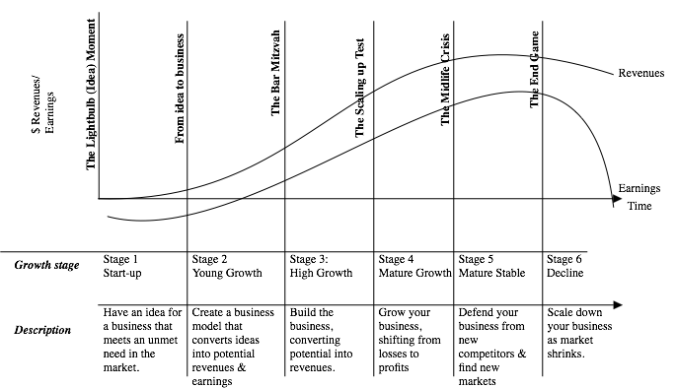
Life Cycle of Firms
Source: Prof. Damodaran, NYU Stern
Notes:
Source: Damodaran http://pages.stern.nyu.edu/~adamodar/New_Home_Page/cfpuzzles/cfspr16puzzle1.htm

Slide 39
Life cycle and funding
Firms
“Self” funding
Cash flow
Stage 1
“Inside” funding
Family & Friends
Stage 2
Firms
Information-intensive external funding
Banks & Financial Intermediation
Widely known firms access investors directly
Corporate bond markets
Firms
Stage 3
Notes:
Stage 1: building up savings from internally generated funds (self funding) and borrowing from close or distant relatives and friends (inside funding) where borrower is “bonded” by its close relationship which monitors its behaviour and enforce discipline
Stage 2: firms have grown such that self and inside funding is insufficient and need external funding. Banks provide information intensive external funding; the external finance premium includes cost of credit evaluation, loan monitorinng, component for risk of default and cost of managing default.
Stage 3: firms grow such that large external funding required (eg infrastructure); widely known firms can access funding directly from investors with corporate bond funding (eg railroad companies in 19th century used direct bond finance because they had a relatively transparent public image and a physical capital structure that was relatively easy to monitor). => firms with good public image which produce a product that is widely used and easily monitored, have an incentive to bypass bank loans in order to exploit their transparency to lower their external finance premium
Firms with access to bond markets also continue to use bank financing because banks provide other services:
backstop financing (LOC, SBLC)
debtor-in-possession financing in event of bankruptcy
Customised borrowing
Confidential borrowing
By encouraging innovation, competition among banks and non-bank financial markets helps to improve the distribution of financial risk in the economy and lower the cost of external finance.
The growth of non-bank finance also improves the resilience of the financial system => “spare-tyre” role of capital markets in cushioning the effect of financial distress on the macroeconomy.
Long term, local currency corporate bonds can also efficiently hedge real future retirementm pension, life insurance and entitlement commitments.
Source: Marvin Goodfriend, Carnegie Mellon University “Why a corporate bond market: growth and direct finance” BIS Papers No 26, BIS conference on Developing Corporate Bond Markets in Asia, Nov 2005

Slide 40
The Income Statement
The income statement lists the firm’s revenues and expenses over a period of time
Sometimes called the profit and loss statement, or “P&L”
The last or “bottom” line of the income statement shows net income (also called “profits” or “earnings”)
A measure of its profitability during the period
Also referred to as the firm’s earnings
In simple terms, the income statements shows what the company earns and how profitable it is!
Financial Statements
Copyright ©2015 Pearson Education, Inc. All rights reserved.

Slide 41
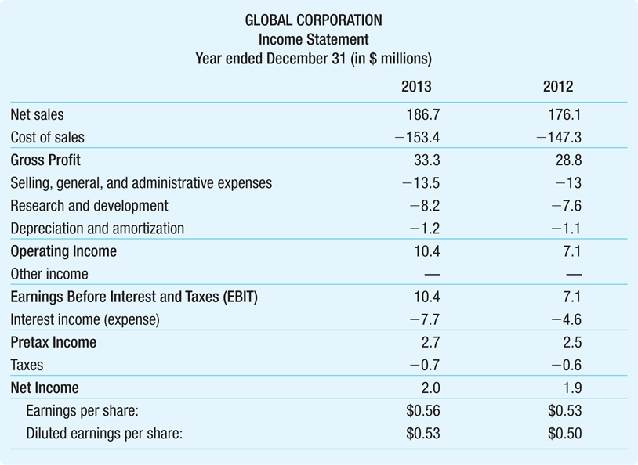
Illustration: Global Corporation’s Income Statement Sheet for 2013 and 2012
Profit & Loss Account
Revenues
Cost of Goods Sold
S, G & A
Operating Expenses
R & D
Net Profit, Earnings
EPS
Financial Statements
Copyright ©2015 Pearson Education, Inc. All rights reserved.

Slide 42

The Statement of Cash Flows
The firm’s statement of cash flows uses the information from the income statement and balance sheet to determine:
How much cash the firm has generated
How that cash has been allocated during a set period
Cash is important because it is needed to pay bills and maintain operations and is the source of any return of investment for investors
Financial Statements
Copyright ©2015 Pearson Education, Inc. All rights reserved.

Slide 43
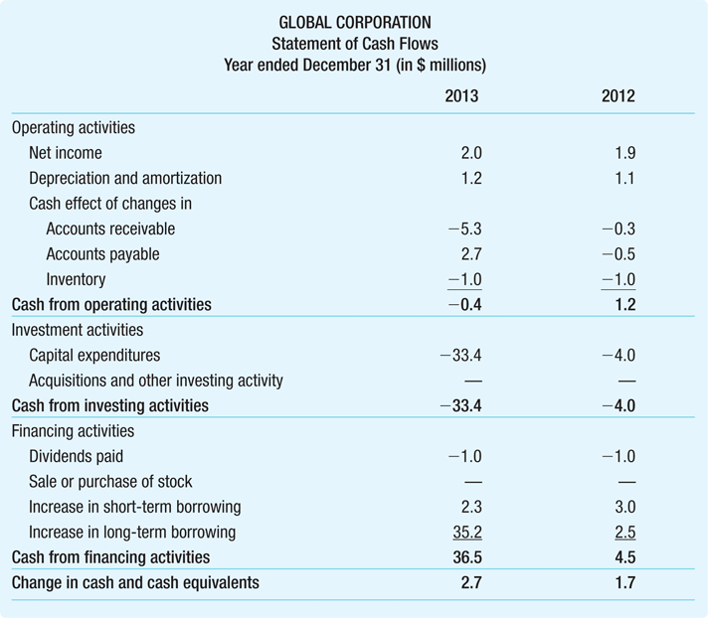
Illustration Global Corporation’s Statement of Cash Flows for 2013 and 2012
The statement of cash flows is divided into three sections which roughly correspond to the three major jobs of the financial manager: Operating activities Investment activities
Financing activities
Financial Statements
Copyright ©2015 Pearson Education, Inc. All rights reserved.

Slide 44
Pop Quiz!
When a start-up raises equity capital from investors, does it issue shares or bonds?
When a company needs to finance a new project with debt, will it issue shares or bonds?
If a company is losing money, are its earnings positive or negative?
As a retail investor, how can you invest in a company to make money from its growth?

Slide 45
Some important ratios and terms you should know about
EBIT and EBITDA
EPS

Slide 46
EBITDA
EBITDA
Financial analysts often compute a firm’s earnings before interest, taxes, depreciation, and amortization, or EBITDA
Because depreciation and amortization are not cash flows (non-cash expense), this subtotal reflects the cash a firm has earned from operations
This is a measure frequently used in debt covenants
Financial Statements
Copyright ©2015 Pearson Education, Inc. All rights reserved.

Slide 47
EPS
Earnings Per Share EPS
Net income reported on a per-share basis
EPS = Net Income
Shares Outstanding
Financial Statements
Copyright ©2015 Pearson Education, Inc. All rights reserved.

Slide 48
Quick Search!
Find out Cathay Pacific’s EPS as of 2019
Notes:
https://www.bloomberg.com/quote/293:HK?sref=INmNRPZ9
Negative EPS…

Slide 49
Course Map
Overview
The Language of Business
What is finance? Why do we need a financial system?
Who are the players?
How does it work?

Slide 50

Imagine…
A region without money…
A country with no banking system…
A world with no global capital flows…
Why was Muhammad Yunus the 2006 Nobel Peace Prize winner?

Slide 51
Evolution of Financial System
Securitization
Corporate
Bond
Markets
Equity
Finance
Exclusive
Reliance
on Bank
Finance
Notes:
Financial markets (systems) evolve over time, accompanying the development of the economy, in a progression beginning with exclusive reliance on bank finance, moving gradually towards equity finance, then corporate bond markets, and ultimately to securitization
The whole structure of the financial system, from the banking sector to securities markets, together with its link to the international financial markets through the capital and financial account, must be adjusted to the stage of development of the economy.
The linear evolution of the financial system from bank-based to market-based in a domestic context must be complemented by a second, international dimension, along the process of integration of the domestic financial markets in the global financial markets. Ultimately, the desired outcome is one of full financial liberalisation.
Integration into the global economy brings obvious benefits, but also poses risks.

Slide 52

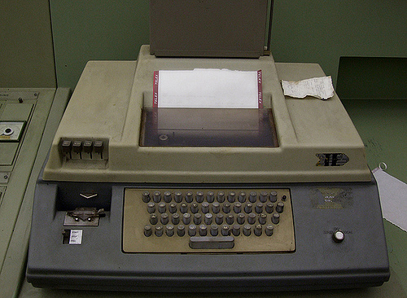
Tech, tech, FinTech
When I started working, this is the technology we had:
Mainframe computer
Telephone
Telex
Typewriter
Post

Slide 53
Quick Search!
What is a telex?
Notes:
https://en.wikipedia.org/wiki/Telex#:~:text=Telex%20was%20a%20major%20method,in%20popularity%20in%20the%201980s.
https://www.youtube.com/watch?v=byMwNPj47X8

Slide 54
Disruptive Technologies
The next big thing?
Mobile Internet
IoT
PC
Internet
Computer
Fax
Typewriter
Telex
Telegraph
Telephone
Recent developments: artificial intelligence (AI), Big Data……
Post
Fall 08
Notes:
54

Slide 55
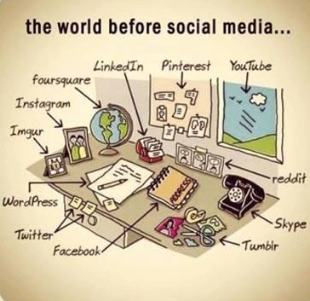
Notes:
Source: Twitter https://twitter.com/FactsGuide/status/593663669235482624

Slide 56

Class discussion
What do we need for financial markets to exist and function properly?

Slide 57
Financial Markets
Media & PR
Corporations
Commercial
Banks
Brokers
Service
Providers
Institutionals
Investment
Banks
Information
Providers
Public
Exchanges
Regulators
Notes:
57
Participants in the corporate finance industry include:
Ultimate clients: (in green) corporations, institutionals, public; they can be issuers, sellers, buyers…
Regulators and exchanges (in blue)
Financial Intermediaries (in pink): commercial and investments banks and brokers and other FSPs
In yellow: various service providers including:
Information providers : Bloomberg, Reuters, Thomson and others
Media and PR: CNN, CNBC, PR firms, roadshow organizers
Service Providers : Lawyers, Accountants, Auditors, Printers
The IP sell their services to pretty much all the other players (limited sales to Joe Public)
We concentrate on the 2 main bodies of financial intermediaries who are the main sales target for information providers such as Thomson.

Slide 58
Key building blocks for capital markets
Source McKinsey April 2017
Notes:
Source McKinsey April 2017 http://www.mckinsey.com/industries/financial-services/our-insights/deepening-capital-markets-in-emerging-economies?cid=other-eml-alt-mip-mck-oth-1704&hlkid=98808b4c6c284aa7b75c982fa702146b&hctky=2168735&hdpid=9657dc63-3be4-4ca0-9adc-7de54fcfb8a6
Patient reputation building
High performance standards
Resilient infrastructure
Robust regulatory framework = understanding the regulatory imperative
Leadership & Vision => setting clear objectives
Political commitment => actively developing the market:
Stimulate development of new asset classes
Encourage pension fund reform
Promote privatization
Obstacles
Volatile and inconsistent economic policy
Underdeveloped commercial law
Slow pace/absence of privatization
Lack of talent
Poor regulation
Inadequate pension systems
Inadequate market makers
Inadequate infrastructure

Slide 59
Functions of Financial Markets
Channeling funds
Efficiency
Price determination
Risk sharing
Liquidity
Financial stability
Information aggregation and coordination
Notes:
59
Channeling funds: financial markets permit the transfer of funds (purchasing power) from one agent to another for either investment or consumption purposes; Allow transfers of funds from person or business without investment opportunities to one who has them; Channel funds from savers (economic units with financial surplus and/or who don’t have a productive use for the funds) to investors (economic units with financial deficit and/or who do have a productive use for the funds), thereby promoting economic efficiency; Do not serve only for raising funds (cf FX and derivatives markets)
Efficiency: financial markets reduce transaction costs and information costs. Provide an efficient allocation of resources from savers to productive investors; Improve economic efficiency
Price determination: financial markets provide vehicles by which prices are set both for newly issued financial assets and for the existing stock of financial assets; Offer current and future price determination through bid/offer mechanism
Risk sharing: financial markets allow a transfer of risk from those who undertake investments to those who provide the funds for those investments. Dilute risk by spreading it across a large pool of economic agents
Liquidity: financial markets provide the holders of financial assets with a chance to resell or liquidate these assets
Reduce both probability and cost of systemic instability and financial crises
Information aggregation and coordination: financial markets act as collectors and aggregators of information about financial assets values and the flow of funds from lenders to borrowers;
Market structure:
Require active participation of a number of professionals (it takes at least three participants to create a market) who are free to make decisions (apart from resources/rules constraints); the exchange carried out through the market is voluntary and competition is usually present and adds to the autonomy
Generally share a common information system
Can work with no one in charge
Are a social construction which must be well built in order to work smoothly : the market design must be good, i.e. the mechanisms that organize buying and selling; the channels for the flows of information; the laws and regulations that define property rights and sustain contracting; and the markets culture, its self-regulating norms, codes and conventions regarding behavior. (source: John McMillan)
Function of financial markets as supplier of financial services to the public: the financial system can also be viewed as collection of financial service firms that produce, distribute and sell financial services to the public, including:
Payments services (payment accounts, checks, fund transfer & wire, cash/debit/payment/credit cards)
Thrift services (financial instruments with adequate safety and yield to encourage people to save)
Insurance services (providing protection from loss of income or property)
Credit services
Hedging services (providing protection against loss arising from market movements)
Agency services (acting as agent for customer in managing funds or other property)

Slide 60
Quick Search!
Find a map of Asia

Slide 61
Asia’s Financial Markets
No transaction efficiency
Information asymmetry
Affects price efficiency
Fragmented markets
Lack of information
Reliability of information
Timeliness and accuracy of information
Legal (un)certainty
Weak regulators
Notes:
61
Asia compared to Europe or the US is a heterogeneous market; some countries are developed, OECD countries with sophisticated financial systems; others are developing countries with rather primitive financial markets and archaic infrastructure. Payments systems are at times extremely basic (e.g. India) and at times highly sophisticated (Hong Kong). Information can be extremely difficult to obtain. (expand with map next slide)
The corporations run the gamut from highly sophisticated investment grade MNCs to local, family owned companies.
Generally speaking disclosure standards are very low, although improvements have been noted after the Asian crisis.
Quality of information varies dramatically depending on the countries and the corporations.
What does this mean for banks? =>
Local teams and regional headquarters => conference calls with HQ in US or Europe at midnight
Wide range of products
Strategic choice of target markets and target clients (eg super-core and core accounts)
Potential P&L versus expanded cost base.
Volatility
Political risk

Slide 62
McKinsey Asian Capital Markets Development Index
Source McKinsey April 2017
Notes:
Source McKinsey April 2017 http://www.mckinsey.com/industries/financial-services/our-insights/deepening-capital-markets-in-emerging-economies?cid=other-eml-alt-mip-mck-oth-1704&hlkid=98808b4c6c284aa7b75c982fa702146b&hctky=2168735&hdpid=9657dc63-3be4-4ca0-9adc-7de54fcfb8a6

Slide 63
Constituents of the McKinsey ACMD Index
Source McKinsey April 2017
Notes:
Source McKinsey April 2017 http://www.mckinsey.com/industries/financial-services/our-insights/deepening-capital-markets-in-emerging-economies?cid=other-eml-alt-mip-mck-oth-1704&hlkid=98808b4c6c284aa7b75c982fa702146b&hctky=2168735&hdpid=9657dc63-3be4-4ca0-9adc-7de54fcfb8a6

Slide 64
Pop Quiz!
When everything in a country is fully owned by the government, can there be an effective capital market?
Why is climate change a risk factor for capital markets?
What are some of the challenges investors face in frontier markets?

Slide 65
Course Map
Overview
The Language of Business
What is finance? Why do we need a financial system?
Who are the players?
How does it work?

Slide 66
The Players
Sources of funds (Investors)
Institutionals
Sovereigns and quasi-sovereigns
Banks & FIs
Corporations
HNWI
Public (households)
Users of funds (Issuers)
SSAs:
Supras
Sovereigns
Agencies
Banks
Corporations
SPVs
Notes:
66
Institutionals include:
Insurance companies (life and non-life) => life insurance cos have relatively assured C/F so can commit to take down up to several years forward and
Pension funds (private and public)
Mutual funds
Professional money managers invest on behalf of customers, owners or beneficiaries of financial institutions and private firms (hedge funds)
A Hedge Fund is a private investment partnership that takes leveraged positions in various segments of the capital markets.
Governments include state and local governments
Agencies is a term that describes agencies of the US government in the broad sense. It includes both agencies of the US that carry the full faith and credit of the US government and others.
HNWI = High Net Worth Individuals (important investor segment in the Eurobond markets)
Investors tend to be classified according to their investment strategies. For example, some investors are passive, tending to run indexed portfolios in which the investors portfolio is indexed to a broad index market e.g. Lehman’s fixed Income Index. Other investors follow active portfolio policies.
Supra = supranationals. A supranational is an institution formed by 2 or more central governments through international treaties. Example: World Bank, ADB
Captive finance companies of large corporations are active players in the markets as issuers and/or investors.

Slide 67
The Players
Warning! We will explain the difference between “intermediaries” and “financial intermediaries” later
Intermediaries
Investment bankers
Primary dealers/traders
Brokers
Credit and liquidity enhancers
Other actors
Regulators
Service providers
Rating agencies
Notes:
67
Investment Bankers:
Offer advice
Help prepare documentation
Agree pricing
Underwrite securities
Underwriters:
purchase bonds and resell them at an agreed mark-up
Provide a form of insurance by guaranteeing the price
Are middlemen who typically buy securities from the issuer and resell to the market
Sometimes actually don’t underwrite but just market the securities
Note that when Glass-Steagall Act was enforced (before it started to crumble in the 80s), commercial banks in the US were prohibited from underwriting securities.
Traders/Market Makers/Dealers:
“make” markets by offering to buy/sell bonds
Includes primary dealers for government securities
In the US, national and regional securities dealers maintain the OTC market.
Brokers: (also called interdealer brokers)
don’t take positions
Charge a fee/commission for putting parties together
Aggregate information about the bids and offers posted by various dealers and disseminate that information on computer screens without revealing the identity of the dealers. Dealers pay interedealer brokers commissions for their services.
Regulators:
In the US the securities industry is regulated at the national level by the SEC and NASD, and at the state level by local regulators
The US SEC is a Federal Agency that oversees the securities regulation in the US. The SEC:
Licenses brokers, broker-dealers, mutual funds managers
Administers registration of securities for public trading
Monitors Federal securities law compliance
Service Providers include:
Lawyers
Accountants
Auditors
Rating Agencies
Information Providers (Reuters, Bloomberg, Thomson Financial)
Printers
Media & PR

Slide 68
Class discussion
“Incentives are the cornerstone of modern life and understanding them - or, often, ferreting them out - is the key to solving just about any riddle, from violent crime to sports cheating to online dating.”
Steven Levitt/Stephen Dubner, Freakonomics
What are the objectives and incentives of each of the
categories of players in the markets?
Notes:
68
An incentive is simply a means of urging people to do more of a good thing and less of a bad thing. There are 3 basic flavors of incentives: economic, social and moral. Very often a single incentive scheme will include all three varieties.
Issuers:
To sell securities at a fair price
To have orderly and liquid secondary market in their securities
To be able to reverse and modify earlier issuance decisions in response to market conditions efficiently
To design and issue debts securities that best suit their requirements
Investors:
To buy securities of different risk-return profiles at a fair price
To obtain diversification at a low cost
To reverse previous decisions at a low cost
To have access to risk management services
To get information at a low cost
Intermediaries:
To provide primary market making services such as bidding in the auction, underwriting, and distribution
To provide orderly market making in the secondary market
To provide risk management and asset liability management services
To provide prop trading activities

Slide 69
Course Map
Overview
The Language of Business
What is finance? Why do we need a financial system?
Who are the players?
How does it work?

Slide 70
Classification of Financial Markets
Primary v. Secondary
Debt v. Equity
Exchanges v. OTC
Domestic v. International
Public v. Private
……
Notes:
70
There are many types of classification of financial markets: the most common ones are:
By sequence (primary v. secondary)
By type of claim (debt v. equity)
By localisation of issuer (internal v. external)
By process & location of players (exchange v. OTC)
By maturity of the instruments (money market v. capital markets)
Here are some of the most common classifications of financial markets, but there are others.
Q to Ss: any ideas? A: Example: public and private markets – public being a market where products are sold to the general public, e.g. public debt capital market. Generally in public markets the securities are registered with the regulator; cash v. derivatives).
All the markets do not necessarily fit in all of the classifications, for example the loan markets is not considered part of the Capital Markets but is still a very large component of debt markets.
The interbank market is generally considered by the players in the market as part of the money markets but most books (specially academic books) don’t take them into account. In fact much of academia tends to concentrate rather exclusively on the securities markets, which actually only represent a very small fraction (albeit the most visible) of the ways of raising finance.
Money & Capital Markets:
Q to SS: anyone knows the difference?
A: classification a/c to maturity
Money Markets < 1 year
Capital Markets > 1 year
Sometimes MM is included in DCM (debt capital markets (cf intro Choudry)), generally if MM is defined as excluding the interbank market.
Cash v. Derivatives Markets:
Q to Ss: can anyone think of some examples?
cash market in FX is FX rate; derivatives in FX is forward market;
in equity market cash market is trading shares; derivatives markets is the futures and options markets;
in MM the cash market is the short term debt instruments like CP and CDs, the derivatives market is LIBOR forwards and futures)
ECB Classification of financial markets
Interest Rate
Equity
Foreign Exchange
Investment and Money Market Funds shares/units
Other Financial Markets

Slide 71
Primary & Secondary Markets
Primary market = raising money/capital for the first time
Secondary market = selling securities onto another investor
Notes:
71
The primary market is where companies raise money (known as capital) by issuing shares or bonds, Companies often raise capital via an IPO, In a similar way, the government raises money in the primary market by offering its gilts (government bonds) to investors, commonly by auction.
The key reason that investors are willing to buy securities in the primary market is that they know that they will be easy to sell on later in what is known as the secondary market. Without an active or liquid secondary market investors would be reluctant to invest. Illiquid securities are securities that are difficult to sell quickly and are therefore less attractive investments.

Slide 72
Primary v. Secondary Markets
Primary Market
Investor
A
Borrower/
Issuer
Secondary
Market
Investor
B
Financial
Market
Notes:
72
Primary & secondary markets:
Q to Ss: anyone can give me a definition?
A: classification a/c to sequence (go to Chart 1)
Primary: New security issues sold to initial buyers
Secondary: Securities previously issued are bought and sold
This distinction applies to both debt and equity markets as well as loan markets.
Primary markets: where issuers initially sell securities
Secondary markets : after debt or equity securities have been initially sold, they are traded in the secondary market.
The secondary markets can be auction markets (exchanges) or dealer markets (OTC).
Primary Markets
markets for issue of new securities to raise money for consumption or investment purposes
Include issue of both primary and indirect securities
Markets in non-negotiable instruments are entirely primary markets
Secondary Markets
Markets in which previously issued financial claims are traded
Differ in terms of breadth/depth/liquidity
Important
Functions of secondary markets:
Assist primary markets by providing investors with reversibility/marketability/liquidity
Provides the basis for price determination on new issues
Registers market conditions rapidly
Enables investors to adjust portfolios (size, risk, return, liquidity and maturity)
Enables central bank to influence liquidity in financial markets through open-market operations

Slide 73

Test Your Understanding/PRS time!
Is an IPO (initial public offering) a primary market or secondary market transaction?
Primary
Secondary
If you buy shares from another investor, is it primary market or secondary market transaction?
Primary
Secondary

Slide 74
Debt v. Equity
Debt
Legally binding obligation
No voting rights
Requires repayment of principal and interest
Interest is tax-deductible (some countries inc. US, but not always)
Covenants can be restrictive
Equity
Ownership
Voting rights on common stock
Dividends on common stock are optional
Dividends are paid from after-tax profits
All cumulative preferred dividends must be paid before dividends paid on common stock
The conditions in the contract
Notes:
74
A: Equities represent ownership shares in a business firm and as such are claims against the firm’s profits and against proceeds from the sale of its assets (P. Rose, Money & Capital Markets Ch2). Holders of equity shares are called shareholders or stockholders. Shareholder equity represents the difference between the value of the assets and the debt (liabilities) of the firm. In this sense it is a residual claim on the firm’s assets. The stockholders ‘ claim on the firm’s value at the end of the period is the amount that remains after the debt holders are paid (R/W/J Ch 1) Equity securities represent non contractual claims to the residual cash flow of the firm (R/W/J Ch 1). The Equities are generally subdivided into common stock (which entitles the holder to vote for the members of a firm’s board of directors and therefore determine company policy) and preferred stock (which normally carries no voting privileges but does entitle the holder to a fixed share of the firm’s net earnings ahead of its common stockholders). From the “set-of-contract” perspective (R/W/J ch1) the equity contract can be defined as a principal-agent relationship. The members of the management team are the agents, and the equity investors (shareholders) are the principals. It is assumed that the managers and the shareholders, if left alone, will each attempt to act in his/her own self interest (we will talk more about this principal agent problem a bit later under Asymmetric Information).
Debt entitles the debt holder (creditor) to a priority claim over the holders of equities to the assets and income of an individual, business firm, or unit of government. Usually that claim is fixed in amount and in time (not always: eg, perpetuals) and may be backed up by pledges of specific assets as collateral. (P. Rose, Money & Capital Markets Ch2). Debt securities are contractual obligations to repay corporate borrowing (R/W/J Ch2)
Debt and equities are financial assets, e.g. claims against the income or wealth of a business firm, household, or unit, of government usually represented by a certificate, receipt or other legal document.

Slide 75
Securities & Capital Markets
Securities = negotiable, tradable financial instruments
Include equity securities (stocks/shares) and debt securities (bonds/notes)
Capital markets = markets where securities are traded and where firms can raise capital (either equity capital or debt capital)
Include Equity Capital Markets (ECM) and Debt Capital Markets (DCM)
Financial markets include but are not limited to, capital markets. For example:
Foreign Exchange (FX) market (market for trading currencies) – the largest and most liquid of all financial markets, is not a “capital market” since participants don’t raise capital
Commodities market
Loan market
Money market (interbank, commercial paper, CDs…)
Derivatives market

Slide 76
Debt v. Equity Markets
Debt Markets
Equity Markets
DCM
Money
Markets
Loan
Markets
Hybrids
Notes:
76
Money Markets are short term debt markets I.e. instruments have a maturity of less than one year
Loan markets include all forms of bank loans including SAS, project finance, structured trade finance as well as trade finance for the purpose of this presentation (strictly speaking trade finance transactions are not loans)

Slide 77
Test Your Understanding/PRS time!
If a company issues bonds, which type of market does it use?
ECM
DCM
The FX market is a
Capital market
Financial market

Slide 78
Market Organization
4 main types of market organization:
Direct search
Brokered market
Dealer market
Auction market
Notes:
The market organization is the institutional arrangement by which buyers of securities are matched with sellers thereof. Form of market organization has significant impact on resulting price processes and bid-offer spreads
Properties of market organization:
Transparency => a well functioning market should be transparent. Transparency is the extent to which info about trades, quotes and other market info e.g. volume of trading and open interest are available to all players in the market.
Adverse selection
Lemons & plums problem
The intermediaries charge a wider bid-offer spread to all participants in the market when availability of info is not symmetric and the cost of obtaining additional info significant
Can be a significant factor in determining the bid-offer spread
Intermediaries routinely take large positions in securities and absorb the risk of price fluctuation before inventories are sold to customers
Risk of security in the market + ability to offload that risk in other markets + uncertainty in the cost of financing such inventories all contribute to the bid-offer spread determination and to the depth of the markets.
Informational disclosure requirements, regulatory rules and effectiveness of their enforcement affect price processes and bid-offer spreads
Exchanges & OTC:
Question to Students: What do you think this is?
Classification a/c to process and location of players
Exchanges (e.g., New York Stock Exchange): Trades conducted in central locations
OTC : Dealers at different locations buy and sell directly to each other
Question to Students: Give examples of OTC markets? Of Exchange markets?
Direct search => Buyers directly search and identify matching sellers without the benefit of one or more intermediaries, Costs of search, location and negotiation are borne by the individual transactor. Direct search typically applies in small markets with few buyers and sellers. The frequency of transactions must be so low that no intermediary would find it economical to provide any service.
Brokered market => Brokers act as agent to buyer and seller. They intermediate (for a fee) and match buyers and sellers at mutually agreed terms. Trading volume in securities must be heavy and there must be significant economies of scale in the search costs to locate counterparties, so that a direct search is a more costly alternative to buyers and sellers

Slide 79
Methods of Price Determination
Dealer markets: Price determined by market makers (traders/dealers) based on supply/demand; their existing position; their view of the market
Broker markets: Price determined by supply/demand
Auction markets: All bids and offers entered into system; price determined at equilibrium point (Dutch auction) or highest price bid
Some exchanges are auction markets while others are dealer markets

Slide 80
Exchanges vs. Over-the-Counter (OTC)
Exchanges
Over-the-counter (OTC)
One centralized “location”
2 types: stock exchanges and derivatives exchanges
Can be auction markets or dealer markets
Not localized
Dealer markets
Examples: bond market
Notes:
The Nasdaq vs. The NYSE
(Source: http://i.investopedia.com/inv/pdf/tutorials/electronic_trading.pdf )
From a glance, the difference between the New York Stock Exchange (NYSE) and Nasdaq may not be marked. The NYSE lists household names like Coca-Cola, Wal-Mart, Citicorp, and General Electric, whereas the Nasdaq is home to many of the tech giants such as Microsoft, Cisco, Intel, Oracle and Sun Microsystems. Besides the heavy tech weighting, the fundamental difference between the two exchanges is in the way securities are traded.
NYSE
The NYSE is an auction market that uses floor traders to make most of its trades. Each stock on the NYSE has a specialist; this is a person who oversees and facilitates all of the trades for a particular stock. If you wish to buy a stock that trades on the NYSE, your broker will either call your order to a floor broker, or enter it into the DOT system (which we will discuss later on).
Nasdaq
The Nasdaq, on the other hand, is not a physical entity. The Nasdaq might be known for its fancy MarketSite Tower and broadcast studio in Times Square, but very little is done there. The Nasdaq is an over-the-counter (OTC) market and it relies on market makers rather than specialists to facilitate trading and liquidity in stocks. For each stock, there is at least one market maker, (large stocks such as Microsoft have several), whose duties we will discuss later on. Rather than being an auction market, the Nasdaq is a communications network between thousands of computers. Instead of brokers calling out orders, market makers place their names on a list of buyers and sellers, which is then distributed by the Nasdaq in a split second to thousands of other computers. If you wish to buy a stock that trades on the Nasdaq, your broker will either call up a market maker with the information of your trade or enter your order into a Nasdaq-sponsored online execution system

Slide 81

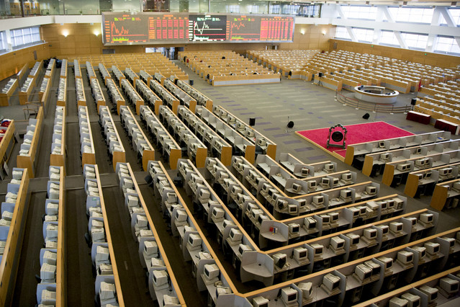

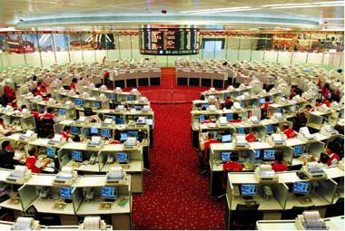
Game: Identify these Asian securities exchanges
3
1
2
4
Notes:
Shanghai Stock Exchange
HKEx (HK Stock exchange)
SGX (Singapore Stock Exchange (before floor trading stopped)
Tokyo stock exchange

Slide 82
Some misunderstandings
Trading v. listing: financial instruments can be listed on an exchange …
to list a security or a financial instrument on an exchange, the firm needs to meet the listing requirements and rules of that particular exchange
… But don’t necessarily trade on that exchange
Trading has to do with supply and demand for that particular instrument
A stock can be listed on an exchange but very rarely trade on it if there is no or limited liquidity
Some financial instruments ONLY trade on exchanges
for example futures are exchange specific financial instruments
Others can be traded on exchanges or OTC
for example bonds are often listed on exchanges but generally trade OTC.
Spot FX only trades OTC

Slide 83
Current issues related to market organization
The advent of electronic trading
Will open outcry disappear?
Demutualization and listing of exchanges
Mergers and consolidation
Dark pools and private exchanges
Advent of High Frequency Trading (HFT)
Regulators push to move OTC onto exchanges
Impact?
Notes:
As recently as December 2005, the floor was home to 1,244 equity members — specialists, now called “designated market makers,” and brokers — and 2,087 clerks, according to the exchange. Today there are 442 equity members and 627 clerks. The number of independents has fallen to fewer than a dozen from 50 or more two decades ago. The floor is a victim of technology. Electronic exchanges such as longtime rival Nasdaq Stock Market and recent upstart BATS Exchange have siphoned off much of the activity from the floor by creating ultrafast trading networks. The NYSE responded to the pressure in 2006 by acquiring an electronic exchange of its own, Archipelago Holdings; the following year it snapped up Euronext, the multinational European exchange that had itself gone largely electronic, to create holding company NYSE Euronext. Now, of the roughly 6.5 billion shares of U.S.-listed stocks that change hands each day, the NYSE handles only about a third of the total, according to industry estimates. Even for NYSE-listed stocks, the exchange has a market share of just 42 percent, according to its most recent statistics. A substantial percentage of the volume that does make it to the floor, moreover, is executed via a single click on NYSE Arca without the need for two human beings — a floor broker and a specialist — to interact. Floor brokers accounted for just 5 percent of overall volume in April, exchange data show. Source: NYSE technology threatens survival of floor traders, II 06 July09

Slide 84
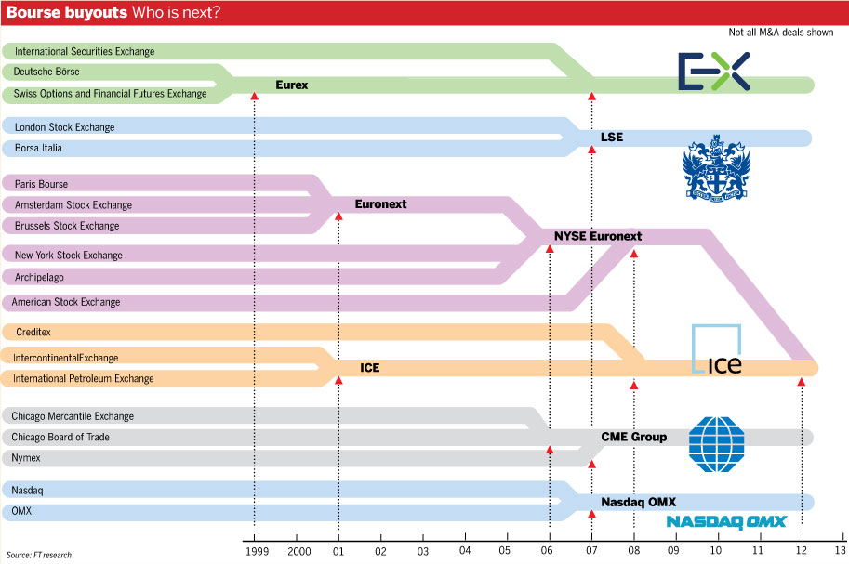
Source: FT“ICE and NYSE Euronext go where other exchanges have struggled” 3 October 2013
Notes:
Source: FT“ICE and NYSE Euronext go where other exchanges have struggled” 3 October 2013
http://www.ft.com/intl/cms/s/0/c6c899fc-2b56-11e3-bfe2-00144feab7de.html?ftcamp=crm/email/2013104/nbe/GlobalBusiness/product#axzz2hC887RHW

Slide 85
Test Your Understanding
Futures are traded on
Exchange markets
OTC markets
FX is traded on
Exchange markets
OTC markets

Slide 86
Domestic, Euro and Foreign markets
To determine if a securities issue is domestic, foreign or “Euro” we need to check three key variables:
what currency is the security issued in?
Where is the security placed? (where are the investors)
Where is the issuer?
Domestic issues: placed with investors in the country of the currency and the issuer is also from the country of the currency
Example: HK Land issues a HKD bond placed to HK investors

Slide 87
Domestic, Euro and Foreign markets
Foreign issues: placed with investors in the country of the currency but the issuer is from a different country
Example: HK Land issues USD bond to US investors
“Euro” issues: placed with investors outside the country of the currency. It doesn’t matter where the issuer is from.
WARNING!! Very confusing as “Euro” here is NOT the Euro currency. “Euro” here means the currency is used OUTSIDE its country.
Example 1: HK Land issues a EUR denominated bond to HK investors
Example 2: HK Land issues a USD denominated bond to EU investors

Slide 88
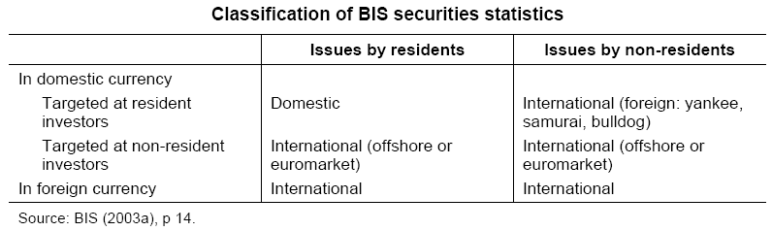
BIS Classification of Bond Markets
For the BIS, securities issues are classified as domestic or international. The international category includes foreign and “euro” issues.
Notes:
88
Source: http://www.bis.org/publ/bppdf/bispap30d.pdf
Bond markets can be classified according to residence of issuer, targeted investors and currency of denomination. For instance, the BIS international securities data cover everything but issues by residents targeted at resident investors denominated in domestic currency (Table 1). Issues by non-residents targeted at resident investors and denominated in domestic currency are part of the foreign bond markets, which go by various colourful names (yankee for United States; samurai for Japan; bulldog for the United Kingdom). Offshore (or “euro” in the old sense) markets involve targeting investors with bonds not denominated in their domestic currency.
Our approach to defining global, regional and national or domestic markets relies primarily on the “who’s who” of issuers and investors and to a lesser extent on currency of denomination. Thus, global markets require broad international participation on the sell and the buy side, but can, conceptually at least, operate in as few as one or as many as all of the world’s currencies. A regional bond market would be defined primarily as one that brings together issuers and investors from a region, and secondarily as one that uses the currencies of the region. Finally, domestic bond markets feature mostly domestic issuers and investors, although foreign investors may play a more or less important role, while the currency of choice is the local currency.
We fine-tune our definitions of global, regional and national or domestic markets to East Asia and play down the distinction between onshore and offshore markets. Global bond markets would mostly feature dollar or euro bonds underwritten in London, placed in Asia and Europe and housed in Euroclear or Clearstream, as well as truly global bonds, which are also SEC-registered, offered simultaneously offshore and in the United States and housed in both the offshore depositories and the US Depository Trust Company.3 Yen issues by Asian borrowers are taken to be examples of regional bonds whether they are legally sold offshore (relative to Japan) as euroyen bonds, onshore as samurai bonds or onshore as private placements. Issues by Asian borrowers non-resident in Hong Kong SAR or Singapore denominated in Hong Kong or Singapore dollars (foreign bonds rather than offshore bonds) are also termed regional bonds. It should be clear, therefore, that we consider that there are potentially several regional bond markets in East Asia.

Slide 89
Internal v. External classification
Internal
(national)
Market
External
(international, offshore,
Euromarket)
Market
Securities offered simultaneously to investors in a number of countries and issued outside the jurisdiction of a single country
Domestic
Market
Foreign
Market
Issuers domiciled
in the country
Issuers not domiciled in the country, e.g. Yankee market in the US
Source: Fabozzi/Modigliani “Capital Markets: Institutions and Instruments” 1996
Notes:
89
Internal & External: (go to Chart 3) classification a/c to localisation of issuer
Euromarkets
International Debt Markets
FX Markets
World Stock Markets
Example in HK of foreign market = “Canto” bond, Japan: “Samurai”; Spain: “Matador”
A bit confusing as a “foreign” market is in fact an internal/national market rather than an international or external market.

Slide 90
Test Your Understanding
HK Land issues a HKD bond to HK investors. This is a:
Domestic issue
BIS records the issue as a:
National securities issue
International securities issue
This issue was done in an
Internal market
External market

Slide 91
Private v. Public
Disclosure
Registration
General
Public
(individuals)
Issuer
Public Markets
Sophisticated
Investors
(institutions)
Private Markets
Notes:
91
For issuers unable or unwilling to take up the cost and implications of SEC filing and registration, banks and other intermediaries can arrange private placements = direct sale of securities by a company to institutional investors
Securities can only be distributed to professional investors
Terms & conditions tend to be negotiated ahead of the issue with the target investors (e.g. covenants)
Generally illiquid in the secondary market except for rule 144A issues which are quasi-bond issues
Public Offering
Non-exclusive sale of securities to the general public
Registration and rating (from NRSRO) required
Normally executed with help of investment bank that usually underwrites the issue
More lengthy issuance process given registration requirement
Issue size: minimum size of US$50 Million
Liquid secondary market
Private Placement
Sale of new securities directly to sophisticated investors (one or more)
Exempt from registration (in US, 2 types: 144A and other); rating recommended (NAIC)
Bank (IB or CB) acts as arranger – no underwriting
Quicker issuance process (no registration required)
Illiquid secondary market except 144A (“quasi-bond”)
Flexibility of issue size

Slide 92
Public Issues
Targeted at the general public (also called “retail” issues)
Subject to regulatory control
Typically underwritten by an investment bank
Typically require
Registration/filing
Disclosure (prospectus) + due diligence
Rating (in some countries)
In some countries there may be a need for prior approval from regulator (e.g. PRC) and a queuing system

Slide 93
Private Issues (Private Placements)
Targeted at “sophisticated investors” or QIBs
Typically exempted from registration requirements (in the US various exemptions may apply depending on the nature of the issue e.g. rule 144A)
Lower standards of disclosure and due diligence as investors are deemed “sophisticated”
Generally no need for underwriting

Slide 94
Test Your Understanding
HK Land issues a HKD bond to HK investors. The placing banks are targeting individual investors in HK. This is a:
Public issue
The MTRC places a USD bond with sophisticated investors in the US under rule 144A. This is a:
Private issue

Slide 95
FINA 1303 FOUNDATIONS OF INTEREST RATES Part I
Veronique Lafon-Vinais
Associate Professor of Business Education - Department of Finance

Slide 96
Course Map
Overview
Foundations of
Interest Rates
Financial Institutions
Pricing of Financial Assets
Regulations
DCF
Sell Side
Buy Side
Stock
Valuation
Banking Regulation
Basics of
Interest Rates
Commercial Banking
Traditional Institutional Investors
Monetary Policy
Investment Banking
Alternative Investors
96

Slide 97
Overview
Foundations of
Interest Rates
DCF
Students will establish an understanding of
Time and the value of payments
Present value versus future value
DCF
Basic Formulas
Basics of
Interest Rates

Slide 98








Get a Glimpse: Movies
Notes:
“Trading Places” – funny movie starring Eddie Murphy and Dan Ackroyd – good background information on commodity trading
“Wall Street” – eponymous illustration of the M&A fever and junk bond market starring Michael Douglas
“Boiler Room” – relatively recent movie about penny stock trading in the US –
“Barbarians at the Gate” – the movie from the famous book depicting the giant KKR deal for RJR Nabisco –
“Rogue Trader” – the story of Nick Leeson and the collapse of Barings –
“Other People’s Money” – a funny movie starring Danny De Vito, building on “Wall Street” but as a comedy –
“Glengarry Glen Ross” – a dark satire of the ultra-salesmanship in the world of real estate – but could be similarly applied to sales teams in banks!
“Liar’s Poker” – the movie from the book (the book is much better)-
“Rollover” – not terribly good movie starring Jane Fonda and Kris Kristofferson but provides some background on money & commodity markets and crises –
“Dealers” –

Slide 99

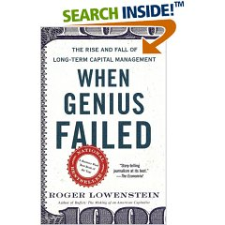








Get a Glimpse: Books
Notes:
“Liar’s Poker” – highly entertaining read about life in fixed income - Lewis describes his four years with the Wall Street firm Salomon Brothers, from his bizarre hiring through the training program to his years as a successful bond trader. Lewis illustrates how economic decisions made at the national level changed securities markets and made bonds the most lucrative game on the Street. His description of the firm's personalities and of the events from 1984 through the crash of October 1987 are vivid and memorable.
“When Genius Failed” – the story of LTCM – Roger Lowenstein's When Genius Failed is the gripping story of the Fed's unprecedented move, the incredible heights reached by LTCM, and the firm's eventual dramatic demise.
“Barbarians at the Gate” – the story of RJR Nabisco and KKR
“Fool’s Gold” excellent story of the financial crisis of 2008 told through the story of the JPM derivatives group. “Tett has the remarkable ability to make swaps, derivatives and their arcane securitized, synthetic offspring understandable to a financially challenged dummy like me and she does it while telling the tale of how this brainstorming group of J.P. Morgan whiz kids came up with a way to make risk, riskless, removing old constraints and unleashing a great wave of capital into the economy that should have been beneficial. But, sadly, it was all too good to be true. When Morgan s rivals combined this financial alchemy with subprime mortgage madness, without considering that a boom could bust, it was all over, leaving us battered by the rippling toxic aftereffects of unregulated greed “
“Monkey Business” – sobering read about life as an associate in an investment bank - As eager-beaver business school students, Rolfe and Troob garnered job offers as junior associates at the elite Wall Street investment bank Donaldson, Lufkin & Jenrette, lured by dreams of wealth, glamour and power. By the time Rolfe and Troob were able to discern the key fact that the "investment banking community has long been an oligopoly, with only a handful of real players with the size and scale to drive through the big deals," they were already grappling with the gritty reality of performing grunt labor in an environment ruled by despotic senior partners who called innumerable meetings to set unrealistic deadlines and make superhuman demands on anybody within screaming distance.
“Hedgehogging” - In Hedgehogging, Biggs offers a fascinating glimpse behind the scenes at the personalities and egos making decisions about the enormous sums being dumped en masse into these funds. It's full of personal anecdotes and critical insights from an insider's insider. You should not even consider giving money to anyone on Wall Street ever again until you've read this book. He discusses investing in general, hedge funds in particular, and how he has learned to find and profit from the best moneymaking opportunities in an eat-what-you-kill, cutthroat investment world.
“The Big Short” Although Lewis is perhaps best known for his sports-related nonfiction (including ), his first book was the autobiographical , in which he chronicled his disillusionment as a young gun on Wall Street in the greed is good 1980s. He returns to his financial roots to excavate the crisis of 2007–2008, employing his trademark technique of casting a microcosmic lens on the personal histories of several Wall Street outsiders who were betting against the grain—to shed light on the macrocosmic tale of greed and fear.
“F.I.A.S.C.O” – another sobering read about an associate’s life, in derivatives this time – FIASCO is the shocking story of one man's education in the jungles of Wall Street. As a young derivatives salesman at Morgan Stanley, Frank Partnoy learned to buy and sell billions of dollars worth of securities that were so complex many traders themselves didn't understand them. In his behind-the-scenes look at the trading floor and the offices of one of the world's top investment firms, Partnoy recounts the macho attitudes and fiercely competitive ploys of his office mates. And he takes us to the annual drunken skeet-shooting competition, FIASCO, where he and his colleagues sharpen the killer instincts they are encouraged to use against their competitors, their clients, and each other.
Traders, guns and money” – fantastic stories on derivatives from an experienced trader and now educator
Other recommendations
“Against the Gods – The Remarkable Story of Risk” – fantastic book about risk in all its aspects – a must read if you’re going to be in markets!
“Goldman Sachs: the culture of success” – book about GS –
“My Life as a Quant” – a recent book about an academic’s foray in the real world of financial markets (!!!!) –
“Predator’s Ball” – the story of junk bonds, DBL and Mike Milken
“Merkin Brothers” – tongue-in-cheek account of the pre-crisis Asian I-banks antics by the editor of Finance Asia – I have a limited supply of books available at the deeply discounted price of HKD 50-

Slide 100
Get a Glimpse: Newsletters and Blogs
General:
Matt Levine “Money Stuff”: https://www.bloomberg.com/opinion/authors/ARbTQlRLRjE/matthew-s-levine
Marc Rubinstein “Net Interest”: https://netinterest.substack.com/
Barry Ritholtz “The Big Picture”: https://ritholtz.com/
John Authers: https://www.bloomberg.com/opinion/authors/AT2bBytfUHQ/john-authers
Corporate Finance:
Vernimmen: http://www.vernimmen.com/ (check out the newsletter)
Damodaran: http://aswathdamodaran.blogspot.com/

Slide 101
FINA 1303 – Basics of financial calculations
Veronique Lafon-Vinais
Associate Professor of Business Education - Department of Finance

Slide 102
Agenda
Part 1: Time Value of Money
Present Value
Future Value
Part 2: Valuing a Stream of Cash Flows
Part 3: Applications
IRR
Mortgages
Basics of Financial Calculations

Slide 103
Interest in History & Islamic Finance
Throughout history, money lenders have been unpopular because they charge interest
Shakespeare’s famous play “The Merchant of Venice” is an illustration of this
Christianity banned the charging of interest (usury) for centuries, and only Jews were involved in providing credit
Today, Islamic Finance prohibits the payment and charging of interest (riba) which is contrary to Islamic laws (sharia). Yet, the Islamic Finance market is growing fast including in Hong Kong, where the HKSAR Government has issued two sukuks (Islamic bonds)

Slide 104
Important things to know before we start!
In this section, unless otherwise indicated, interest rates are yearly (annual) interest rates (in the markets we use the term “per annum” or “p.a.”)
Financial institutions are generally required to indicate the interest rates they charge on an annual percentage rate (APR) basis so that consumers can compare prices
The way we calculate interest payments differs depending on the financial instrument we use. You need to verify the applicable conditions in the contract!
In particular, debt contracts of less than one year and money market securities use simpler formulas (we will discuss this later)
Notes:
Check out money hero website http://www.moneyhero.com.hk/en

Slide 105
Part 1: Time Value of Money

Slide 106
Valuing Monetary Payments now and in the Future: Introducing DCF (“Discounted Cash Flows”)
How do we compare the return on different financial instruments?
Different debt instruments have different streams of cash payments to the holder (known as Cash Flows), with different timing.
How and why is the promise to pay $X on T1 more or less valuable than the promise to pay $Y on T2?
To find out, we use DCF calculations

Slide 107
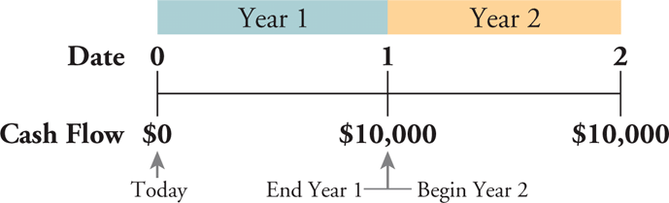
Timelines
Constructing a Timeline
Identifying Dates on a Timeline
Date 0 is today, the beginning of the first year
Date 1 is the end of the first year
Time Value of Money
Copyright ©2015 Pearson Education, Inc. All rights reserved.

Slide 108
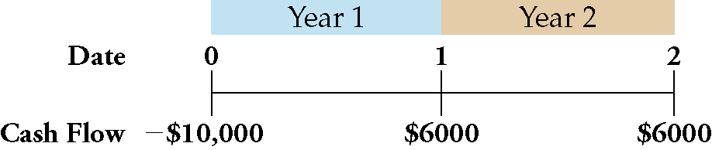
Timelines
Distinguishing Cash Inflows from Outflows (negative signs indicate outflows)
Representing Various Time Periods
Indicate the label :“Year” or “Month” or …..
Time Value of Money
Copyright ©2015 Pearson Education, Inc. All rights reserved.

Slide 109
DCF Introduction
The concept of discounted value is based on the notion (assumption) that a dollar of cash flow paid to you some time from now is less valuable to you than a dollar paid to you today: “a dollar is worth more today than tomorrow” or the time value of money
Why? This notion has been GENERALLY true because you could invest the dollar in a savings account that earns interest
BUT in an era of NEGATIVE interest rates this is no longer true everywhere
We will learn basic pricing of financial instruments under the assumption of positive interest rates. Negative interest rates change significantly our allocation of resources and distort financial markets.

Slide 110
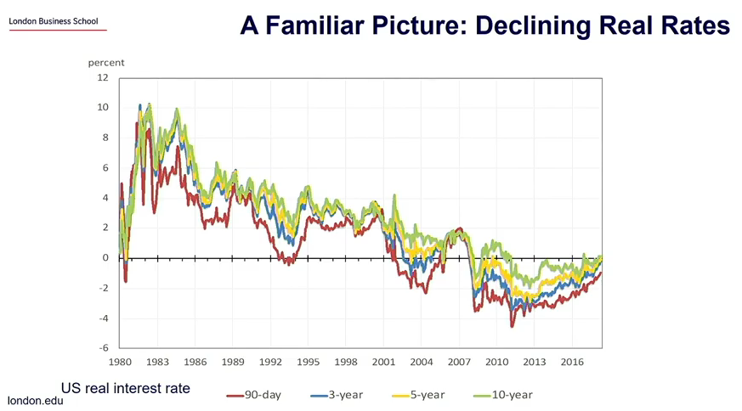
Real Rates
Notes:
Source: LBS Helene Rey ARQ webinar Dec 2020 https://www.youtube.com/watch?v=OMFV-3sJQhw&feature=youtu.be

Slide 111
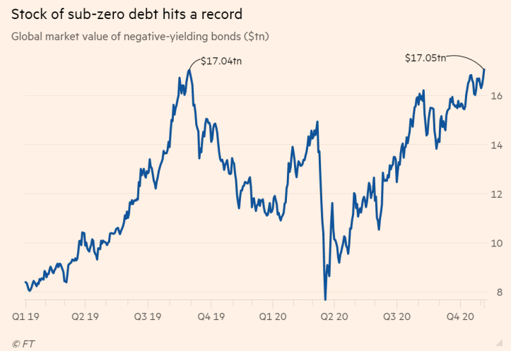
Sub-zero yielding debt reaches $17.05 Tr
Source: FT 7 Nov 2020
Notes:
Source: FT 7 Nov 2020 https://www.ft.com/content/378acc52-b1a5-4d58-8a87-8ea052b2c610?ftcamp=engage%2Femail%2Fnewsletters%2Fsmart_brief%2Fsmartbriefnewsletterscontrafcf%2Fauddev&segid=0800933

Slide 112
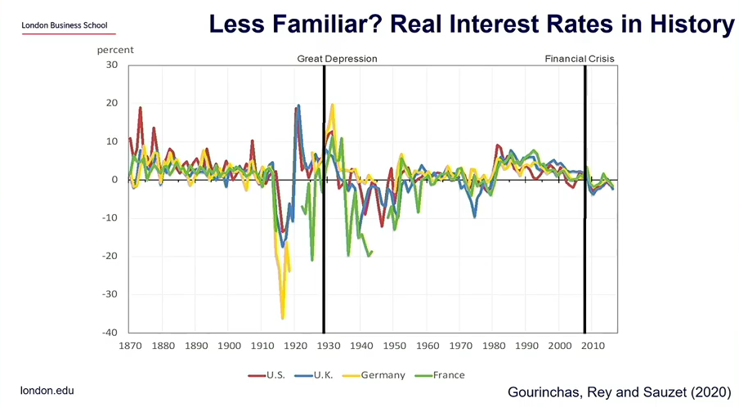
Real Interest Rates in History
Notes:
Source: LBS Helene Rey ARQ webinar Dec 2020 https://www.youtube.com/watch?v=OMFV-3sJQhw&feature=youtu.be

Slide 113
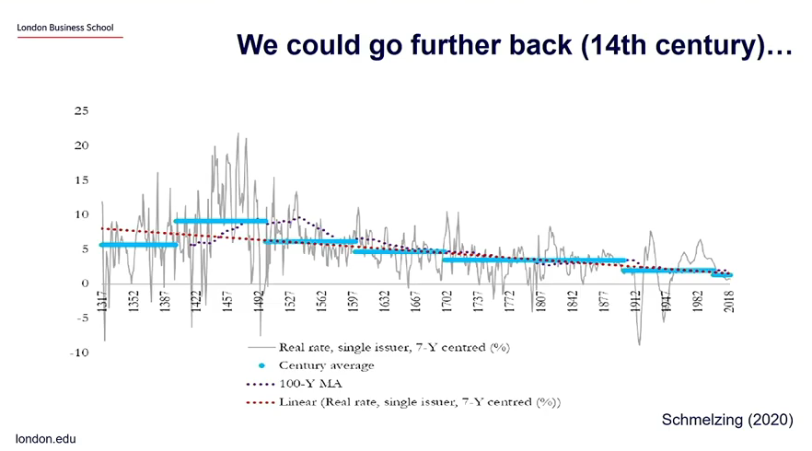
Real Interest Rates a long way back
Notes:
Source: LBS Helene Rey ARQ webinar Dec 2020 https://www.youtube.com/watch?v=OMFV-3sJQhw&feature=youtu.be

Slide 114
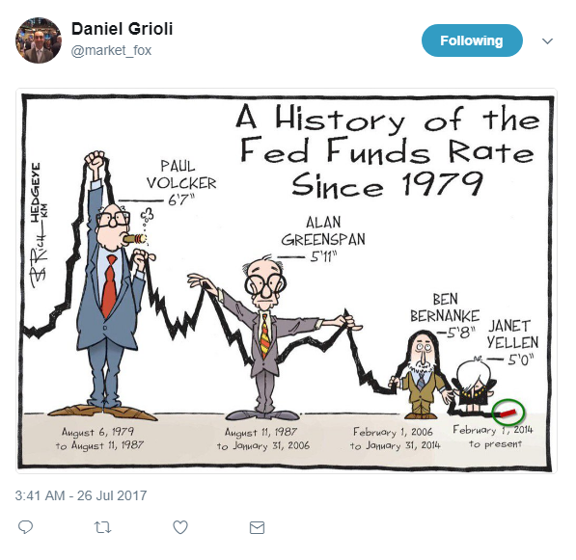
Interest Rates Story
Notes:
Source: LinkedIn https://www.linkedin.com/feed/

Slide 115
Class Discussion
What do you think will happen to interest rates and why?

Slide 116
The Time Value of Money and Interest Rates
The Interest Rate: Converting Cash Across Time
Present Value PV
The value of a cost or benefit computed in terms of cash today
Future Value FV
The value of a cash flow that is moved forward in time
PV
FV
time
today
future
Time Value of Money

Slide 117
Future Value and Interest
Future value is the value on a later date of an investment today.
$100,000 invested today at 10% interest gives $110,000 in a year.
=> the future value of $100,000 today at 10% interest is $110,000 one year from now.
The $100,000 yields $10,000, which is why interest rates are sometimes called yield or yield to maturity.
$100,000
$110,000
time
today
Interest Rate: 10% p.a.
1 year

Slide 118
Future Value example (single period)
Calculate the value of $100,000 Investment in 1 year at a rate of 6% (p.a.)
$100,000
FV?
today
Interest Rate: 6% p.a.
1 year
Time Value of Money

Slide 119
Future Value example (single period)
the cost of the investment is:
($100,000 today) + ($100,000 x 6% p.a.) = $106,000 in one year
We can also express it as:
($100,000 today) × (1.06 $ in one year/$ today) = $106,000 in one year
$106,000 is the opportunity cost of spending $100,000 today
The firm gives up the $106,000 it would have had in one year if it had left the money in the bank
Alternatively, by borrowing the $100,000 from the same bank, the firm would owe $106,000 in one year.

Slide 120
Future Value example (single period)
Calculate the value of $100,000 Investment in 1 year at a rate of 6% (p.a.)
Present value PV
Future value FV
$100,000
106,000
today
Interest Rate r: 6% p.a.
1 year
Number of periods n = 1 year
Time Value of Money

Slide 121
Future Value and Interest (single period)
Notice that
If the interest rate r is 10%, the future value FV in one year is:
$100,000 + ($100,000 x 0.10) = $110,000
If the interest rate r is 6%, the future value FV in one year is:
$100,000 + ($100,000 x 0.06) = $106,000
The higher the interest rate, the higher the future value.
FV = PV + PV x r = PV x (1 + r)

Slide 122
Future Value and Compound Interest
The higher the interest rate, the higher the future value.
The higher the amount invested, the higher the future value.
Most financial instruments are not so simple, so what happens when time to repayment varies?
When using one-year interest rates to compute the value repaid more than one year from now, we must consider compound interest.
Compound interest is the interest on the interest.

Slide 123
Future Value and Compound Interest
What if you leave your $100 in the bank for two years at 6% yearly interest rate?
Yearly: Calculated and credited at the end of each year!
The future value is:
$100 + ($100 x 0.06) + ($100 x 0.06) + ($6 x 0.06) = $112.36
$100 x 1.06 x 1.06 = $100 x (1.06)²
In general
FV_{n} = PV x(1 + r)^{n}

Slide 124
Future Value and Compound Interest

Slide 125
Future Value and Compound Interest

Slide 126
Pop Quiz!
The time value of money: “a dollar is worth _____today than tomorrow”
The higher the interest rate, the ______ the future value.
The higher the amount invested, the ______ the future value.
Present Value = The value of a cost or benefit computed in terms of cash _____
Compound interest is _________________

Slide 127
Compounding Frequency
If the annual interest rate is 6%, what is the equivalent monthly rate if interests are calculated and credited on a monthly basis?
Assume j is a one-month interest rate and n is the number of months, then a one year (n = 12) deposit of $100 will have a future value of: $100 x (1 + j)¹².

Slide 128
Compounding Frequency
In one year the future value is $100 x 1.06 so we can find j:
(1 + j)¹² = 1.06
(1 + j) = (1.06)^{1/12} = 1.0049
j = 0.49% = 49bp
A basis point (bp) is one one-hundredth of a percentage point, 0.01 percent.

Slide 129
Changing Compounding Frequency
The frequency of the compounding (calculating and crediting interest) changes substantially the future value
What if compounding is:
12% annual,
6% semi-annual,
3% quarterly,
1% monthly?

Slide 130
Changing Compounding Frequency

Slide 131
Changing Compounding Frequency
With higher interest rates, the difference from a higher compounding frequency is even larger

Slide 132
Present Value
Financial instruments promise future cash payments. Valuing those payments under the same or consistent assumptions enables us to compare several alternatives.
Present value is the value today of a payment to be made in the future.
Present value is the equivalent amount to invest today in order to be equal to a specific amount on a given future date.

Slide 133
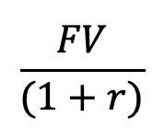
Present Value for 1 Period
Knowing the Future Value, we can find easily the Present Value:
FV = PV x (1+r), so
PV=
This is just the future value calculation inverted.
$$\frac{FV}{(1+r)}$$

Slide 134
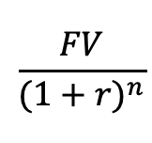
Present Value for n Periods
We can generalize the process as we did for future value.
Present Value of one payment credited n years in the future, but calculated at the end of each year:
PV =
$$\frac{FV}{{(1+r)}^{n}}$$

Slide 135
Present Value: THE Basis for DCF
The present value is higher:
The higher future value of the payment, FVn.
The shorter time period until payment, n.
The lower the interest rate, r.
Present value is the single most important relationship in our study of financial instruments. It is THE basis for Discounted Cash Flows analysis.

Slide 136
Present Value as a Function of Tenor

Slide 137
Present Value of $100 Payment
Higher interest rates are associated with lower PV no matter the timing of the payment.
At any interest rate, a longer tenor reduces PV.
For 1% interest rate variation, the difference in PV varies with rate and tenor: Convexity
Present Value

Slide 138
Example 1: Comparing Revenues at Different Points in Time
Problem:
The launch of Sony’s PlayStation 3 was delayed until November 2006, giving Microsoft’s Xbox 360 a full year on the market without competition. Sony did not repeat this mistake in 2013 when the PS4 launched at the same time as the Xbox One.
It is November 2005 and you are the marketing manager for the PlayStation. You estimate that if the PlayStation 3 were ready to be launched immediately, you could sell $2 billion worth of the console in its first year.
However, if your launch is delayed a year, you believe that Microsoft’s head start will reduce your first-year sales by 20% to $1.6 billion.
If the interest rate is 8%, what is the cost of a delay in terms of dollars in 2005?
Time Value of Money
Copyright ©2015 Pearson Education, Inc. All rights reserved.

Slide 139
Example 1: Comparing Revenues at Different Points in Time
Solution:
Plan:
Revenues if released today: $2 billion
Revenue if delayed: $1.6 billion
Interest rate: 8%
We need to compute the revenues if the launch is delayed and compare them to the revenues from launching today.
However, in order to make a fair comparison, we need to convert the future revenues of the PlayStation if delayed into an equivalent present value of those revenues today.
Time Value of Money
Copyright ©2015 Pearson Education, Inc. All rights reserved.

Slide 140
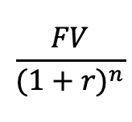
Example 1: Comparing Revenues at Different Points in Time
Execute:
If the launch is delayed to 2006, revenues will drop by 20% of $2 billion, or $400 million, to $1.6 billion.
To compare this amount to revenues of $2 billion if launched in 2005, we must convert it using the interest rate of 8% (this is calculating the present value of the $1.6Bn):
$1.6 billion/1.08 = $1.481 billion in 2005
Therefore, the cost of a delay of one year is
$2 billion - $1.481 billion = $0.519 billion ($519 million).
In other words, we multiply the future value ($1.6Bn) by the discount factor (1/1+r) to get the present value
PV =
$$\frac{FV}{{(1+r)}^{n}}$$
Time Value of Money
Copyright ©2015 Pearson Education, Inc. All rights reserved.

Slide 141
Example 1: Comparing Revenues at Different Points in Time
Nov 2005
Nov 2006
Nov 2007
0
1
2
(1) $2 Bn
(2) $1.481 Bn
(2) $1.6 Bn

Slide 142
Example 1: Comparing Revenues at Different Points in Time
Evaluate:
Delaying the project for one year was equivalent to giving up $519 million in cash.
In this example, we focused only on the effect on the first year’s revenues. However, delaying the launch delays the entire revenue stream by one year, so the total cost would be calculated in the same way by summing the cost of delay for each year of revenues.
Time Value of Money
Copyright ©2015 Pearson Education, Inc. All rights reserved.

Slide 143

Your Turn!
Problem:
The launch of Sony’s PlayStation 3 was delayed until November 2006, giving Microsoft’s Xbox 360 a full year on the market without competition.
It is November 2005 and you are the marketing manager for the PlayStation. You estimate that if the PlayStation 3 were ready to be launched immediately, you could sell $3 billion worth of the console in its first year.
However, if your launch is delayed a year, you believe that Microsoft’s head start will reduce your first-year sales by 35%.
If the interest rate is 6%, what is the cost of a delay in terms of dollars in 2005?
Time Value of Money
Copyright ©2015 Pearson Education, Inc. All rights reserved.

Slide 144

Your Turn! (PRS, please)
The cost of delay is
$519 million
$1.160 billion
$2 billion
I don’t care I don’t like video games
Time Value of Money

Slide 145
Solution to Example: Comparing Revenues at Different Points in Time
Solution:
Plan:
Revenues if released today: $3 billion,
Revenue decrease if delayed: 35% ,
Interest rate: 6%
We need to compute the revenues if the launch is delayed and compare them to the revenues from launching today.
However, in order to make a fair comparison, we need to convert the future revenues of the PlayStation if delayed into an equivalent present value of those revenues today.
Time Value of Money
Copyright ©2015 Pearson Education, Inc. All rights reserved.

Slide 146
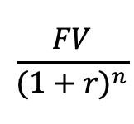
Solution to Example: Comparing Revenues at Different Points in Time
Execute:
If the launch is delayed to 2006, revenues will drop by 35% of $3 billion, or $1.05 billion, to $1.95 billion.
To compare this amount to revenues of $3 billion if launched in 2005, we must convert it using the interest rate of 6%:
$1.95 billion/1.06 = $1.840 billion in 2005
Therefore, the cost of a delay of one year is
$3 billion - $1.840 billion = $1.160 billion
PV =
$$\frac{FV}{{(1+r)}^{n}}$$
Time Value of Money
Copyright ©2015 Pearson Education, Inc. All rights reserved.

Slide 147
Solution to Example: Comparing Revenues at Different Points in Time
Evaluate:
Delaying the project for one year was equivalent to giving up $1.16 billion in cash.
In this example, we focused only on the effect on the first year’s revenues.
However, delaying the launch delays the entire revenue stream by one year, so the total cost would be calculated in the same way by summing the cost of delay for each year of revenues.
Time Value of Money
Copyright ©2015 Pearson Education, Inc. All rights reserved.

Slide 148
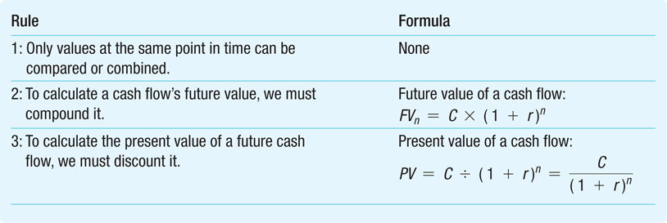
The Three Rules of Valuing Cash Flows
Time Value of Money
Copyright ©2015 Pearson Education, Inc. All rights reserved.

Slide 149
Valuing Cash Flows at Different Points in Time
Rule 1: Comparing and Combining Values
It is only possible to compare or combine values at the same point in time
Time Value of Money
Copyright ©2015 Pearson Education, Inc. All rights reserved.

Slide 150
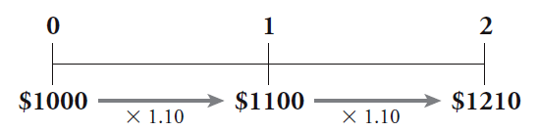
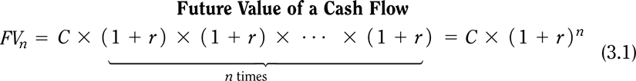
Valuing Cash Flows at Different Points in Time
Rule 2: Compounding
To calculate a cash flow’s future value, you must compound it
Compound Interest = The effect of earning “interest on interest”
Time Value of Money
Copyright ©2015 Pearson Education, Inc. All rights reserved.

Slide 151
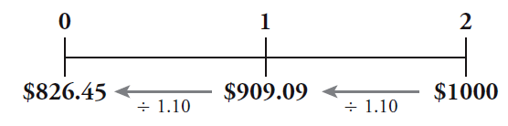
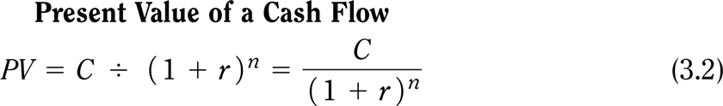
Valuing Cash Flows at Different Points in Time
Rule 3: Discounting
To calculate the value of a future cash flow at an earlier point in time, we must discount it.
Time Value of Money
Copyright ©2015 Pearson Education, Inc. All rights reserved.

Slide 152
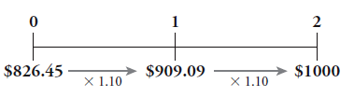
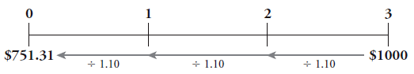
Valuing Cash Flows at Different Points in Time
Rule 3: Discounting & Compounding - Example
If $826.45 is invested today for two years at 10% interest, the future value will be $1,000-
If $1,000- were three years away, the present value, if the interest rate is 10%, would be $751.31
Time Value of Money
Copyright ©2015 Pearson Education, Inc. All rights reserved.

Slide 153
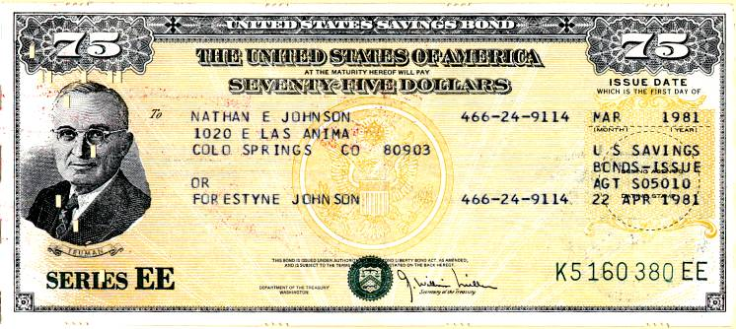
Example: Present Value of a Single Future Cash Flow
Problem:
You are considering investing in a savings bond that will pay $15,000 in 10 years.
If the competitive market interest rate is fixed at 6% per year, what is the bond worth today?
Time Value of Money
Copyright ©2015 Pearson Education, Inc. All rights reserved.

Slide 154
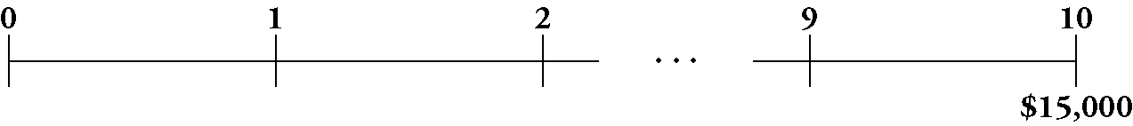
Example: Present Value of a Single Future Cash Flow
Solution:
First set up your timeline. The cash flows for this bond are represented by the following timeline:
Thus, the bond is worth $15,000 in 10 years. To determine the value today, we compute the present value using the PV equation and our interest rate of 6%.
Where C is the single cash flow – in this case, it’s also the Future Value
Time Value of Money
Copyright ©2015 Pearson Education, Inc. All rights reserved.

Slide 155





Example: Present Value of a Single Future Cash Flow
Execute:
Using the financial calculator we can input the relevant variables
Given: | 10 | 6 |  | 0 | 15,000
Solve for: |  |  | -8,375.92
Excel Formula: =PV(RATE,NPER, PMT, FV) = PV(0.06,10,0,15000)
Time Value of Money
Copyright ©2015 Pearson Education, Inc. All rights reserved.

Slide 156
Example: Present Value of a Single Future Cash Flow
Evaluate:
The bond is worth much less today than its final payoff because of the time value of money.
Food for thought:
What if interest rates were lower?
Time Value of Money
Copyright ©2015 Pearson Education, Inc. All rights reserved.

Slide 157
Your Turn!
Problem:
XYZ Company expects to receive a cash flow of $2 million in five years.
If the competitive market interest rate is fixed at 4% per year, how much can they borrow today in order to be able to repay the loan in its entirety with that cash flow?
Time Value of Money
Copyright ©2015 Pearson Education, Inc. All rights reserved.

Slide 158
Your Turn! (PRS, please)
We can borrow
$1.5 million
$1.6 million
$2 million
Borrowing is bad, it leads to trouble!
Time Value of Money

Slide 159
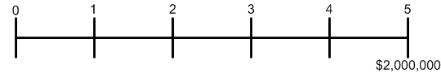
Solution to Example: Present Value of a Single Future Cash Flow
Solution:
First set up your timeline. The cash flows for the loan are represented by the following timeline:
Thus, XYZ Company will be able to repay the loan with its expected $2 million cash flow in five years. To determine the value today, we compute the present value using our interest rate of 4%.
Where C is the single cash flow – in this case, it’s also the Future Value
Time Value of Money
Copyright ©2015 Pearson Education, Inc. All rights reserved.

Slide 160
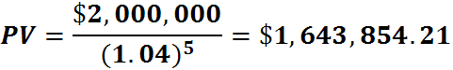
Solution to Example: Present Value of a Single Future Cash Flow
Execute:
Using the financial calculator we can input the relevant variables
Given: | 5 | 4 |  | 0 | 2,000,000
Solve for: |  |  | -1,643,854.21
Excel Formula: =PV(RATE,NPER, PMT, FV) = PV(0.04,5,0,2000000)
Time Value of Money
Copyright ©2015 Pearson Education, Inc. All rights reserved.

Slide 161
Solution to Example: Present Value of a Single Future Cash Flow
Evaluate:
The loan is much less than the $2 million the company will pay back because of the time value of money.
Time Value of Money
Copyright ©2015 Pearson Education, Inc. All rights reserved.

Slide 162
Part 2: Valuing a Stream of Cash Flows

Slide 163
Valuing a Stream of Cash Flows
Applying the Rules of Valuing Cash Flows
Suppose we plan to save $1,000 today, and $1,000 at the end of each of the next two years
If we earn a fixed 10% interest rate on our savings, how much will we have three years from today (future value)?
We can do this in several ways
First, take the deposit at date 0 and move it forward to date 1
Combine those two amounts and move the combined total forward to date 2
Valuing a Stream of Cash Flows
Copyright ©2015 Pearson Education, Inc. All rights reserved.

Slide 164
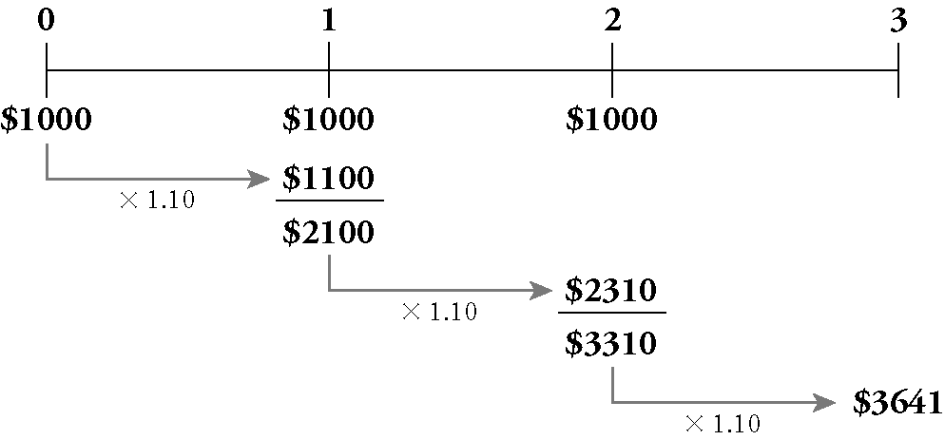
Valuing a Stream of Cash Flows
Continuing in the same fashion, we can solve the problem as follows:
Valuing a Stream of Cash Flows
Copyright ©2015 Pearson Education, Inc. All rights reserved.

Slide 165
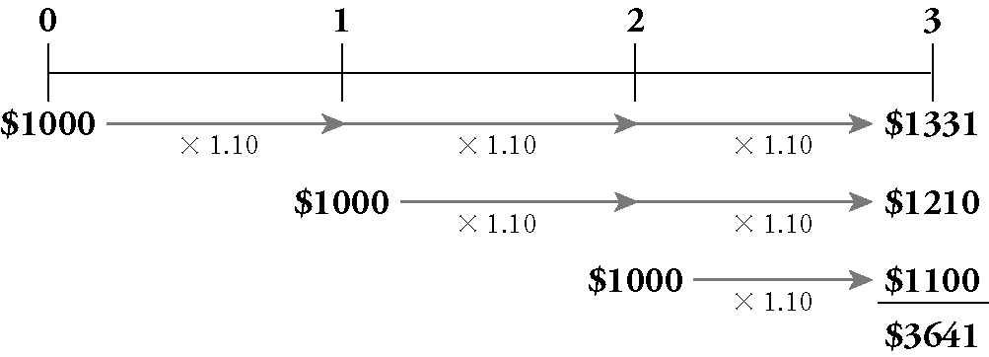
Valuing a Stream of Cash Flows
Another approach is to compute the future value in year 3 of each cash flow separately
Once all amounts are in year 3 dollars, combine them
Valuing a Stream of Cash Flows
Copyright ©2015 Pearson Education, Inc. All rights reserved.

Slide 166
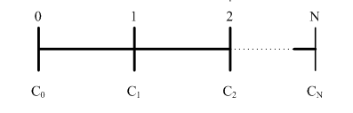
Valuing a Stream of Cash Flows
Consider a stream of cash flows: C₀ at date 0, C₁ at date 1, and so on, up to C_{N} at date N
We compute the present value of this cash flow stream in two steps
Valuing a Stream of Cash Flows
Copyright ©2015 Pearson Education, Inc. All rights reserved.

Slide 167
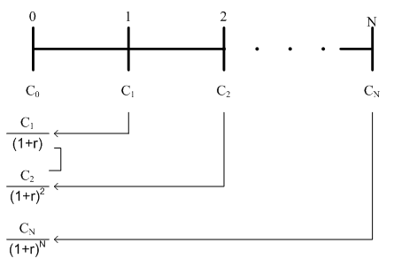
Valuing a Stream of Cash Flows
First, compute the present value of each cash flow
Then combine the present values: the PV of a stream of cash flows is the sum of the present values of each cash flow
Valuing a Stream of Cash Flows
Copyright ©2015 Pearson Education, Inc. All rights reserved.

Slide 168
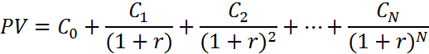
Valuing a Stream of Cash Flows
The present value of a cash flow stream is the sum of the present values of each cash flow
Valuing a Stream of Cash Flows

Slide 169
Your Turn!
Problem:
You have just graduated and need money to buy a laptop
Your aunt will lend you the money so long as you agree to pay her back within six years.
You offer to pay her the rate of interest that she would otherwise get by putting her money in a savings account.
Based on your earnings and living expenses, you think you will be able to pay her $70 next year, $85 in each of the next two years, and then $90 each year for years 4 through 6.
If your aunt would otherwise earn 0.5% per year on her savings, how much can you borrow from her?
Valuing a Stream of Cash Flows
Copyright ©2015 Pearson Education, Inc. All rights reserved.

Slide 170
Your Turn! (PRS, please)
We can borrow
$600.7
$500.9
$400.5
Borrowing is bad, it leads to trouble!
Valuing a Stream of Cash Flows

Slide 171
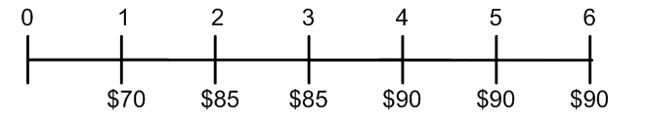
Solution : Present Value of a Stream of Cash Flows
Plan:
The cash flows you can promise your aunt are as follows:
She should be willing to give you an amount equal to these payments in present value terms.
Valuing a Stream of Cash Flows
Copyright ©2015 Pearson Education, Inc. All rights reserved.

Slide 172
Solution : Present Value of a Stream of Cash Flows (cont’d)
Plan:
We will:
Solve the problem using the equation
the present value of a series of cash flows is the sum of the present values of each of the cash flows; so we calculate the present value of each cash flow and add up all the present values
Verify our answer by calculating the future value of this amount.
Valuing a Stream of Cash Flows
Copyright ©2015 Pearson Education, Inc. All rights reserved.

Slide 173
Solution : Present Value of a Stream of Cash Flows (cont’d)
Execute:
We can calculate the PV as follows:
Valuing a Stream of Cash Flows
Copyright ©2015 Pearson Education, Inc. All rights reserved.

Slide 174
Solution : Present Value of a Stream of Cash Flows (cont’d)
Part 2
Now, suppose that your aunt gives you the money, and then deposits your payments in the bank each year.
How much will she have six years from now?
Valuing a Stream of Cash Flows
Copyright ©2015 Pearson Education, Inc. All rights reserved.

Slide 175
Your Turn! (PRS, please)
She will have
$600
$516
$475
Valuing a Stream of Cash Flows

Slide 176
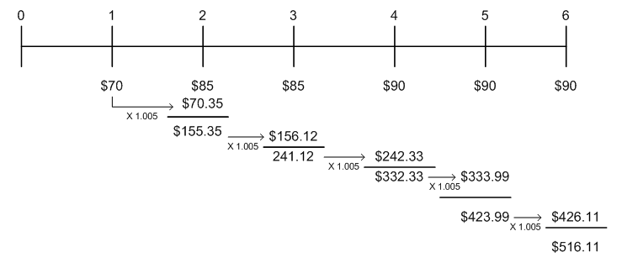
Solution : Present Value of a Stream of Cash Flows (cont’d)
Execute:
We need to compute the future value of the yearly deposits.
One way is to compute the bank balance each year.
Valuing a Stream of Cash Flows
Copyright ©2015 Pearson Education, Inc. All rights reserved.

Slide 177
Solution : Present Value of a Stream of Cash Flows (cont’d)
Execute:
To verify our answer, suppose your aunt kept her $500.90 in the bank today earning 0.5% interest.
In six years she would have:
FV = $500.90×(1.005)⁶= $516.11 in 6 years
Valuing a Stream of Cash Flows
Copyright ©2015 Pearson Education, Inc. All rights reserved.
Notes:
Thus, your aunt should be willing to lend you $500.90 in exchange for your promised payments.
This amount is less than the total you will pay her ($70+$85+$85+$90+$90+$90=$510) due to the time value of money.

Slide 178
Your Turn!
Problem:
We plan to save $1,000 today and at the end of each of the next two years.
At a fixed 6% interest rate, how much will we have in the bank three years from today?
Valuing a Stream of Cash Flows
Copyright ©2015 Pearson Education, Inc. All rights reserved.

Slide 179
Your Turn! (PRS, please)
We will have
$3,505.5
$2,833.4
$3,374.6
Valuing a Stream of Cash Flows

Slide 180
Solution : Computing the Future Value (cont’d)
Plan:
We’ll start with the timeline for this savings plan:
First we’ll compute the present value of the cash flows.
Then we’ll compute its value three years later (its future value).
Valuing a Stream of Cash Flows
Copyright ©2015 Pearson Education, Inc. All rights reserved.

Slide 181
Solution : Computing the Future Value (cont’d)
Execute:
This is how we’ve done it so far – this works no matter the cash flows
Valuing a Stream of Cash Flows
Copyright ©2015 Pearson Education, Inc. All rights reserved.

Slide 182
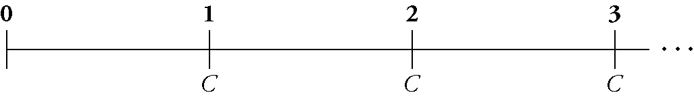
Perpetuities
Examples?
Perpetuities (also called consols)
A perpetuity is a stream of equal cash flows that occur at regular intervals and last forever
Here is the timeline for a perpetuity:
the first cash flow does not occur immediately; it arrives at the end of the first period
Perpetuities
Copyright ©2015 Pearson Education, Inc. All rights reserved.
Notes:
Examples include endowments, perpetual bonds

Slide 183
Perpetuities
Using the formula for present value, the present value of a perpetuity with payment C and interest rate r is given by:
Notice that all the cash flows are the same
Also, the first cash flow starts at time 1 (not 0)
Perpetuities
Copyright ©2015 Pearson Education, Inc. All rights reserved.

Slide 184
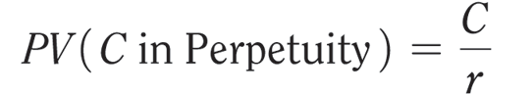
Perpetuities/Consols
Present Value of a Perpetuity
This formula only works when r is positive!
Perpetuities
Copyright ©2015 Pearson Education, Inc. All rights reserved.

Slide 185
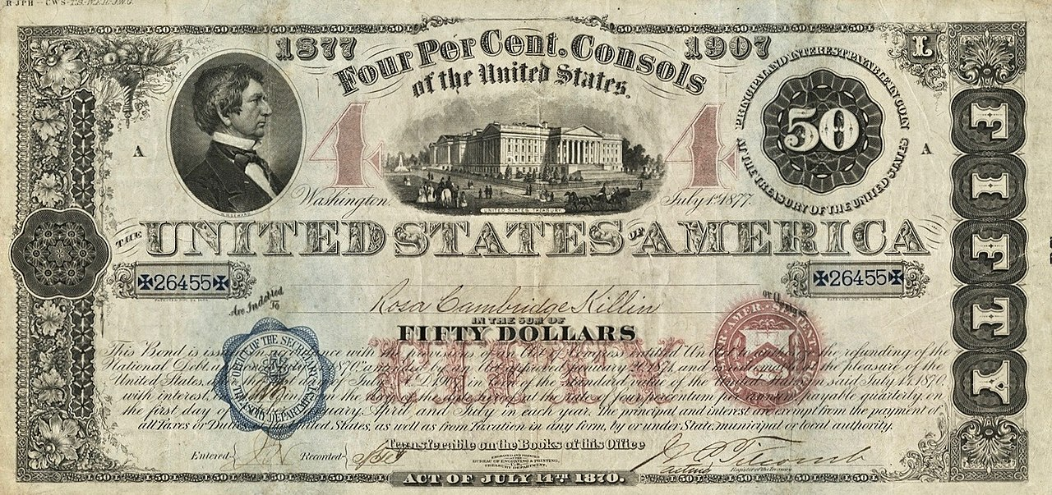
Example of consol
Perpetuities
Notes:
Source: Wikipedia https://commons.wikimedia.org/wiki/File:1877_4%25_$50_United_States_Consols_.jpg#/media/File:1877_4%_$50_United_States_Consols_.jpg
Consols were issued by the UK (1750s) and the US government (1870s). All the outstanding US consols were redeemed by 2015.
Consol (short for consolidated) bonds were issued by the U.S. Treasury during the 19th and early 20th Centuries. Used to refinance the national debt, the 41st Congress passed an act in 1870 authorizing three separate consol issues with redemption privileges after ten, fifteen, and thirty years. Unlike traditional debt issuances, consols have no definitive redemption dates. It is from this feature that they are occasionally referred to as "perpetual bonds." They are redeemable at the pleasure of the Treasury Department after a specified date. Several nations have issued sovereign consols. The interest rates on these securities are such that governments have often left consols outstanding for decades. In 2014, the British government redeemed 4% consols issued to pay for the costs of WWI. The Acts of July 14th, 1870, and January 20, 1871 provided authorization for the issuance of $1 billion of thirty-year consols, exempted from all local, state, and federal taxation. The Herbstman Collection features the only known examples of registered bonds authorized by the act. These bonds were referred to as the Funded Loan of 1907.
877 $50 Thirty-year Registered 4% Consol
$740 Million Issued
Like other sovereign-issue consols, this debt security has no definitive payable date. The bond is redeemable at the pleasure of the Treasury Department after July of 1907. This security, known on the government's books as the Funded Loan of 1907, was issued between 1877-1879. The interest on this security was paid quarterly: January, April July, and October. The back of this security features the Treasury's transfer form for registered bonds. Also featured are two parallel blue-colored anti-counterfeiting swaths imbedded within the paper itself.
The only $50 registered consol known to exist from this year, and one of two registered 1877 Consols known

Slide 186

Your Turn!
Problem:
You just won the lottery, and you want to endow a professorship at your alma mater.
You are willing to donate $4 million of your winnings for this purpose.
If the university earns 5% per year on its investments, and the professor will be receiving her first payment in one year, how much will the endowment pay her each year?
Perpetuities
Copyright ©2015 Pearson Education, Inc. All rights reserved.

Slide 187
Your Turn! (PRS, please)
The endowment will pay
$200,000
$283,334
$337,456
Perpetuities

Slide 188
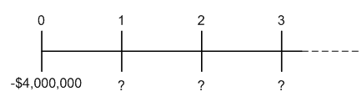
Solution : Endowing a Perpetuity
Plan:
The timeline of the cash flows you want to provide is:
This is a standard perpetuity. The amount she can withdraw each year while keeping the principal intact is the cash flow C when solving the equation:
Perpetuities
Copyright ©2015 Pearson Education, Inc. All rights reserved.

Slide 189
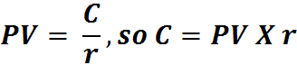
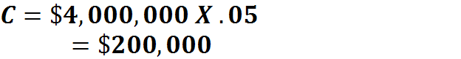
Solution : Endowing a Perpetuity (cont’d)
Execute:
From the formula for a perpetuity,
Perpetuities
Copyright ©2015 Pearson Education, Inc. All rights reserved.
Notes:
If you donate $4,000,000 today, and if the university invests it at 5% per year forever, then the chosen professor will receive $200,000 every year.

Slide 190
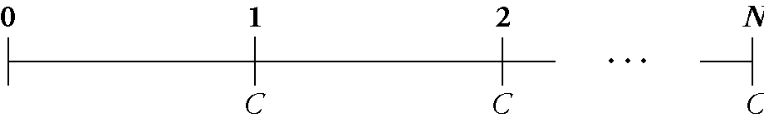
Annuities
Examples?
Annuities (also called fixed payment loans)
An annuity is a stream of N equal cash flows C paid at regular intervals
The difference between an annuity and a perpetuity is that an annuity ends after some fixed number of payments (N)
Annuities
Copyright ©2015 Pearson Education, Inc. All rights reserved.
Notes:
Most obvious one is mortgages, but also savings plans

Slide 191
Annuities
Present Value of An Annuity
Note that, just as with the perpetuity, we assume the first payment takes place one period from today (time 1)
Annuities
Copyright ©2015 Pearson Education, Inc. All rights reserved.

Slide 192
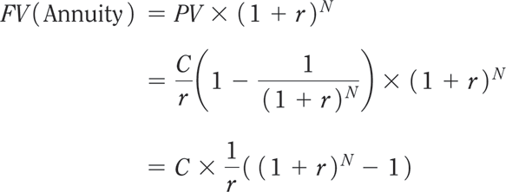
Annuities
Future Value of an Annuity
Annuities
Copyright ©2015 Pearson Education, Inc. All rights reserved.

Slide 193
In Practice: Mortgages
If you consider the cash flows for a fixed rate mortgage with annual repayments, that is exactly that formula.
C is your annual payment (installments), including some interests and some capital repayment (PMT in Excel or HP12C),
n is the number of years (NPER in Excel or n in HP12C),
r is the interest rate (RATE in Excel or i in HP12C)
And PV is the amount initially borrowed (PV in Excel or HP12C)
(FV = 0 in both, type being End (credited at end of period) )
Annuities

Slide 194
In Practice: Fixed Rate Mortgage
For this mortgage:
The amortization table would be:
Annuities
Notes:
In order to make things easier for borrowers as well as reduce credit risk over time for lenders, mortgage payments have been structured so that ALL the periodical payments are equal.
On T=0, the Amount Due is FV
On T=1 when PMT is paid, it is in fact {FV x i} in interests for past period and {PMT – FV x i} in principal repaid
On T=2 the Amount Due is lower because of piece of principal repaid and the same calculations apply again….
That is how you can calculate your amortization table to know the Amount Due at any time

Slide 195
Your Turn!
Problem:
Your parents have made you an offer you can’t refuse.
They’re planning to give you part of your inheritance early (!).
They’ve given you a choice.
Option a: They’ll pay you $10,000 per year for each of the next seven years (beginning today, last payment at the end of the 7th year)
Option b: they’ll give you their BMW Convertible, which you can sell for $61,000 (guaranteed) today.
If you can earn 7% annually on your investments, which should you choose?
Annuities
Copyright ©2015 Pearson Education, Inc. All rights reserved.

Slide 196
Your Turn! (PRS, please)
We should choose
A
B
Annuities

Slide 197
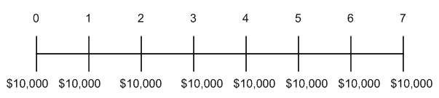
Solution : Present Value of an Annuity
Plan:
Option (a) provides $10,000 paid over time. To evaluate it correctly, we must convert it to a present value. Here is the timeline:
The $10,000 at date 0 is already stated in present value terms, but we need to compute the present value of the remaining payments.
Fortunately, this case looks like a 7-year annuity of $10,000 per year, so we can use the annuity formula.
Annuities
Copyright ©2015 Pearson Education, Inc. All rights reserved.

Slide 198

Solution : Present Value of an Annuity (cont’d)
Execute:
PV = 53,892.89
Annuities
Copyright ©2015 Pearson Education, Inc. All rights reserved.

Slide 199
Solution : Present Value of an Annuity (cont’d)
Execute (cont’d):
Thus, the total present value of the cash flows is $10,000 + 53,892.89 = $63,892.89 which is more than the value of the car. In timeline form:
0
1
2
3
4
5
6
7
10,000
10,000
10,000
10,000
10,000
10,000
10,000
10,000
53,892.89
63,892.89
Annuities
Copyright ©2015 Pearson Education, Inc. All rights reserved.

Slide 200
Solution : Present Value of an Annuity (cont’d)
Execute (cont’d):
Financial calculators or Excel can handle annuities easily—just enter the cash flow in the annuity as the PMT:
Given: | 7 | 7 |  | 10000 | 0
Solve for: |  |  | -53,892.89
Excel Formula: =PV(RATE,NPER, PMT, FV) = PV(0.07,7,10000,0)
Annuities
Copyright ©2015 Pearson Education, Inc. All rights reserved.

Slide 201
Your Turn!
Problem:
Adam is 25 years old, and he has decided it is time to plan seriously for his retirement.
He will save $10,000 in a retirement account at the end of each year until he is 45.
At that time, he will stop paying into the account, though he does not plan to retire until he is 65.
If the account earns 10% per year, how much will Adam have saved at age 65?
Annuities
Copyright ©2015 Pearson Education, Inc. All rights reserved.

Slide 202
Your Turn! (PRS, please)
Adam will have saved
$572,750
$1,545,250
$3,853,715
Annuities

Slide 203

Solution : Retirement Savings Plan Annuity
Solution:
Plan:
As always, we begin with a timeline. In this case, it is helpful to keep track of both the dates and Adam’s age:
Annuities
Copyright ©2015 Pearson Education, Inc. All rights reserved.

Slide 204



Solution : Retirement Savings Plan Annuity
Execute:
Using Financial calculators or Excel:
X 1/0.10
Given: | 20 | 10.0 | 0 | -10,000
Solve for: |  |  |  |  | $572,750
Excel Formula: =FV(RATE,NPER, PMT, PV) = FV(0.10,20,-10000,0)
Copyright ©2015 Pearson Education, Inc. All rights reserved.
Notes:
Adam’s savings plan looks like an annuity of $10,000 per year for 20 years.
The money will then remain in the account until Adam is 65 => 20 more years.
To determine the amount Adam will have in the bank at age 45, we’ll need to compute the future value of this annuity.
Then we’ll compound the future value into the future 20 more years to see how much he’ll have at 65.

Slide 205

Solution : Retirement Savings Plan Annuity
Execute:
Using Financial calculators or Excel:
Given: | 20 | 10.0 | -$572,750 | 0
Solve for: |  |  |  |  | $3,853,175
Excel Formula: =FV(RATE,NPER, PMT, PV) = FV(0.10,20,0,-572750)
Annuities
Copyright ©2015 Pearson Education, Inc. All rights reserved.

Slide 206
Part 3: Applications

Slide 207
Application 1: Your Credit Card in Hong Kong
Check out your credit card statement
What does it show at the end of the statement?
Why do you think the financial regulators are forcing the credit card issuers to include this information?

Slide 208
Credit Cards “Easy Money”: Pay Fast!
Credit cards are useful, but sometimes too easy.

Slide 209
Applying PV : Example - calculating the Internal Rate of Return
Imagine that you run a toy manufacturing company and that you are considering purchasing a new machine.
Machine costs $4 million and can produce 50,000 toys per year.
You sell the toys for $10, generating $500,000 in revenue per year.
Assume that the machine is the only input, you have certainty about the revenue, there is no maintenance and the machine has a 10 year lifespan.

Slide 210
Internal Rate of Return: Example
If you borrow $4 million, is the revenue enough to make the payments?
We need to calculate the internal rate of return (IRR) of this investment:
It is the interest rate that equates the present value from the cash flow of an investment with its cost.

Slide 211
Internal Rate of Return: Example
Balance the cost of the machine against the revenue.
$4 million today versus $500,000 a year for ten years.
At the internal rate of return, the cost of the machine is equal to the present value of all the yearly revenues.
Solve for i - the internal rate of return. (NB: we can use the notation i or r)

Slide 212
Internal Rate of Return: Example
Solving for i,
i = 4.28%
As long your borrowing cost is less than 4.28%, then you should buy the machine.
Knowing the cash flows (and dates), this IRR calculation is a way to identify the break even funding cost.

Slide 213
Key Formulas: Fixed Cash Flows + Residual Value
Often there are cases with fixed cash flows over the tenor of the transaction and one final but different amount on maturity date leading to this:

Slide 214
Annex

Slide 215
Basic Math Time!
Dealing with Cash Flows, Amounts and Dates, an Excel spreadsheet (or the HP12C) with the Excel functions FV, PV, PMT, Rate, NPRER, XNPV, XIRR,…is of course a solution but relatively straightforward cases could be and should be dealt with some analytical formulas in order to understand how the different variables impact the output.
Please keep in mind that 25/30 years ago, many derivative markets were open-outcry and market markers had NO access real time to a computer when asked to quote derivatives!
For those having doubts about Geometric Sequences and Sums of consecutive terms, you might want to look at the Annex!

Slide 216
Basic Math Refresher
Adding 5% interest p.a. (per annum) compounding for several years to $100 is like multiplying by 1.05 for each year, so the basic instrument to be fluent with is the Geometric Sequence as well as the Sum of n consecutive terms of a geometric sequence!

Slide 217
Basic Math Refresher
A geometric sequence is defined as such:
Which is equivalent to the general term:
So once the first term and the ratio are defined everything there is to know about it is easily accessible

Slide 218
Basic Math Refresher
One useful aspect to know is the Sum of n consecutive terms of a geometric sequence
One solution is to learn by heart the simple formula; another solution lowering the risk level is to know how to find again this formula quickly !

Slide 219
Basic Math Refresher
Here is the way:

Slide 220
Basic Math Refresher
Worth noticing is the case where n is ∝
AND
In that case
And
Only works with positive interest rates

Slide 221
FINA 1303 FOUNDATIONS OF INTEREST RATES Part II
Veronique Lafon-Vinais
Associate Professor of Business Education - Department of Finance

Slide 222
Course Map
Overview
Foundations of
Interest Rates
Financial Institutions
Pricing of Financial Assets
Regulations
DCF
Sell Side
Buy Side
Stock
Valuation
Banking Regulation
Basics of
Interest Rates
Commercial Banking
Traditional Institutional Investors
Asset
Pricing
Models
Monetary Policy
Investment Banking
Alternative Investors
222

Slide 223
Overview
Foundations of
Interest Rates
Students will establish an understanding of
Bond Pricing Basics
Zero Coupon Bond
Coupon Bond
Computing interest for short term debt
DCF
Basics of
Interest Rates

Slide 224
Bond Basics
A bond is a financial instrument promising to make a series of payments on specific dates. It is similar to a loan but unlike loans, bonds are securities (negotiable, transferable financial instruments)
Bonds are legal contracts between an issuer and the investors (buyers) that:
Require the issuer to make payments to the buyer, and
Specify in great detail all the terms and conditions, including what happens in case the issuer fails to make a payment (called “event of default”)

Slide 225
Bond Basics: Coupon Bond
The most common type of bond is a coupon bond:
Issuer is required to make regular payments, called coupon payments.
The interest the issuer pays, and which is used to calculate the coupons, is the coupon rate.
The frequency of the coupon payments is annual or semi-annual (USA).
The date on which the principal of the bond is repaid is the maturity date.
The final payment includes (1) the principal, face value, or par value of the bond and (2) the final coupon payment.

Slide 226

Coupon Bond
Script coupon bond as buyer would receive a certificate with coupons attached.
Coupons not yet paid

Slide 227
Key Formulas: Bond Price
That formula for fixed cash flows with a residual value on maturity date is also the general formula that covers many different cases of DCF calculations but is also the way (for you for now) to value bonds based on Coupon (C), Principal (P), Number of Years (n), Yield To Maturity (i):

Slide 228
Key Formulas: Bond Price
If P=0 that is our mortgage case (in part I),
If P=0 and n=∝ AND i > 0, then it is a consol or a perpetual bond:
If C= 0 it is a Zero-Coupon Bond:

Slide 229
Zero Coupon Bonds

Slide 230
Zero-Coupon Bonds
Zero-coupon bonds
Only two cash flows
The bond’s market price at the time of purchase
The bond’s face value (principal P) at maturity
Copyright ©2015 Pearson Education, Inc. All rights reserved.
Notes:
230

Slide 231

Zero-Coupon Bonds - Example
A one-year zero-coupon bond with a $100,000 face value has an initial price of $96,618.36
If you purchased this bond and held it to maturity, you would have the following cash flows:
Copyright ©2015 Pearson Education, Inc. All rights reserved.
Notes:
231

Slide 232
Zero-Coupon Bonds
Yield to Maturity of a Zero-Coupon Bond
The discount rate that sets the present value of the promised bond payments equal to the current market price of the bond
This is the same problem as when we solved for the rate of return
Yield to Maturity of an n-Year Zero-Coupon Bond:
Copyright ©2015 Pearson Education, Inc. All rights reserved.
Notes:
232

Slide 233
Example: Yields for Different Maturities
Suppose the following zero-coupon bonds are trading at the prices shown below per $100 face value.
Determine the corresponding yield to maturity (YTM) for each bond.
Maturity | 1 year | 2 years | 3 years | 4 years
Price | $96.62 | $92.45 | $87.63 | $83.06
Copyright ©2015 Pearson Education, Inc. All rights reserved.
Notes:
233

Slide 234
Example: Yields for Different Maturities
We can use our equation to solve for the YTM of the bonds.
The table gives the prices and number of years to maturity.
Copyright ©2015 Pearson Education, Inc. All rights reserved.
Notes:
234

Slide 235
Example: Yields for Different Maturities
We have
Copyright ©2015 Pearson Education, Inc. All rights reserved.
Notes:
235

Slide 236
Example: Yields for Different Maturities
Solving for the YTM of a zero-coupon bond is the same process we used to solve for the rate of return.
Indeed, the YTM is the rate of return of buying the bond.
NB: we can do it quickly in our calculator, where we solve for i, with n = tenor (number of periods) PMT is zero (no coupons), FV is $100 (par value) and PV is the price (with negative cash flow)
Copyright ©2015 Pearson Education, Inc. All rights reserved.
Notes:
236

Slide 237
Your Turn!
Suppose the following zero-coupon bonds are trading at the prices shown below per $100 face value.
Determine the corresponding yield to maturity for each bond.
Maturity | 1 year | 2 years | 3 years | 4 years
Price | $98.52 | $96.59 | $94.23 | $91.48
Copyright ©2015 Pearson Education, Inc. All rights reserved.
Notes:
237

Slide 238
Your Turn (PRS please)
The YTMs are
1 year bond:
1.2%
1.5%
1.7%
2 year bond:
1.6%
1.75%
1.8%
3 year bond:
1.9%
2.0%
2.5%
4 year bond:
2.0%
2.25%
3%

Slide 239
Solution: Yields for Different Maturities
We can solve for the YTM of the bonds. The table gives the prices and number of years to maturity.
NB: we can do it quickly in our calculator, where we solve for i, with n= tenor (number of periods) PMT is zero (no coupons), FV is $100 (par value) and PV is the price (with negative cash flow)
Copyright ©2015 Pearson Education, Inc. All rights reserved.
Notes:
239

Slide 240
Solution: Yields for Different Maturities
We have
Copyright ©2015 Pearson Education, Inc. All rights reserved.
Notes:
240

Slide 241
Solution: Yields for Different Maturities
Solving for the YTM of a zero-coupon bond is the same process we used to solve for the rate of return.
Indeed, the YTM is the rate of return of buying the bond.
Copyright ©2015 Pearson Education, Inc. All rights reserved.
Notes:
241

Slide 242

Example: Computing the Price of a Zero-Coupon Bond
Given the yield curve below, what is the price of a 5-year “risk-free” zero-coupon bond with a face value of $100?
Copyright ©2015 Pearson Education, Inc. All rights reserved.
Notes:
242

Slide 243
Example: Computing the Price of a Zero-Coupon Bond
We can use the bond’s yield to maturity to compute the bond’s price as the present value of its face amount, where the discount rate is the bond’s yield to maturity.
From the yield curve, the yield to maturity for 5-year “risk-free” zero-coupon bonds is 5.0%.
Copyright ©2015 Pearson Education, Inc. All rights reserved.
Notes:
243

Slide 244
Zero-Coupon Yield Curve Consistent with the Bond Prices in Example
Copyright ©2015 Pearson Education, Inc. All rights reserved.
Notes:
244

Slide 245
Example: Computing the Price of a Zero-Coupon Bond
Execute:
Copyright ©2015 Pearson Education, Inc. All rights reserved.
Notes:
245

Slide 246
Example: Computing the Price of a Zero-Coupon Bond
We can compute the price of a zero-coupon bond simply by computing the present value of the face amount using the bond’s yield to maturity.
Note that the price of the 5-year zero-coupon bond is even lower than the price of the other zero-coupon bonds in Example 6.1, because the face amount is the same but we must wait longer to receive it.
Copyright ©2015 Pearson Education, Inc. All rights reserved.
Notes:
246

Slide 247
Your Turn!
Given the yield curve below, what is the price of a 3-year risk-free zero-coupon bond with a face value of $900?
Copyright ©2015 Pearson Education, Inc. All rights reserved.
Notes:
247

Slide 248
Your Turn (PRS please)
The price is:
$900
$879
$788.67

Slide 249
Solution: Computing the Price of a Zero-Coupon Bond
We can use the bond’s yield to maturity to compute the bond’s price as the present value of its face amount, where the discount rate is the bond’s yield to maturity.
From the yield curve, the yield to maturity for 3-year risk-free zero-coupon bonds is 4.50%.
Copyright ©2015 Pearson Education, Inc. All rights reserved.
Notes:
249

Slide 250
Zero-Coupon Yield Curve Consistent with the Bond Prices in Example
Copyright ©2015 Pearson Education, Inc. All rights reserved.
Notes:
250

Slide 251
Solution: Computing the Price of a Zero-Coupon Bond
Execute:
P = 900 / (1.045)³ = $788.67
Copyright ©2015 Pearson Education, Inc. All rights reserved.
Notes:
251

Slide 252

U.S. Government Securities “Treasuries”
Video on Tbills: https://www.youtube.com/watch?v=aVvDy9gVe90
https://www.treasury.gov/resource-center/data-chart-center/quarterly-refunding/Documents/auctions.pdf
The 30 year T-Bond is called the “long bond”
Because of their short tenor, US T-Bills are zero coupon. They trade at a discount to yield.
Copyright ©2015 Pearson Education, Inc. All rights reserved.
Notes:
252

Slide 253
Zero-Coupon Yield Curve
Copyright ©2015 Pearson Education, Inc. All rights reserved.
Notes:
253

Slide 254
Coupon Bonds

Slide 255
Coupon Bonds
Coupon bonds
Pay face value at maturity
Also make regular coupon interest payments
Return on a coupon bond comes from:
The difference between the purchase price and the principal value
Periodic coupon payments
To compute the yield to maturity of a coupon bond, we need to know the coupon interest payments, and when they are paid
Copyright ©2015 Pearson Education, Inc. All rights reserved.
Notes:
255

Slide 256
Key Formulas: Bond Price
That formula for fixed cash flows with a residual value on maturity date is also the general formula that covers many different cases of DCF calculations but is also the way (for you for now) to value bonds based on Coupon (C), Principal (P), Number of Years (n), Yield To Maturity (i):

Slide 257
Example: Computing the Yield to Maturity of a Coupon Bond
Consider a five-year, $1,000 bond with a 2.2% coupon rate and semiannual coupons .
If this bond is currently trading for a price of $963.11, what is the bond’s yield to maturity?
Copyright ©2015 Pearson Education, Inc. All rights reserved.
Notes:
257

Slide 258

Example: Computing the Yield to Maturity of a Coupon Bond
We can solve it by financial calculator, or a spreadsheet. To use a financial calculator, we enter the price we pay as a negative number for the PV (it is a cash outflow), the coupon payments as the PMT, and the bond’s par value as its FV. Finally, we enter the number of coupon payments remaining (10) as N.
Given: | 10 |  | -963.11 | 11 | 1,000
Solve for: |  | 1.50
Excel Formula: =RATE(NPER,PMT,PV,FV)= RATE(10,11,-963.11,1000)
Copyright ©2015 Pearson Education, Inc. All rights reserved.
Notes:
258

Slide 259
Example: Computing the Yield to Maturity of a Coupon Bond
Therefore, y = 1.50%.
Because the bond pays coupons semiannually, this yield is for a six-month period.
We convert it to an APR (annual percentage rate) by multiplying by the number of coupon payments per year.
Thus the bond has a yield to maturity equal to a 3.0% APR with semiannual compounding.
Copyright ©2015 Pearson Education, Inc. All rights reserved.
Notes:
259

Slide 260
Example: Computing the Yield to Maturity of a Coupon Bond
As the equation shows, the yield to maturity is the discount rate that equates the present value of the bond’s cash flows with its price.
Note that the YTM is higher than the coupon rate and the price is lower than the par value.
Copyright ©2015 Pearson Education, Inc. All rights reserved.
Notes:
260

Slide 261
Example: Computing a Bond Price from Its Yield to Maturity
Consider a five-year, $1,000 bond with a 2.2% coupon rate and semiannual coupons.
Suppose interest rates drop and the bond’s yield to maturity decreases to 2% (expressed as an APR with semiannual compounding).
What price is the bond trading for now?
Copyright ©2015 Pearson Education, Inc. All rights reserved.
Notes:
261

Slide 262
Example: Computing a Bond Price from Its Yield to Maturity
Given the yield, we can compute the price.
First, note that a 2.0% APR is equivalent to a semiannual rate of 1.0%.
Also, recall that the cash flows of this bond are 10 payments of $11, paid every 6 months, and one lump-sum cash flow of $1,000 (the face value), paid in 5 years (ten 6-month periods).
We can compute the effective annual yield from the bond’s yield to maturity expressed as an APR.
Copyright ©2015 Pearson Education, Inc. All rights reserved.
Notes:
262

Slide 263
Example: Computing a Bond Price from Its Yield to Maturity
We can use a financial calculator:
Given: | 10 | 1.0 |  | 11 | 1,000
Solve for: |  |  | -1,009.47
Excel Formula: = PV(RATE,NPER,PMT,FV)=PV(.01,10,11,1000)
Copyright ©2015 Pearson Education, Inc. All rights reserved.
Notes:
263

Slide 264
Your Turn!
Consider a nine-year, $1,000 note with a 3% coupon rate and semiannual coupons.
If this bond is currently trading for a price of $1,038.32, what is the bond’s yield to maturity?
Copyright ©2015 Pearson Education, Inc. All rights reserved.
Notes:
264

Slide 265
Your Turn (PRS please)
The bond’s YTM (on an APR basis) will be:
1.26%
2.52%
3.16%

Slide 266
Solution: Computing the Yield to Maturity of a Coupon Bond
From the cash flow timeline, we can see that the bond consists of 18 payments of $15, paid every 6 months, and one lump-sum payment of $1,000 in 9 years (eighteen 6-month periods).
We can solve for the yield to maturity.
However, we must use 6-month intervals consistently.
Copyright ©2015 Pearson Education, Inc. All rights reserved.
Notes:
266

Slide 267
Solution: Computing the Yield to Maturity of a Coupon Bond
We can solve it by financial calculator, or a spreadsheet. To use a financial calculator, we enter the price we pay as a negative number for the PV (it is a cash outflow), the coupon payments as the PMT, and the bond’s par value as its FV. Finally, we enter the number of coupon payments remaining (10) as N.
Given: | 18 |  | -1038.32 | 15 | 1,000
Solve for: |  | 1.26
Excel Formula: =RATE(NPER,PMT,PV,FV)= RATE(18,15,-1038.32,1000)
Copyright ©2015 Pearson Education, Inc. All rights reserved.
Notes:
267

Slide 268
Solution: Computing the Yield to Maturity of a Coupon Bond
Therefore, y = 1.26%.
Because the bond pays coupons semiannually, this yield is for a six-month period.
We convert it to an APR by multiplying by the number of coupon payments per year.
Thus the bond has a yield to maturity equal to a 2.52% APR with semiannual compounding.
As the equation shows, the yield to maturity is the discount rate that equates the present value of the bond’s cash flows with its price.
Copyright ©2015 Pearson Education, Inc. All rights reserved.
Notes:
268

Slide 269
Bond Pricing Recap

Slide 270
Bond Pricing
The relationship between the bond price and interest rates is very important.
Bonds promise fixed payments on future dates, so the higher the interest rate, the lower their present value.
The value of a bond varies inversely with the interest rate used to calculate the present value of the promised payment.

Slide 271
Bond Pricing Example
Bond terms and conditions:
Par Value / Face Value: US$1000
Coupon Rate: 3.15%
Coupon Frequency: Annual
Tenor: 7 years
Else: N/A
Key terms for calculations:
Annual Coupon Amount (PMT): US$1000 x 3.15% = US$31.50
Principal Payment (FV): US$1000
Nbr Payments (NPER): 7

Slide 272
Bond Pricing Example
Then depending on what is available, Bond Price (PV) or interest rate, Yield To Maturity “YTM” (i) it’s possible to calculate the other:
If YTM = i = 2%,
If YTM = i = 4%,

Slide 273
Bond Pricing
Par, Premium, Discount
If YTM is equal to Coupon Rate then Bond Price = 100% of Par Value (the bond trades “at par”)
If YTM is higher than Coupon Rate then Bond Price < 100% of Par Value (the bond trades “at a discount”)
If YTM is lower than Coupon Rate then Bond Price > 100% of Par Value
(the bond trades “at a premium”)
The Tenor further amplifies those variations

Slide 274
Interest for short term debt instruments

Slide 275
Money Market ( ≤1 Year) Rates
For debt instruments within a year, interest calculations as well as names are different!
Money market instruments include: Time Deposits, T Bills, Certificate of Deposits, Commercial Paper, Bankers’ Acceptances, Forward Rate Agreements (FRA) including those listed in future markets.
The interest are calculated as follow:

Slide 276
Simple Interest on Short Term Loans
Simple interest applied to short term loans:
FV = PV [ 1 + r x (d/y)]
Where
FV = Future Value
PV = Present Value
r = interest rate
d = number of days to term
y = year basis used in calculation
Notes:
Detailed Explanation:
Generally used for short term instruments, in particular in the money markets.
The year basis is determined by market convention depending on currency (see later)
Example:
Calculate the interest earned on a 100$ simple loan for 3 months at a rate of 5%
Interest = 100 x 90/360 x 5/100

Slide 277
The DIY Dilemma
On 1st January 2010, Delta Investments Yield has HK$10 million excess cash to invest for 2 months; the treasurer considers the following options:
Placing the money in 2 month fixed deposit in Sunny Bank Ltd that pays 3% on a money market (actual/365) day basis
Buying a Lucky Gold Company bond with a remaining maturity of 2 months that yields 3% on a bond basis (30/360)
What should DIY do?

Slide 278
The DIY Dilemma (Continued)
Ceteris paribus, what is the only difference between the two options?
What other factors should DIY consider?
How do we compare the two options?
Interest calculation: Principal * Interest rate * DTM/year
Why is that important?

Slide 279
The DIY Dilemma (Continued)
To compare the two options, we need to answer the following questions:
How do we calculate the number of days to maturity?
How is the number of days in the year defined?
Notes:
Detailed Explanation:
If we want to compare the yield on two instruments it’s important to understand the mechanics involved in the computation of yield. Such mechanisms include ascertaining the applicable market conventions, to ensure that the comparison is effected appropriately.
Conventions include day count conventions (on which basis is the interest computed); trade, value and settlement dates; and business day conventions.
Obviously, the frequency of payment of the coupon will be also need to be taken into consideration (eg quarterly, semi-annually, annually).

Slide 280
Day Count Conventions
Day count convention (year basis) is the market convention used in calculating interest expressed as a ratio of number of days in a month (d) to number of days in a year (y)
Most common conventions:
 | Actual | 30
Actual | X
365 | X
360 | X | X
Notes:
Detailed Explantion:
Day count conventions specify how to count the number of days between two dates and how to calculate the size of an interest period when the number of days is a fraction of a normal period. Day count conventions differ in assumptions on the number of days in a year as well as the number of days in a month.
Actual = actual number of days between two dates. Leap years count for 366 days, non-leap years count for 365
365 = all years are assumed to have 365 days
360 = all years are assumed to have 360 days and to have 12 months of 30 days each
30 = all months are assumed to have 30 days; if the first date falls on the 31st, it is changed to the 30th ; if the second date falls on the 31st, it is changed to the 30th, but only is the first date falls on the 30th or 31st
The calculation basis may be using the actual number of days elapsed (“actual”) or a 30 day month in a 360 day year “bond” basis (as in Eurobond). 30/360 means that each month is assumed to have 30 days and a year 360 days.
Many ST instruments (CP and T Bills) pay interest calculated on a 360 day year basis; others pay interest calculated on a 365 day basis (T Bonds and T Notes). For interbank money market instruments, the calculation basis will vary according to the currency, and whether the trade is on the domestic MM or euromarket.
Most major eurocurrencies interbank depo other than sterling pay interest on an actual/360 day basis; money market interest in sterling is actual/365.
The HK$ interbank market is traded on an actual/365 basis as is Australia, Canada, Malaysia, NZ, Singapore, South Korea, Taiwan, Thailand
Actual/Actual, means that the numerator is the number of days between the two dates. The denominator is the actual number of days in the coupon period multiplied by the coupon frequency. This is mainly relates to bonds. This normally results in day count factors of 1.0 for annual coupons, 0.5 for semi annual coupons and 0.25 for quarterly coupons.
Actual/365(Fixed), known as bond basis in the United States, means that the day count fraction is equal to the number of days between the last payment date and the next date divided by 365.
Actual/360, known in the United States as money market basis, has a day count fraction equal to the number of days between the payment dates, divided by 360.
30/360, means that day count fractions are calculated assuming 30 day months and 360 days in a year. The second date is only adjusted if the first date is on the 31st of a month.
30E/360, means that day count fractions are calculated assuming 30 day months and 360 days in a year. In this case, the second date is always adjusted to the 30th, if it is the 31st.
30E+/360, means that day count fractions are calculated assuming 30 day months and 360 days in a year. If the second date is on the 31st, it is adjusted to the 30th and an second month is incremented by one.

Slide 281
Market | Calculation Convention | Coupon Structures | Coupon Payment | Day Count Convention
Brunei Darussalam | N/A | N/A | N/A | N/A
Cambodia | N/A | N/A | N/A | N/A
China | Yield to Maturity | Fixed coupon mostly; two listed float –rate treasury bonds | Annual | Actual/365
Hong Kong | Yield to Maturity | EFBNs are issued on a discount basis | EFBNs are issued on a discount basis | Government: Actual/365
Japan | Yield to Maturity | Fixed coupon; float-rate for 15yr maturities | Semi-annual coupon | Government: Actual/Actual
Indonesia | Yield to Maturity | Fixed and variable coupons for government bonds; Variable rate bonds for some recapitalization bond issues | Quarterly or semi annual depending on the terms of the bonds | Government: Actual/Actual
Korea, Republic of | Yield to Maturity | All coupon-bearing bonds. Some Municipal bond (Seoul Sub) issues are deferred amortized and some MSB are discounted | Annual or semi-annual | Government: Actual/Actual
Lao PDR | N/A | Fixed | Annual | N/A
Malaysia | Yield to Maturity; Internal rate of return of cash flows | Fixed for government bonds | Annual or semi-annual | Government: Actual/Actual Corporate: Actual/365
Myanmar | N/A | Fixed | N/A | N/A
Philippines | Yield to Maturity | FXTNs/RTBs, fixed coupon; T-bills/CMBs, zero coupon | Semi-annual except for RTBs | Government: Actual/Actual Corporate: Actual/365
Singapore | Yield to Maturity | Varies depending on instrument | SGS Bond: Semi-annual coupon | SGS Bond: Actual/Actual
Thailand | Yield to Maturity | Fixed for government bonds; Floating rate notes are also issued | Semi-annual | Government: Actual/365
Vietnam | Varies depending on the instrument | Varies depending on instrument | Varies depending on the instrument | Varies depending on the instrument
Notes:
Source:
http://asianbondsonline.adb.org/scripts/graphs.php?Graph_Title=Calculations%20Summary&SourceURL=mt_reg_mktact_streetconv_calcs.gif&Graph_Desc
Summary Information compiled by AsianBondsOnline from lings listed in market pages

Slide 282
The DIY Dilemma (Continued) Day Count Conventions
Sunny Bank
Lucky Gold
Actual/365
Interest calculation: 10,000,000*3%*actual number of days in 2 months/365
30/360
Interest calculation: 10,000,000*3%*(30 days/month for 2 months)/360
Can we do the calculation?
When does the deposit start and when does it mature?

Slide 283
The DIY Dilemma (Continued)
After the treasurer agrees a trade with the banker, it takes time for the transaction to be executed: the trade date is generally not the same as the settlement date
What do we need to know?

Slide 284
The DIY Dilemma (Continued) Trade and Value Dates
When does the DIY Treasurer call his banker?
The trade date
When can the money be invested?
The value/settlement date
When can the money be returned?
The maturity date

Slide 285
Trade, Value & Maturity Dates
Trade/
Fixing
Date
Value/
Settlement/
Effective
Date
Maturity/
Term
Date
T
V = T + _
M = V + _
Notes:
Detailed Explanation:
In finance, a contract “settles” when one party performs an obligation under that contract. In trading, a trade settles when the instrument being traded actually changes hands and/or is paid for, Both events typically occur on the same date, which is called the “settlement date” (or delivery date).
Because of mistakes or events beyond the control of the counterparties, transactions sometimes fail to settle on the intended date. For this reason, it is useful to distinguish between a transaction’s settlement date and its value date.
“value date” is the date on which it is intended to settle at the time of the trade.
Second meaning: “Value date” is also typically used in determining the value of a product that fluctuates in price (the date of valuation)
In banking, “value date” is the date the transfer entry to an account is considered effective ; either the day the instruction is received or some future date specified by the originator (back value, good value).

Slide 286
Illustration: 1 Month Deposit
Trade Date:
28/03
Value Date:
30/03
1 month
Maturity Date:
30/04
T
V = T + 2
V + 1 month

Slide 287
The DIY Dilemma (Continued) Trade and Value Dates
Sunny Bank
Lucky Gold
Trade date : ?
Value date: (spot) T+ 2 business days
Maturity date : V+ 2 months
Trade date : ?
Value date: (spot) T+ 2 business days
Maturity date : V+ 2 months
But, wait a minute… 1st January is a public holiday!
Notes:
Detailed Explanation:
Money transits through the payment system which is operated by banks. Banks are closed on certain days such as public holidays. Money cannot be remitted on days which are not banking days. It is important to know which days are NOT banking days because it affects payments and the calculation of interest

Slide 288
The DIY Dilemma (Continued) Business Day Definitions
1st January 2010 (Friday) is a public holiday in HK => DIY’s treasurer cannot reach his banker and has to wait for the next banking day to agree a trade
The next day when banks are open is Monday 4th January, which is the Trade Date
Let’s assume market convention is spot (T+2) for deposits and bond purchases
The Value Date will be T + 2 : Wednesday 6th January
To determine the Maturity Date we need to compute 2 (calendar) months from the Value Date
that is to say Saturday 6th March
But Saturday is not a banking day, what do we do?

Slide 289
Business Day Conventions
Market convention for adjusting payment dates in response to days that are not business days
Definition of “business day”
Most common business day conventions:
Following
Preceding
Modified following
Notes:
Detailed Explanation:
The business day convention is a procedure used for adjusting payment dates in response to days which are not “good business days”.
A “good business day” is a day which is neither a holiday nor a week-end; it’s generally defined as a day when banks are open for business in the place where the payment is to be made.
Following = if a payment falls on a day which is not a business day, then the payment rolls forward onto the next Business Day (even if it’s in another month)
Preceding = if a payment falls on a day which is not a business day, then the payment rolls backwards onto the preceding Business Day (even if it’s in another month)
Modified Following = if a payment falls on a day which is not a business day, then the payment rolls forward onto the next Business Day unless that day falls in the next calendar month in which case the payment rolls backwards to the immediately preceding business day
ISDA Modified Following Business Day convention, which states that if the maturity date of a deposit falls on a day that is not a Business Day the maturity date shall be the first following day that is a Business Day, unless that day falls in the next calendar month, in which case the maturity date will be the first preceding day that is a Business Day.
The modified following business day convention is generally applied in most markets in order to determine the maturity date for a transaction. Since most instruments are traded for standard periods (1 day, 1 week, 1 month, etc..) the maturity date is set by reference to the period but may not fall on a business day. This will then set the maturity date to fall on the next following business day unless it makes us change month in which case it will be the preceding business day. It’s important to know if the convention is used or not as again it affects the number of days in the calculation. Also important to note which countries are used as reference as the “business day” is typically defined as a day when banks are open for business in the country of reference.
BBA LIBOR rates fixed at the end of the month end dealing. Where a deposit is made on the final business day of a particular calendar month, the maturity of the deposit shall be on the final business day of the month in which it matures (not the corresponding date in the month of maturity). Or in other words, in line with market convention, BBA LIBOR rates are dealt on an end-end basis. For instance a one month deposit for value 28th February would mature on 31st March, not the 28th of March.

Slide 290
Business Day Conventions
Trade/
Fixing
Date
Value/
Settlement
Date
Maturity/
Term
Date
Business
Day
Business
Day
V + _
T
T + _
Preceding
Following
Modified Following

Slide 291
The DIY Dilemma (Continued) Trade and Value Dates
Sunny Bank
Lucky Gold
Trade date : Monday 4th January
Value date: Wednesday 6th January
Maturity date : (applying modified business day): Monday 8th March
Trade date : Monday 4th January
Value date: Wednesday 6th January
Maturity date : (applying modified business day): Monday 8th March
Now we can calculate DTM using the relevant convention
Notes:
Detailed Explanation:
Money transits through the payment system which is operated by banks. Banks are closed on certain days such as public holidays. Money cannot be remitted on days which are not banking days. It is important to know which days are NOT banking days because it affects payments and the calculation of interest

Slide 292
The DIY Dilemma (Continued) DTM applying day count convention
Sunny Bank
Lucky Gold
Day count convention: actual/365
Means we count the actual number of days in the relevant months and 365 days in a year
January = 25 days (31-6) + February 28 days + March 8 days
DTM = 61 days
Day count convention: 30/360
Means each month is assumed to have 30 days and the year 360 days
January = 24 days (30-6)+ February 30 days+ March 8 days
DTM = 62 days

Slide 293
The DIY Dilemma Solution
Sunny Bank
Lucky Gold
Trade date : 4 January 2010
Value date: 6 January
Maturity date : 8 March
DTM = 61
Interest:= 10,000,000*3%*61/365 = 50,136.99
Trade date : 4 January 2010
Value date: 6 January
Maturity date : 8 March
DTM = 62
Interest = 10,000,000*3%*62/360 = 51,666.67
Ceteris paribus, DIY should invest in Lucky Gold bond
Notes:
Short Explanation:
DIY has a better return on the Sunny Bank deposit mainly due to the day count convention

Slide 294
Your turn! Supreme Bank
Trade date: Friday 29 January 2010
Supreme Bank (HK) Ltd borrows HK$ 50 million for 1 month from KS Lee Bankers (HK) Co at 5 % p.a.
What amount of interest will Supreme Bank pay?

Slide 295
Supreme Bank: What Do We Need to Know?
What is the market convention for value date?
Deposits: spot (T + 2)
What is the day count convention?
Actual/365
What is the business day definition?
Banking days in HK
Modified Following applies to maturity date

Slide 296
Supreme Bank Solution Steps
First calculate the Value Date
V = T + 2
V =
Then determine the Maturity Date
M = V + (calendar) month adjusted by the business day convention
M =
Calculate DTM
DTM =
Calculate interest applying day count convention
Interest =

Slide 297
Supreme Bank solution
Trade date: 29 January (Friday)
Value date: 2 February (Tuesday)
Maturity date: 2 March (Tuesday)
DTM: 28
Convention: actual/365
Interest: 191,780.82

Slide 298
FINA 1303 FOUNDATIONS OF FINANCIAL INSTITUTIONS
Veronique Lafon-Vinais
Associate Professor of Business Education - Department of Finance

Slide 299
Course Map
Overview
Foundations of
Interest Rates
Financial Institutions
Pricing of Financial Assets
Regulations
DCF
Sell Side
Buy Side
Stock
Valuation
Banking Regulation
Basics of
Interest Rates
Commercial Banking
Traditional Institutional Investors
Asset
Pricing
Models
Monetary Policy
Investment Banking
Alternative Investors
299

Slide 300
Course Map
Overview
Financial Institutions
Role of Financial Institutions
Types of Financial Institutions
Financial Intermediation
Conflicts of Interest

Slide 301


Role of financial institutions
Financial services industry links organizations needing capital with those able to provide it
Major contributor to economy in UK, US, HK….
NYSE and Wall Street
Source: Wikipedia
City of London, the Square Mile
Source: www.freefoto.com

Slide 302
Course Map
Overview
Financial Institutions
Role of Financial Institutions
Types of Financial Institutions
Financial Intermediation
Conflicts of Interest

Slide 303
Types of Financial Institutions
Financial Intermediaries
Other Financial Institutions
Depository
Institutions
Commercial Banks
Credit Unions
Mutual/Savings Banks
Building Societies
Other Financial
Intermediaries
Insurance Companies
Pension Funds
Mutual Funds
Money Market Funds
Finance Companies
Securities Firms
Brokers
Dealers
Investment Banks
……
Issue checkable
deposits
Issue financial claims

Slide 304
Financial System
Surplus
of
Funds
Financial
Intermediaries
Shortage
of
Funds
Indirect Finance
Financial
Markets
Direct Finance
Notes:
In the financial system funds flow from those who have a surplus of them to those who have a shortage of them, either through direct, market-based financing or by indirect, bank-based finance
The optimal financial system should include both direct and indirect finance.
Basic role of financial markets = channeling savings into productive investments

Slide 305
Financial institutions that are not financial intermediaries
Brokers
Dealers
Investment banks
Custodians
Trustees

Slide 306

Brokers
Act on behalf of their clients
Charge a commission (fee) for the service
Do NOT take positions
Examples:
Real estate broker: will put together a buyer and a seller and charge a fee
Insurance broker: will find the “right” policy for his clients among various possible insurance companies
Stock broker: will execute orders on behalf of clients on the exchange

Slide 307

Dealers
Act as PRINCIPAL
Takes positions and carries inventories
Makes money from the difference (the spread) between the price at which he buys the assets (bid) and the price at which he sells them (offer)
Market makers are dealers who post 2-way prices and “make markets” thus providing liquidity
Examples:
FX dealer
Primary dealer in government securities
Securities dealers in certain exchanges

Slide 308
SUMMARY (KLO)
Classification of FIs
Dealer definition
Broker definition

Slide 309
Course Map
Overview
Financial Institutions
Role of Financial Institutions
Types of Financial Institutions
Financial Intermediation
Conflicts of Interest

Slide 310
Financial Intermediaries
Deposit Intermediaries
Non-Deposit Intermediaries
Commercial Banks
Savings Banks
Mutual Banks
Post Office
Central Bank
Contractual Intermediaries
Insurers
Pension Funds
Portfolio Institutions
Unit trusts
Other FIs
Finance Companies
Notes:
The intermediation function of financial intermediaries is performed by many different types of institutions. As regards the essential function of intermediation, there is little distinction between banks, finance houses, insurance companies, unit trusts and any other type of intermediary. The distinguishing feature lies in the nature of the claims and services offered to lenders and in the nature of the claims and services offered to the borrowers. Since financial institutions tend to be more specialized on the liability side of their balance sheets, it would be appropriate to classify them according to the nature of the indirect securities which they issue.
Financial intermediaries may be classified in 2 broad categories: deposit and non-deposit intermediaries.

Slide 311
Financial Intermediation
Requirements:
Risk
Return
Maturity
Lenders
Surplus
of Funds
Borrowers
Shortage
of Funds
Notes:
There is generally a conflict between the requirements of the borrowers and the lenders in terms of risk, return and term to maturity
Financial institutions exist primarily because of this conflict
Financial intermediaries issue liabilities that are acceptable as assets to lenders and use the funds so obtained to acquire claims that reflect the requirements of the borrowers
By so doing they facilitate the flow of funds from surplus to deficit economic units

Slide 312
Financial Intermediation (Cont)
Lenders
Surplus
of Funds
Financial
Intermediary
Borrowers
Shortage
of Funds
Money
Money
Claim on Financial Intermediary (Indirect Securities)
Claim on Borrower
(Primary Securities)
Notes:
The basic function of financial intermediation (indirect finance) is transformation: financial intermediaries transform unacceptable claims on borrowers into acceptable claims on themselves.
Financial intermediaries performing so-called indirect financing assist in resolving the conflict between borrowers and lenders by creating markets in two types of financial instruments:
One type for borrowers: primary securities
One type for lenders: indirect securities, or claims against themselves (the financial intermediaries). These are tailored to the liquidity and maturity needs of the lenders
The financial intermediaries make money from the difference between the cost of the indirect securities and the revenues from the primary securities held.
There is also an element of financial intermediation between financial intermediaries: for example, banks issue liabilities to insurance companies and pension funds and make loans to and/or hold the securities of other financial institutions such as the central bank

Slide 313
Function of Financial Intermediaries
Example?
Engage in process of indirect finance
More important source of finance than securities markets
Reduce transactions costs and asymmetric information
Reduce transactions costs by developing expertise and taking advantage of economies of scale
Low transaction costs increase profits and allow some intermediaries to provide liquidity services
Checking accounts that enable them to pay their bills easily
Depositors can earn interest on checking and savings accounts and yet still convert them into goods and services whenever necessary
The time & money spent on carrying out financial transactions
?
The reduction in transaction costs per dollar of transaction as the size (scale) of transaction increases
Notes:
Transactions costs influence financial structure
E.g., a $5,000 investment only allows you to purchase 100 shares @ $50 / share (equity)
No diversification
Bonds even worse—most have a $1,000 size
In sum, transactions costs can hinder flow of funds to people with productive investment opportunities
Financial intermediaries make profits by reducing transactions costs
Take advantage of economies of scale (example: mutual funds)
Develop expertise to lower transactions costs
Also provides investors with liquidity
Liquidity : customers expect to be able to withdraw deposits from current accounts at any time, so liquidity is an important service that a bank offers its customers. This differentiates banks from other financial firms offering near-bank or non-bank financial products.

Slide 314
Function of Financial Intermediaries
Another benefit made possible by the financial intermediaries’ low transaction costs is that they can help reduce the exposure of investors to risk, through a process known as risk sharing
Financial intermediaries create and sell assets with lesser risk to one party in order to buy assets with greater risk from another party
This process is referred to as asset transformation, because in a sense risky assets are turned into safer assets for investors
Banks can also enjoy economies of scope by providing multiple services to their customers
?
Notes:
Economies of Scope
(Source: en.wikipedia.org/wiki/Economies_of_scope )
Economies of scope are conceptually similar to Economies of scale. Whereas economies of scale apply to efficiencies associated with increasing or decreasing the scale of production, economies of scope refer to efficiencies associated with increasing or deceasing the scope of marketing and distribution. Whereas economies of scale refer to changes in the output of a single product type, economies of scope refer to changes in the number of different types of products. (...)
Additional Definitions:
Exists when multiple products can be produced at a lower cost in combination than they can separately. (Source: highered.mcgraw-hill.com/sites/0072506369/student_view0/chapter10/glossary.html)
Decreases in average total cost made possible by increasing the range of goods produced. (Source: www.econ100.com/eu5e/open/glossary.html)

Slide 315
Banks as Financial Intermediaries
Lenders
Households
Corporations
Other FIs
Borrowers
Corporations
Households
Other FIs
Bank
Deposits
Loans
Notes:
“Loans” includes mortgages, purchase of securities, leasing contracts, hire-purchase contracts.
Banks buy/sell money seeking to realize a profit. They buy money by borrowing from depositors or through other sources of funds. They sell money when they make loans or buy securities. Objective = sell money for more than it costs to buy money.
Banks and insurance companies are in the spread business, pension funds and investment companies are not.
Depository institutions seek to generate income by the difference between the return that they earn on assets and the cost of their funds => the spread income, or margin
Another major source of income for depository institutions is fee income
Depository institutions are highly regulated as result of important role they play in the financial system (banking system provides payment mechanism and government monetary policy is implemented through it).
Banks are most important source of external finance
Banks create money through credit; largest component of money supply is credit, thus sector most heavily regulated.

Slide 316
Insurers as Financial Intermediaries
Lenders
Households
Corporations
Other FIs
Borrowers
Corporations
Other FIs
Insurer
Contractual Savings
Equities & Securities

Slide 317
Services performed by financial intermediaries
Monitoring Costs
Collect information and monitor firms activities at a lower cost than individual actors due to economies of scale
Liquidity and Price Risk
The financial claims issued by financial intermediaries give savers liquidity and lower price risk
Transaction Cost Services
Are reduced as a result of economies of scale

Slide 318
Services performed by financial intermediaries (Cont)
Maturity Intermediation
Financial intermediaries bear and manage the risk of mismatching the maturities of their assets and liabilities
Denomination Intermediation
By pooling their savings, financial intermediaries allow small investors to buy assets which would have been inaccessible due to large minimum investment size (e.g. bonds)

Slide 319
Services provided by financial intermediaries benefiting the overall economy
Money Supply Transmission
Depository institutions are the conduit through which monetary policy actions impact the rest of the financial system and the economy in general
Credit Allocation
Financial intermediaries are the major and sometimes only source of financing for particular sectors of the economy
Intergenerational Wealth Transfers
Financial intermediaries such as life insurance companies or pension funds provide savers with the ability to transfer wealth from one generation to another
Payment Services
The efficiency with which the depository institutions provide payment services directly benefits the economy

Slide 320
Test Your Understanding
Is a mutual fund a financial intermediary?
Yes
No
Is a stock broker a financial intermediary?
Yes
No
How do dealers make money?
They charge a commission
The difference between bid and offer

Slide 321
SUMMARY (KLOs)
Understanding financial intermediation
Distinguishing financial and non-financial intermediaries
Understanding key services performed by financial intermediaries

Slide 322
Course Map
Overview
Financial Institutions
Role of Financial Institutions
Types of Financial Institutions
Financial Intermediation
Conflicts of Interest

Slide 323
What are conflicts of interest and why are they important?
Financial intermediaries engage in a variety of activities to collect, produce, and distribute information. By providing multiple services, they realize economies of scope.
However, these services may be competing with one another, and this creates the potential for a conflict of interest:
Whereby one party has incentives to act in its own interest rather than in the interests of the other party
Conflicts of interest generate incentives to provide false or misleading information
We care about these conflicts of interest because a reduction in the quality of information increases the presence of asymmetric information.
?
Source: Mishkin/Eakins

Slide 324
Ethics and Conflicts of Interest
Recent cases of conflict of interest:
Underwriting and research in investment banking
Auditing and consulting in accounting firms
Credit assessment and consulting in credit-rating agencies
Universal banking
…..
“I try not to break the rules, but merely to test their elasticity”
Bill Veeck as cited in FT 24/8/07 article “Derivatives Dodges”
Notes:
Conflicts of interest generate incentives to provide false or misleading information. This behavior is considered unethical.
One way to limit these conflicts is to make workers aware of the ethics issues at stake, so that they are less likely to engage in unethical behavior.

Slide 325
Approaches to remedying Conflicts of Interest
Leave It to the Market
Regulate for Transparency
Supervisory Oversight
Separation of Functions
Socialization of Information Production
Notes:
Leave It to the Market: an appealing approach that relies on market forces, but has the problem that the market has a “short” memory for past problems.
Regulate for Transparency: regulate mandatory disclosure, even if it is more costly than the information provided.
Supervisory Oversight: force firms to provide private information to a supervisor, who can act on it as deemed necessary.
Separation of Functions: separate those functions that create conflicts, either within firms or (in extreme cases) by not allowing those functions within the same firm.
Socialization of Information Production: look to public funding for information providers, such as credit agencies.

Slide 326
Sarbanes-Oxley “SOX” Act of 2002
Passed following the public outcry over corporate scandals. Six major components:
Established the Public Company Accounting Oversight Board to supervise accounting firms
Prohibited public accounting firms from engaging in non-audit services to a client it is also auditing
Members of the board’s audit committee must be independent
Required the reporting of off-balance sheet activities
Appropriated additional funding for the SEC
Increased the charges for white-collar crimes and obstruction
Section 404 requires an annual "internal control report", which must be certified by auditors and personally signed off by two executives.
Source: Mishkin/Eakins
Notes:
Important provision not mentioned here are the reporting requirements.
Section 404
This is the most contentious part of Sarbanes-Oxley. It requires an annual "internal control report", which must be certified by auditors and personally signed off by two executives. It has concentrated minds, but raised costs considerably. Some say this is because it is being implemented too zealously. That battle may already be won: the Securities and Exchange Commission, America's chief market-regulator, and the Public Company Accounting Oversight Board, which was created by Sarbanes-Oxley, have both announced reviews of Section 404, hinting strongly that the burden will be eased, especially for smaller firms. On November 16th Christopher Cox, the SEC's chairman, promised "significant changes" in coming weeks.

Slide 327
Global Legal Settlement of 2002
The New York Attorney General and several of the largest U.S. investment banks reached an agreement which key terms included:
$1.4 billion in fines
Firms must severe the link between underwriting and research activities
Spinning is banned
Firms must make public analyst recommendations and target prices
Brokerage firms required to obtain third-party, independent research for their clients
“The widespread practice on Wall Street of giving shares of IPOs -- which often jumped in value in the first days of trading -- to preferred and prospective clients in what appeared to be an effort to bolster investment banking business”
Source: NY Times 28/9/02
Notes:
When a brokerage firm is interested in obtaining business from a particular company, it may offer that company's executives IPO shares under the understanding that they will direct their company's investment banking business toward the firm.
Source: “Salomon Talks To the S.E.C. About Settling Conflict Cases” The New York Times, September 28, 2002.
The widespread practice on Wall Street of giving shares of initial public offerings -- which often jumped in value in the first days of trading -- to preferred and prospective clients in what appeared to be an effort to bolster investment banking business
Securities Fraud Definition (www.securitiesfraudfyi.com/securities_fraud_glossary.html)

Slide 328
Asymmetric Information: Adverse Selection and Moral Hazard
Adverse Selection
Moral Hazard
One party in a transaction has better information than the other party
Before transaction occurs: Potential borrowers most likely to produce adverse outcome are ones most likely to seek loan and be selected
One party has an incentive to behave differently once an agreement is made between parties
After transaction occurs: Hazard that borrower has incentives to engage in undesirable (immoral) activities making it more likely that won't pay loan back
Examples?
Notes:
Asymmetric information can take on many forms. We will focus on two specific forms:
Adverse selection
Moral hazard
Example of adverse selection: Robert Maxwell
Example of moral hazard: deposit insurance schemes; if Fed cuts rates to bail out mortgage lenders and banks for conduits

Slide 329
Current Issues
Central banks face moral hazard in subprime crisis
Rating agencies face increased scrutiny as result of conflict of interest in rating of structured products
Government bailout vs. bonuses
Insider trading
……

Slide 330
Group 10:Conflicts of interest in banks: find recent example in Asia, explain issue, implications
Video link
https://www.youtube.com/watch?v=_00dD2ElInE
Article link
https://apps.sfc.hk/edistributionWeb/gateway/EN/news-and-announcements/news/doc?refNo=19PR101

Slide 331
Test Your Understanding
What is moral hazard?
What is adverse selection?
The global legal settlement of 2002 addressed conflicts of interest in which type of financial institution?

Slide 332
SUMMARY (KLOs)
Understand conflicts of interest
Sarbanes-Oxley
Legal Settlement of 2002
Ways to remedy conflicts of interest

Slide 333
FINA 1303 THE SELL-SIDE: COMMERCIAL BANKS
Veronique Lafon-Vinais
Associate Professor of Business Education - Department of Finance

Slide 334
Course Map
Overview
Foundations of
Interest Rates
Financial Institutions
Pricing of Financial Assets
Regulations
DCF
Sell Side
Buy Side
Stock
Valuation
Banking Regulation
Basics of
Interest Rates
Commercial Banking
Traditional Institutional Investors
Asset
Pricing
Models
Monetary Policy
Investment Banking
Alternative Investors
334

Slide 335
Course map
Overview
Financial Institutions
What are Commercial Banks?
Bank Management
Types of Risk in Banking
Measuring Bank Performance
Current Issues
Sell Side
Commercial Banking

Slide 336
Banks as financial intermediaries
Bank
Saver/
Lender
$
Borrower
$
Deposit
Account
Loan
Contract
Asset transformation
Notes:
(US definition, source Mishkin)
Financial intermediaries are financial institutions that engage in financial asset transformation.
Financial intermediaries purchase one kind of financial asset from borrowers (generally a long term loan contract whose terms are adapted to the specific circumstances of the borrower) and sell a different kind of financial asset to savers, generally some kind of relatively liquid claim against the financial intermediary (eg deposit account).
Unlike brokers and dealers, financial intermediaries typically hold financial assets as part of an investment portfolio rather than as an inventory for resale.
In addition to making profits on their investment portfolios, financial intermediaries make profits by charging relatively high interest rates to borrowers and paying relative low interest rates to savers (margin income).
Types of financial intermediaries include:
depository institutions (commercial banks, savings and loans, mutual savings banks, credit unions)
Contractual savings institutions (life insurance companies, fire and casualty insurance companies, pension funds, government retirement funds)
Investment intermediaries (finance companies, stock and bonds mutual funds, money market mutual funds)

Slide 337
Commercial Banks
Financial Institutions
Financial Intermediaries
Depository Institutions
Commercial Banks
Retail Banking
Corporate & Investment Bank
Consumer Finance
Retail/Consumer
Banking
Wholesale
Banking
Trading, Treasury & Markets
Credit Cards
Private Banking/
Asset Management

Slide 338
Class discussion
What products and services do commercial banks offer to retail clients?
Who are the banks competitors?
What is the business model for retail banking v. wholesale banking?

Slide 339
Banking discussion: retail products & services
Lending
Deposits
Credit cards
Wealth management
Currency exchange
Insurance
Mortgage
Stock trading
Transfer services
Branches
Education services about finance
Checking and savings account
CDs
Utility functions: safe deposit boxes; travelers checks
ATM
Advisory services for investments
Customers include SMEs

Slide 340
Banking discussion: bank competitors
Fast lending services
Crypto currencies
Fintech companies: Paypal, Square (banks are too slow)
Online B2B platforms
Online companies like Alipay in China, Ant Financial
Retailers like Starbucks
Start ups providing solutions for SMEs to consolidate credit
Finance companies like UA
Financial companies that provide substitute to deposits
All companies that provide installment loans
Securities companies (apps for stock trading)
Companies offering their own credit cards
Investment banks
Credit unions
Corporates have investment banking/corporate finance
Government departments?
Buy Now Pay Later

Slide 341
Banking discussion: retail v. wholesale banking
Customers are different: individual v. companies, large corporates, governments
Different size of transactions
Interest rate based for retail; fee based for wholesale
Using deposits for corporate lending
Brokerage services
Wholesale much bigger scale; retail give loans to individuals
Different objectives
Can offer discount based on scale
Different value proposition: convenience, more dispersed services (retail)
Higher customer intimacy – customer relationship (wholesale)
Corporate finance advice (wholesale)
Collaborate with other banks
High origination costs

Slide 342
Commercial Banking
Retail banking
Wholesale banking
Clients = Retail (individuals)
Provide residential and consumer loans
Accepting small deposits
Clients = Corporates and Institutionals (large size → wholesale)
Provide commercial and industrial loans
Funded with deposits and purchased funds

Slide 343
Mortgages in HK: what types of mortgages do banks offer? What are typical terms? Could we have a subprime crisis in HK?
Group 1
Video
https://www.youtube.com/watch?v=cP7IjoeMcZw
Article
https://www.moneyhero.com.hk/blog/en/mortgage-lesson-4-types-of-mortgages-in-hk#:~:text=Mortgage%20plans%20in%20Hong%20Kong,(3)%20Deposit%2Dlinked

Slide 344
Forces shaping International Banking
Changes in the structure of banking
New entrants
Globalization
Reduction in profit margins
Disintermediation
Technological changes
Increased competition
Ongoing product & process innovation
Innovation
Transformation of regulatory framework
Regulation/
Deregulation

Slide 345
Commercial Banks
Traditional products and services:
New products and services
Deposit accounts
Credit services
Payment and collection services
Trade services
FX services
Credit enhancement or payment guaranty
Agent or fiduciary services
Investment banking services
Consulting services
Risk management services
Broker/dealer services
Insurance services
Asset management
Notes:
Deposit accounts - 2 basic types:
Demand deposit accounts (DDAs) (also known as checking accounts) = a method by which an account holder uses a financial institution to transfer funds to a third party
Time deposit accounts. Time deposits must be held at a bank, thrift or credit union for a specified period. They include:
CDs = negotiable or non-negotiable obligations of a bank offered at either fixed or variable interest rates. Sold to individuals or companies, maturities 7 days to several years
Negotiable CDs = generally sold in blocks of $1 million to companies, MM funds and other large investors. Maturities 14 days to 5 years
Retail CDs = non-negotiable CDs sold to individual investors in amounts varying from institution to institution, maturities 3 months to 5 years
Savings accounts or passbook accounts = accounts that pay interest on balances
Other interest-bearing accounts, for example accounts that have some features of both demand and time deposit accounts e.g.
Money market deposit accounts = accounts that pay an unregulated rate of interest determined by the bank and allow limited check writing transfers and electronic withdrawals
NOW (Negotiable Order of Withdrawal) accounts = offer unlimited check writing and pay unregulated rates of interest. Available only to individuals, sole proprietorships, not-for-profit orgs and government entities

Slide 346

Banks in the old days

Slide 347

Banks today

Slide 348
Multiple Role of Banks
Borrower
Lender
Liquidity
Providers
Banks
Payment
Channel
Credit
Enhancement
Custody Agents
Conduit for
Monetary Policy
Trustees

Slide 349

The very special role of banks: money creation

Slide 350

Money creation: how it works
The loan is an asset for the bank
The deposit is a liability for the bank
The bank makes a loan to the business
The bank deposits the money from the loan into a deposit account for the business
Bank deposits are part of the money supply

Slide 351
Banks in Hong Kong: digital banking developments and implications
Group 2
Video
https://drive.google.com/file/d/10q84pxiGauRLVrAv2oVCBGiKpyY-7ScK/view
Article
https://blog.startupr.hk/virtual-banking-in-hong-kong/

Slide 352

Source: Mox FCCIHK presentation 2 Feb 21
Notes:
Source: Mox FCCIHK presentation 2 Feb 21 by Edwin Hui

Slide 353

Source: Mox FCCIHK presentation 2 Feb 21
Notes:
Source: Mox FCCIHK presentation 2 Feb 21 by Edwin Hui

Slide 354

Source: Mox FCCIHK presentation 2 Feb 21
Notes:
Source: Mox FCCIHK presentation 2 Feb 21 by Edwin Hui

Slide 355

Trends in banking industry
Source: McKinsey Global Banking report 2020
Notes:
Source: McKinsey Global Banking report 2020 https://www.mckinsey.com/industries/financial-services/our-insights/global-banking-annual-review

Slide 356

Customers are increasingly turning to digital banking
Source: BCG Dec 2020
Notes:
Source: BCG Dec 2020 https://web-assets.bcg.com/33/41/c8a334f74926921d5aa9296ea6cc/bcg-the-sun-is-setting-on-traditional-banking-nov-2020.pdf

Slide 357
Banks in China: will digital banking replace traditional banking?
Group 3
Video
https://www.youtube.com/watch?v=s4tSP9-o7ZQ
Article
https://www.ft.com/content/196cfd50-46d9-11e7-8d27-59b4dd6296b8

Slide 358

Global Financial Intermediation
Source: McKinsey Global Banking report 2020
Notes:
Source: McKinsey Global Banking report 2020 https://www.mckinsey.com/industries/financial-services/our-insights/global-banking-annual-review

Slide 359
SUMMARY (KLOs)
What are commercial banks
What they do (basic business models)
Competitors
Money creation

Slide 360
Course map
Overview
Financial Institutions
What are Commercial Banks?
Bank Management
Types of Risk in Banking
Measuring Bank Performance
Current Issues
Sell Side
Commercial Banking

Slide 361
Class discussion
Imagine that you are the CEO of a large bank
(pick one and name it)
What keeps you awake at night and why?

Slide 362
Bank Management
4 primary concerns of bank managers: | Aspects of bank management:
Make sure bank has enough cash to pay deposit outflows | Liquidity management
Pursue an acceptably low level of risk by acquiring assets with low default rate and diversifying asset holdings | Asset management
Acquire funds at low cost | Liability management
Decide the amount of capital the bank should maintain and acquire this capital | Capital management
ALM
Notes:
3 major aspects of bank management:
Liquidity Management (management of reserves so the bank stays liquid to meet deposit outflows)
ALM i.e. Assets and Liabilities Management (management of balance sheet for profits i.e. cheap sources of funds and high income producing assets)
Capital Management (management of solvency): Bank capital prevents bank failure; necessity to maintain balance between high capital (high solvency) and low capital (higher return to shareholders measured by ROE Return on Equity = Net Profits over Equity Capital). More refined way would be RAROC (Risk Adjusted Return on Capital)

Slide 363
Liquidity Management Scenario 1
Bank A (Reserve Requirement = 10% of Deposits)
Assets |  | Liabilities
Reserves | $20 mil | Deposits | $100 mil
Loans | $80 mil | Capital | $10 mil
Securities | $10 mil
Reserve req.
= $10 mil
Excess reserves
= $10 mil
Deposit outflow of $10 mil
Bank A (Reserve Requirement = 10% of Deposits)
Assets |  | Liabilities
Reserves | $10 mil | Deposits | $90 mil
Loans | $80 mil | Capital | $10 mil
Securities | $10 mil
Reserve req.
= $9 mil
Excess reserves
= $1 mil
Notes:
Liquidity Management : When bank receives deposits, reserves ↑ by equal amount; when bank loses deposits, reserves ↓ by equal amount.
Assume that bank has to keep 10% of total deposits as required reserves. In this case Bank A has reserves of $20 million therefore it has excess reserves of $10 million.
Question to Students: What is liquidity risk?
Answer: The risk that a bank may not be able to fund increases in assets or meet obligations as they fall due without incurring unacceptable losses.
Question to Students: why is liquidity management extremely important?
Answer: Because lack of liquidity can trigger bank run.
10% reserve requirement is applied to total amount of deposits in this case 10% of 100 million is 10 million
If a bank has ample reserves a deposit outflow does not necessitate changes in other parts of its balance sheet

Slide 364
Liquidity Management Scenario 2
Bank B (Reserve Requirement = 10% of Deposits)
Assets |  | Liabilities
Reserves | $10 mil | Deposits | $100 mil
Loans | $90 mil | Capital | $10 mil
Securities | $10 mil
Reserve req.
= $10 mil
Excess reserves
= none
Deposit outflow of $10 mil
Bank B (Reserve Requirement = 10% of Deposits)
Assets |  | Liabilities
Reserves | $0 mil | Deposits | $90 mil
Loans | $90 mil | Capital | $10 mil
Securities | $10 mil
Reserve req.
= $9 mil
Shortfall of res.
= $9 mil

Slide 365
Liquidity Management 4 Possible actions for Bank B
Borrow from other banks or corporations
Sell securities
Assets |  | Liabilities
Reserves | $9 mil | Deposits | $90 mil
Loans | $90 mil | Capital | $10 mil
Securities | $10 mil | Borrowings | $9 mil
Assets |  | Liabilities
Reserves | $9 mil | Deposits | $90 mil
Loans | $90 mil | Capital | $10 mil
Securities | $1 mil
Source: Mishkin/Eakins
Notes:
The bank can acquire reserves by borrowing from other banks in the fed funds market or borrowing from corporations by issuing CDs or CP.
It can sell of its securities to cover the deposit outflow; however some securities may be illiquid, and there will be brokerage and other transactions costs

Slide 366
Liquidity Management 4 Possible actions for Bank B (Cont)
Borrow from the FED
Call in or sell off loans
Assets |  | Liabilities
Reserves | $9 mil | Deposits | $90 mil
Loans | $90 mil | Capital | $10 mil
Securities | $10 mil | Discount loans | $9 mil
Assets |  | Liabilities
Reserves | $9 mil | Deposits | $90 mil
Loans | $81 mil | Capital | $10 mil
Securities | $10 mil
Source: Mishkin/Eakins
Notes:
The bank can borrow from the Fed at the discount window – it will pay the discount rate, which is set by the Fed and is normally higher than interbank rates
It can also sell some of its loans
Conclusion: excess reserves are insurance against above 4 costs from deposit outflows
Calling in loans = not renewing them when they come due
Selling off loans = secondary sale of loans

Slide 367

Reserves
Source: Bloomberg 15 March 21
Notes:
Source: Bloomberg 15 March 21 https://mail.google.com/mail/u/0/#inbox/WhctKJWQjnCLMlpqRJVHNpdTHDtZZzgqHfGfcdrDkQJLZhzKVrwwCqlBSWpgPrDBVzVSfqB?projector=1
Supplementary leverage ratio (SLR)
The supplementary leverage ratio is the US implementation of the Basel III Tier 1 leverage ratio, with which banks calculate the amount of common equity capital they must hold relative to their total leverage exposure. Large US banks must hold 3%. Top-tier bank holding companies must also hold an extra 2% buffer, for a total of 5%. The SLR, which does not distinguish between assets based on risk, is conceived as a backstop to risk-weighted capital requirements.

Slide 368
ALM: Asset and Liability Management
Asset Management
Get borrowers with low default risk, paying high interest rates
Buy securities with high return, low risk
Diversify portfolio
Manage liquidity by holding liquid assets and managing reserves
Liability Management
No longer primarily depend on deposits
When see loan opportunities, borrow or issue CDs to acquire funds
Notes:
To maximize its profit, a bank must simultaneously seek the highest returns possible on loans and securities, reduce risk, and make provisions for liquidity by holding liquid assets.
ALM : Diversification of
Asset portfolio (shoot for high returns and low risks) and
Sources of funds
(Decrease in cheap deposits as source of funds for banks since the 60s  new ways to fund business includes borrowings i.e. CDs, CP, etc…). One measure of bank profitability is ROA (Return on Assets = net profits over total assets).
Before the 1960s, over 60% of the sources of funds of the banks were obtained through checkable (demand) deposits that by law could not pay interest => cheap funding cost for banks. Banks could not compete for the deposits so their amount was a given for any individual bank. Also the interbank market was not well developed.
Starting in the 60s, large money center banks in key financial sectors (NY, Chicago, SF) began to explore ways in which the liabilities on their balance sheets could provide them with reserves and liquidity  development of the o/n interbank market (fed funds) and money market instruments such as CDs  shift of emphasis on liability management as a way to fuel expansion and growth.

Slide 369
Off-Balance-Sheet Activities
Fee income from:
Foreign exchange trades for customers
Servicing mortgage-backed securities
Guarantees of debt
Backup lines of credit
Trading in and of:
Financial futures and options
Foreign exchange
Interest rate swaps
Loan sales
Off-balance sheet activities involve trading financial instruments and generating income from fees and loan sales, activities that affect bank profits but do not appear on bank balance sheets
(source: Mishkin)
Contingent
liabilities
All these activities involve RISK
Notes:
Loan sales = asset sales = secondary loans involves a contract to sell all or part of a cash stream from a specific loan and removes the loan from the balance sheet.
Off balance sheet activities involving guarantees of securities and backup credit lines increase the risk a bank faces. Even though a guaranteed security does not appear on a bank’s balance sheet, it still exposes the bank to default risk and if the issuer of the security defaults, the bank if left holding the bag and must pay the security owner.. Back up credit lines also expose the bank to risk because the bank may be forced to provide loans when it does not have sufficient liquidity or when the borrower is a poor credit risk.
Banks attempts to manage IR risk led them to trading in financial futures, options for debt instruments and interest rate swaps. They also engaged in FX trading. All transactions in these markets are off balance sheet because they do not have a direct effect on the bank’s balance sheet.

Slide 370
Capital Adequacy Management
Tradeoff between safety (high capital) and return (ROE)
Banks also hold capital to meet capital requirements
Strategies for Managing Capital
Sell or retire stock
Change dividends to change retained earnings
Change asset growth (increase or shrink balance sheet by acquiring or selling off assets)
Source: Mishkin/Eakins
Notes:
Bank capital benefits the owners in that it makes their investment safer by reducing the likelihood of bankruptcy; but it is costly because the higher the amount of capital, the lower the return on equity for a given return on assets => in determining the amount of capital, bank managers have to decide how much safety they are willing to trade off against return.
Banks hold capital because they are required to do so by regulatory authorities. Generally bank management want to hold less capital than required by authorities due to cost of capital.
Banks experiencing capital shortfalls who are not able to issue new stock or reduce dividends will shrink their balance sheet by selling off assets (eg FNBC in 1984)

Slide 371
Test Your Understanding
What is the theoretical background for capital adequacy requirements
More capital increases cushion for losses
More capital provides incentive for shareholders to monitor management
None of the above
All of the above

Slide 372
SUMMARY (KLOs)
Understand the key aspects of bank management
Liquidity risk and how to manage it
Role of off-balance sheet activities

Slide 373
Course map
Overview
Financial Institutions
What are Commercial Banks?
Bank Management
Types of Risk in Banking
Measuring Bank Performance
Current Issues
Sell Side
Commercial Banking

Slide 374
Risk Management Basics
Identify
1) Eliminate
2) Keep
3) Mitigate
4) Increase
Quantify
Manage
1) Probability
2) Severity
Verify

Slide 375

Types of Risk in Banking
Credit
Liquidity
Market
Operational
Legal & Reputational
Notes:
Credit risk arises from potential that a borrower or a counterparty to a transaction will fail to perform an obligation
Liquidity risk is the potential that an institution will be unable to meet its obligations as they come due because of an inability to liquidate assets or obtain adequate funding (funding liquidity risk) or that it cannot easily unwind or offset specific exposures without significantly lowering market prices because of inadequate market depth or market disruptions (market liquidity risk)
Market risk is the risk to a financial institution’s condition resulting from adverse movement in market rates or prices, such as interest rates, foreign exchange rates or equity prices
Operational risk arises from the potential that inadequate information systems, operational problems, breaches in internal controls, fraud or unforeseen catastrophes will result in unexpected losses
Legal risk arises from the potential that unenforceable contracts, lawsuits, or adverse judgments can disrupt or otherwise negatively affect the operations or condition of a banking organization
Reputational risk is the potential that negative publicity regarding an institution’s business practices, whether true or not, will cause a decline in the customer base, costly litigation, or revenue reductions.

Slide 376

Credit risk
The ability and willingness of a borrower to pay when due
Components: default risk and recovery risk
Within a given level of default risk, recovery risk can vary widely
Recovery highly dependent on position in capital structure e.g. higher recovery for secured debt and on type of issue e.g. recovery higher for loans than bonds
Remedy: liquidate or work-out?

Slide 377
Credit Risk
Types
Mitigation
Borrower
Counterparty
Country
Industry
Consumer
Settlement risk
Credit policy
Credit limits
Concentration limits
Credit scoring
Netting
Credit bureau
Ratings
Notes:
Settlement risk is the risk of loss due to a counterparty’s failure to perform on its obligations after an institution has performed on its obligations under a contract on a settlement date. Settlement risk frequently arises in international transactions due to time zone differences. This risk is only present in transactions that do not involve DVP and generally exists only for a short time.

Slide 378
Credit risk in Asia: what is the level of NPLs (non performing loans) for banks in Asia? How has it evolved over time? Implications?
Group 4
Video
https://www.bloomberg.com/news/videos/2020-02-27/buying-non-performing-loans-in-southeast-asia-arena-management-says-video
Article
https://www.spglobal.com/ratings/en/research/articles/200406-for-asia-pacific-banks-covid-19-crisis-could-add-us-300-billion-to-credit-costs-11359063

Slide 379
Market risk
Types
Mitigation
Interest Rate risk
FX risk
Equity risk
Commodity risk
ALM policy
Hedging
Risk management policy and limits

Slide 380
Liquidity Risk
Types
Mitigation
Funding liquidity risk
Market liquidity risk
ALM policy
Conservative funding policy
Conservative ratios
“Liquidity is an illusion. It’s always here when you don’t need it, and rarely there when you do”
Michael Milken
Notes:
Liquidity risk is the risk of loss due to failure of an institution to meet its funding requirements or to execute a transaction at a reasonable price.
Market liquidity risk is the risk that an institution may not be able to exit or offset positions quickly, and in sufficient quantities, at a reasonable price. This inability may be due to inadequate market depth in certain products, market disruption, or inability of the bank to access the market (eg downgrading of the institution or major counterparty)
Funding liquidity risk is the potential inability of the institution to meet funding requirements because of cash flow mismatches, at a reasonable cost. With respect to derivatives, such funding requirements may arise from cash flow mismatches in swap books, exercise of options, implementation of dynamic hedging strategies.

Slide 381
Operational Risk
Types
Mitigation
Inadequate information systems
Operational breakdown
Breaches in internal control
IT security breakdown
Unforeseen catastrophes
Fraud
Risk management policy
Back up and recovery plans
Segregation of duties
Outsourcing
Audits
“West LB’s equity trading loss soars; trading investigation launched”
FT 31 August 07
“Jail for ex-NAB rogue forex dealers”
FT 5 July 06
Notes:
Operational risk is the risk of loss occurring as a result of inadequate systems and control, deficiencies in information systems, human error or management failure.

Slide 382
Operational risks in banks in Asia: find recent incidents, what happened, consequences
Group 6
Video link
https://www.youtube.com/watch?v=2WV3sIcWNxE
Article
https://finance.yahoo.com/news/hong-kong-slaps-record-fine-093000692.html

Slide 383
Legal & Reputational Risks
Types
Mitigation
Regulatory risk
Money Laundering
Conflicts of Interest
Non-enforceability of contracts
Non-compliance with corporate governance laws
SEE issues
Implement SOX and related corporate governance policies
KYC Policies
Legal & Compliance Dpts reporting to CEO
Audits
SEE audits (environmental and corporate governance)
Notes:
Legal risk is the risk of loss arising from contracts which are not legally enforceable (eg the counterparty does not have the power or authority to enter into a particular type of transaction) or documented correctly
Regulatory risk is the risk of loss arising from failure to comply with regulatory or legal requirements
Reputation risk is the risk of loss arising from adverse public opinion and damage to reputation

Slide 384
Reputational Risk for Financial Institutions: do we care? Examples in Asia
Group 7
Video
https://www.youtube.com/watch?v=G40P66-vTDI
Article
https://www.jocpr.com/articles/research-on-reputation-risk-management-of-commercial-banks-in-china.pdf

Slide 385
Test Your Understanding
What is recovery risk?
The risk of the borrower not paying
The risk of how much the lender can recover in a case of default
How do banks help prevent money laundering (which type of policy?)
ALM policy
KYC policy
Credit policy

Slide 386
SUMMARY (KLOs)
Basics of Risk Management
Credit risk dimensions and mitigation
Understanding market risk
Market risk mitigation strategies
Understanding operational risk
Operational risk mitigation strategies
Understanding legal & reputational risk and mitigation strategies

Slide 387
Course map
Overview
Financial Institutions
What are Commercial Banks?
Bank Management
Types of Risk in Banking
Measuring Bank Performance
Current Issues
Sell Side
Commercial Banking

Slide 388
Measuring Bank Performance
Income statement
Operating Income: the income that comes from a bank’s ongoing operations =
Interest income = interest on the bank’s assets
Non-interest income = service charges and fees, plus revenues from off-balance sheet activities
Operating Expenses : expenses incurred in conducting the bank’s ongoing operations =
Interest expense = interest on bank’s liabilities
Non-Interest expense = operational costs e.g. wages
Provision for loan losses
Net Operating Income (NOI)
Source: Mishkin/Eakins
Notes:
When a bank has a bad debt or anticipates that a loan might become a bad debt in the future it can write up the loss as a current expense in its income statement under the provision for loan losses. This is directly related to the loan loss reserves because when a bank wants to increase its loan loss reserve account it does so by increasing the provision for loan losses. By increasing expenses when losses have not yet occurred, earnings are being set aside to deal with losses in the future.
Net operating income is closely watched as an indicator of how well bank is doing on ongoing basis.
Net income before taxes or profit before taxes is the NOI adjusted for gains/losses on securities sold and net extraordinary items.

Slide 389
Key Indicators
Profitability | Size & Market Share | Other Financial | Other
Operating income Net income EPS ROA ROE ROEC RAROC Customer profitability | Total Assets Market Cap Funds under management League Tables Volume estimations | VAR Share Price Ratings | Awards Customer satisfaction Employee turnover Lawsuits
Notes:
Measures of bank performance:
Net profit (ROA)
Operational income
ROE (Return on Equity)
ROAC (Return on Adjusted Capital)
ROCE (Return on Capital Employed)
RAROC (Risk Adjusted Return on Capital)
Additional tools of bank management:
LOB profitability and VAR
Customer profitability
Importance of looking at the numbers on a historic comparison basis as well as industry basis (ratios don’t mean anything on an absolute basis)  see trends

Slide 390
Key Constituencies
Rating Agencies
Regulators
Suppliers
Management
Shareholders
Creditors
Employees
Competitors
Customers

Slide 391
Bank Organization
Matrix management
Lines of business/lines of products
CRM and implications
Shifting strategies
Impact of bank mergers
Impact of bank regulation/deregulation

Slide 392
Matrix Management
Markets
 | US | EMEA | ASPAC | LATAM
FX
MM
DCM
ECM
Derivatives
M&A
LOB
Notes:
This is a basic matrix with geographies and products; nowadays evolving to customer centric models, can be tri-dimensional matrices with customer segments/markets/lines of business. Reporting lines become increasingly complex, with some specialists having multiple hierarchical reporting lines.

Slide 393
Derivatives in Asia: what is the level of development of derivatives market (on exchange and OTC) across Asia? What about China? What are the issues? Implications?
Group 5
Video
https://www.cnbc.com/video/2020/05/19/70percent-to-80percent-of-asia-investors-trades-are-in-derivatives-td-ameritrade.html
Article
https://www.institutionalinvestor.com/article/b18jf346frjd1v/the-growing-influence-of-asia-in-derivatives-trading

Slide 394
SUMMARY (KLOs)
Understanding the various types of performance indicators
Understanding matrix management

Slide 395
Course map
Overview
Financial Institutions
What are Commercial Banks?
Bank Management
Types of Risk in Banking
Measuring Bank Performance
Current Issues
Sell Side
Commercial Banking

Slide 396
Current issues in banking
Regulatory pressure
New entrants
Technology/FinTech
Shadow banking

Slide 397
FINA 1303 THE SELL-SIDE: INVESTMENT BANKS
Veronique Lafon-Vinais
Associate Professor of Business Education - Department of Finance

Slide 398
Course Map
Overview
Foundations of
Interest Rates
Financial Institutions
Pricing of Financial Assets
Regulations
DCF
Sell Side
Buy Side
Stock
Valuation
Banking Regulation
Basics of
Interest Rates
Commercial Banking
Traditional Institutional Investors
Asset
Pricing
Models
Monetary Policy
Investment Banking
Alternative Investors
398

Slide 399
Course map
Overview
Financial Institutions
Sell Side
What are Investment Banks?
What do Investments Banks do?
Investment Banks vs. Commercial Banks
Investment Banking

Slide 400

Main Street v. Wall Street

Slide 401
Class Discussion
What is investment banking? What do Investment Banks do?

Slide 402
Disclaimer
This material is intended solely for information purposes and is not to be construed, under any circumstances, by implication or otherwise, as an offer to sell or a solicitation to buy or sell or trade in any commodities or securities herein named. Information is obtained from sources believed to be reliable, but is in no way guaranteed. No guarantee of any kind is implied or possible where projections of future conditions are attempted. In no event should the content of this material be construed as an express or implied promise, guarantee or implication that you will profit or that losses can or will be limited in any manner whatsoever. All investments are subject to risk, which should be considered prior to making any investment decisions.

Slide 403
Securities Firms & Investment Banks
Securities Industry
Corporate Finance:
Assisting firms in raising capital and providing advice about M&A, corporate restructuring and finance
Brokerage and market making:
Sale and trading of securities
Primary Market
Secondary Market
Investment banks
Securities Firms (Brokers and Dealers)
Notes:
Source: http://www.iii.org/financial2/securities/overview/
The securities industry consists of securities brokers and dealers, investment banks and advisers, and stock exchanges. Together, these entities facilitate the flow of funds from investors to companies and institutions seeking to finance expansions or other projects. Firms that make up the securities sector may specialize in one segment of the business or engage in a wide range of activities that includes brokerage, asset management and advisory services, as well as investment banking. As part of their asset management activities, some firms sell their own and others’ annuities.
Investment banking involves the underwriting of new debt securities (bonds) and equity securities (stocks) issued by private or government entities to finance new projects. Investment banks buy the new issues and, acting essentially as wholesalers, sell them, primarily to institutional investors such as banks, mutual funds and pension funds. Investment banks are sometimes referred to as securities dealers or broker/dealers because many also participate in the financial market as retailers, selling to individual investors. The primary difference between a broker and dealer is that dealers buy and sell securities for their own account, whereas brokers act as intermediaries for investors who wish to purchase or sell securities. Dealers make money by selling at a slightly higher price than they paid. Like underwriters and wholesalers, they face the risk that the securities in their inventory will drop in price before they can resell them.

Slide 404
Bank v. Investment Bank v. Investment Banking
Bank
Commercial Bank
Investment Bank
Private
Bank
Asset Management
Global Markets
Investment Banking
Support Functions
Sales & Trading (Equity; FICC; Derivatives)
Research
Corporate Finance
(Coverage; Execution)
M&A
ECM
DCM
Rating Advisory
Legal, Compliance, Credit Risk, Market Risk, Operations, Finance,….
Notes:
Bank (say UBS) = Investment Bank + Private Bank + Asset Management (often regrouped with Private Bank into Wealth Management)
Investment Bank = Global Markets + Investment Banking + Supporting functions (Legal, Compliance, Credit Risk, Market Risk, Operations, Finance,….)
Global Markets (outside the wall) = Trading and sales of equity, fixed income, commodities, derivatives of the above + research, equity and fixed income (inside the research information barrier)
Investment Banking (inside the wall) = Corporate finance coverage (Countries and Sectors), M&A, ECM (often a JV equity but inside the wall and PAID by Investment Banking), DCM (often a JV with Fixed Income but inside the wall and PAID by Investment Banking), Corporate Finance execution pool, Hybrids, Rating Advisory

Slide 405
Securities Brokers & Dealers
Securities Brokers
Securities Dealers
Full Service Brokers offer clients research and investment advice, but usually charge a higher commission on trades.
Discount Brokers provide facilities to buy/sell securities but offer no advice
Hold inventories of securities on their own account
Provide liquidity to the market by standing by ready to buy or sell securities (market maker)
Merrill Lynch is the largest full service brokerage house in the US
Charles Schwab is the best known discount broker
Source: Mishkin/Eakins
Notes:
Many on-line discount brokerage firms do have significant research available
The Securities Industry and Financial Markets Association (SIFMA) groups broker/dealers into four categories. The first and largest category, "major firms", consists of national full line companies, which are full service broker/dealers with an extensive national and international branch network system. This category also includes large investment banks and the largest U.S. broker/dealer subsidiaries of global financial holding companies. The major firms provide a broad array of financial services and products to households and institutions.
The second category is regional brokers. Operating on a somewhat smaller scale than the major firms, they offer a range of investment services based on their size and business specialty. Because of their regional expertise, these brokers participate in underwriting securities for businesses that are centered in their region.
New York City (NYC) area regionals, the third category, are mostly broker/dealer subsidiaries of U.S. and foreign banks and securities organizations, excluding those that fall into other listed categories, and are generally institutionally oriented. The fourth category is discounters, broker/dealers primarily engaged in the discount brokerage business.
Only a small percentage of the companies in these four categories are included in the "total firms" column of the chart below. "Total firms" consists of all New York Stock exchange broker/dealers doing public business. It is used by SIFMA as a proxy for the total industry as it accounts for approximately 60 to 80 percent of revenues, capital and assets of all brokers/dealers in the U.S.

Slide 406
Quick Quiz!
Corporate finance is:
Primary market
Secondary market
Full service brokers offer
Only brokerage service
Also offer advice
Which provides liquidity?
Broker
Dealer

Slide 407
Course map
Overview
Financial Institutions
Sell Side
What are Investment Banks?
Investment Banks vs. Commercial Banks
What do Investments Banks do?
Investment Banking

Slide 408
What is the difference between investment banks and commercial banks?
Merchant banks and investment banks
Origins of US investment banks
Basic frameworks for financial services organization

Slide 409






From Merchant to Investment Banks
Notes:
Barings Bank, previously known as Baring Brothers & Co., was the oldest merchant banking company in England, having been founded in 1762 by Sir Francis Baring.
Rothschild: Mayer Amschel Rothschild's role as Court Agent to the local Landgrave in the early years of the 19th century, watching and understanding the money markets, seeking out new investment opportunities.
Samuel Montagu was absorbed by Midland Bank and is now part of HSBC
SG Warburg & Co Limited founded in London in 1946 was absorbed by SBC in 1994, SBC later merged into UBS
Merchant bank = A bank that deals mostly in (but is not limited to) international finance, long-term loans for companies and underwriting. Merchant banks do not provide regular banking services to the general public. “Their knowledge in international finances make merchant banks specialists in dealing with multinational corporations.” (Source: Investopedia)
In banking, a merchant bank is a United Kingdom term for an Investment Bank. It is also used to describe the private equity activities of banking. This article is about the history of banking which originated with merchants, and has nothing to do with the use of the term today. Merchant banks, now so called, are in fact the original "banks". These were invented in the middle ages by Italian grain merchants. (Source: Wikipedia)

Slide 410
Investment Banks
Investment banks were essentially created in the U.S. by the passage of the Glass-Steagall Act (1933). Prior to this, investment banking activities were part of large, money-center commercial banks
The lines between investment banks and commercial banks again begins to blur as legal separation between investment banks and commercial banks is no longer required
Following the Citi-Travellers merger in 1998, the Gramm-Leach-Bliley Act (1999) effectively repealed Glass-Steagall
Source: Mishkin/Eakins

Slide 411







Investment vs. Commercial Banks: Is there a difference?

Slide 412
Basic framework for Banking & Securities
Global Banks
Universal banking
Financial Supermarket (FHCs and BHCs)
Legal separation
Banks can provide a full range of financial services (incl. insurance, securities, real estate) under same legal entity
Banks can provide a full range of financial services (incl. insurance, securities, real estate) but each different activity must be carried out under a different legal entity
Banks are prohibited from engaging in securities activities and other financial services such as insurance
Notes:
Spurred by the passage of the Gramm-Leach-Bliley Financial Services Modernization Act of 1999 (GLB), many leading financial services companies are now doing business across sectors. GLB permits banks, securities firms and insurance companies to affiliate with each other through the financial holding company (FHC) structure. FHCs can engage in activities other than banking as long as they are financial in nature. The most important of these are securities underwriting and dealing, insurance underwriting, insurance agency activities and merchant banking, a form of equity financing. The first step in electing FHC status is becoming a bank holding company (BHC), a company that owns one or more banks. BHCs must meet certain eligibility requirements in terms of capital, management and community investment to become an FHC. GLB allows existing BHCs that have opted for FHC status to acquire full service securities firms and insurance companies. It also permits insurers and securities firms to buy a bank and thus become a BHC eligible for FHC status. One example is Met Life, which purchased a bank and became a FHC. GLB also allowed banks owned by BHCs to expand into financial services activities by creating financial subsidiaries. Income from these subsidiaries’ activities flows up to the BHC parent, and is reported as income by the parent. But the activities permitted banks are not as broad as for FHCs. Financial subsidiaries of banks may not engage in insurance underwriting. In addition, they may not engage as a principal in providing or issuing annuities or in real estate development and investment, merchant banking or insurance investment activities. Before passage of GLB, BHCs could be involved in the securities business, but what they were permitted to do was strictly limited by law.

Slide 413
Current issue: Should Glass-Steagall be reinstated? Pros and cons of narrow banking
Pros
Cons
Protect depositors
Simplify regulation of depository institutions
More transparency for depository institutions customers
Lessens systemic risk
Restricts financial innovation
Limits profit opportunity and competition
Banks will find loopholes, just like in the past
Notes:
Source: http://www.businessweek.com/magazine/content/09_06/b4118030606341.htm?chan=magazine+channel_news, How Banking Diversification Steered Us Wrong by Amar Bhide

Slide 414
Summary (KLOs)
Differentiating securities firms & investment banks
Understanding corporate finance
Commercial banking v. investment banking
brokers and dealers
Regulation of investment banks:
Glass-Steagall Act
Gramm-Leach-Bliley Act
Basic framework
Narrow Banking

Slide 415
Test Your Understanding
Core investment banking activities such as corporate finance advisory and IPOs underwriting take place in the
Primary market
Secondary market
Which legislation gave birth to the first investment banks (e.g. Morgan Stanley)?
Gramm Leach Bliley Act
ERISA
Glass Steagall Act

Slide 416
Course map
Overview
Financial Institutions
Sell Side
What are Investment Banks?
Investment Banks vs. Commercial Banks
What do Investments Banks do?
Investment Banking

Slide 417
What do investment banks actually do?
Products and Services of investment banks
Actors in investment banks

Slide 418
Products and Services of Investment Banks
Advisory
Underwriting
Securities
(Debt & Equity)
Broker/Dealer
M&A
Origination
ECM
Selling
Capital Raising
Syndication
DCM
Trading

Slide 419
Trading: Client vs. Risk-driven revenues
Measuring client value remains more an art than a science
“Flow” trading => Client-driven revenues = fees and commissions, markups and spreads as measured through sales and production credits
“Prop” trading => Risk-driven revenues = dedicated proprietary trading that is delinked from customer business, and substantial residual revenue between sales and production credits
For most players, capital markets are primarily a client business, not a proprietary trading business => client franchise building and delivery are critical
The “Volcker rule” (part of Dodd-Franck Act) prohibits “prop” trading in banks in the US but is in the process of being repelled
Notes:
Some banks are undoubtedly shifting a portion of their risk taking and revenue outside of capital markets to areas such as proprietary investments. Moreover, measuring client value remains more an art than a science, with many institutions seeking to improve the consistency of their methodology. But neither of these factors begin to explain the dominance of client revenues. For most players, it would seem, capital markets are primarily a client business, not a proprietary trading shop. Client franchise building and delivery should be a central strategic imperative for any leader in capital markets. Although client volumes and risk performance are both inherently volatile, a deeper question arises as to whether capital markets activities actually generate revenue streams that are more stable than usually assumed. Indeed, if the implied downside of risk revenues is not as great as everyone thinks, do capital markets not merit higher P/E multiples than the market is currently awarding them?

Slide 420

Chinese Walls & Information Barriers
Everybody Else
Corporate Finance
M&A
Bankers
Notes:
Chinese Walls are a key ingredient of investment banking. They apply whether the entity is an “investment bank” or a “commercial banks” as long as it carries out investment banking activities such as M&A and equity IPOs. In market parlance, being “inside the wall” means having access to priviledged information which could be used for “insider dealing”. Many rules and compliance policies deal with this aspect of the job, including more recent rules governing the separation of research and investment banking post –Spitzer settlements.

Slide 421
Chinese Walls & Information Barriers
Client
Trading
Corporate
Finance
Execution
Group
Sales
Bankers
ECM
Derivatives
Client
Derivatives
Risk
Management
M&A
Client
DCM
Credit
Research
Notes:
Corporate Finance generally performs 2 different functions: M&A advisory and underwriting I.e. shepherding the process of raising capital for the company.
Purple is the product specialists such as ECM, DCM and Derivatives.
Blue is the support groups: Research, Credit, Risk Management and Corporate Finance Execution.
Red circle represents the investment banking or corporate finance group. It includes bankers, corporate finance and M&A, ECM and DCM (origination and syndication) and derivatives structurers who work on specific deals. M&A has a specific sub-Wall with more restrictive rules than corporate finance, they operate strictly on a need-to-know basis. Credit and research have their own Chinese walls to prevent info being leaked prior to publication.
For a particular client, a “Client Service Team” will typically be assembled, including the banker, CFE personnel and relevant product specialists
Red circles and red lines represent Chinese Walls.

Slide 422
Investment banks in Asia: recent trends, issues, implications?
Group 8
Video link
https://www.youtube.com/watch?v=dThut_z5LOY
Article link
https://www.bloomberg.com/news/articles/2021-02-24/credit-suisse-ubs-move-bankers-to-mainland-china-from-hong-kong

Slide 423
Test Your Understanding
Financial institutions like Schwab which simply execute clients orders are an example of:
Full service brokers
Discount brokers
Investment banking boutiques
What is the purpose of Chinese Walls?
Preventing insider trading
Preventing leakage of price sensitive information
Both of the above
None of the above

Slide 424
Summary (KLOs)
Understanding the core services of IBs
Flow trading vs. Prop trading
information barriers (Chinese Wall) - purpose

Slide 425
Actors in I-Banks
Relationship Banker
Product Specialists
Corporate Finance & IB
Sales
Trading
Other Key Players : Research, Credit, Risk Management, ALCO

Slide 426
Relationship Banker
Client
Research
Product
Specialist
Banker
Client
Product
Specialist
Client
Product
Specialist
Credit
Notes:
Simplified version of interaction between banker and others.
Bankers will generally report to head of investment banking/corporate finance (in IB) or head of corporate banking (CB) which is generally a geographical role, and may have a dotted line to global head of IB or corporate banking.
Reporting lines may be more complex if bank arranged in industry groups.
Typically some of the functions will be in different geographical locations, necessitating cross-time lines coordination (e.g. US banks).
There will typically be regional banking teams and industry banking teams.
In ML, the banker draws on resources form corporate finance execution which is a big component of corporate finance.
The banker should prove to the customer that:
He understands the customer’s business very well (big picture)
He is very pro-active
He is available at any time

Slide 427
Product Specialists
Banker
Research
Sales team
Product
Specialist
Traders
Banker
Risk
Management
Banker
Market
Clients
Credit
Notes:
All the lines in the diagram above are not applicable to all product specialists, for example M&A specialists won’t deal with sales teams or traders.
Product specialists typically have multi-reporting lines: locally to country head and globally to product head. It can be further complicated depending on organizational structure.
Product specialists may also have portfolios of “single product” clients i.e. customers that only buy one type of product from the bank and therefore don’t need a relationship banker assigned to them.

Slide 428
Product Specialists
Investment Banks:
Commercial Banks
M&A
Equity Capital Markets
Debt Capital Markets
Securitization (ABS, MBS)
Derivatives
FX and MM
Syndicated Loans & Asset Sales
Project & Structured Finance
Debt Capital Markets
Securitization (ABS, MBS)
Derivatives
FX and MM
Syndicated Loans & Asset Sales
Project & Structured Finance
Cash Management
Trade Finance
Notes:
Information sources needs will vary according to the product specialisation.
We focus on the needs of originators, but ECM and DCM include originators and syndication; in investment banks, the traders and sales teams are separate and are not considered product specialists as such. Traders and sales are “outside the wall” for Chinese wall purposes.

Slide 429
Deal dynamics
BUY SIDE
SELL SIDE
Issuers
Bankers
Product specialists
Sales
Investors

Slide 430

Deal dynamics at CA-CIB
Source: CA-CIB – Ben Lamberg

Slide 431

The role of actors in deal development
“Bankers”
“Origination”
“Underwriting”
“Sales”
Source: CA-CIB – Ben Lamberg

Slide 432
Corporate Finance Execution (CFE)
CFE Head
Geographical Team A
1 Director
1-2 VP
Associates
Analysts
Geographical Team B
1 Director
1-2 VP
Associates
Analysts
Geographical Team C
1 Director
1-2 VP
Associates
Analysts
Notes:
What do they do? Provide support to the bankers and product specialists in:
Preparing pitch books (includes gathering info from all parties, translation, presentation, printing, dispatching)
Crunching numbers (financial analysis, pro-forma forecasting, pro-forma valuation, C/F forecasting, sensitivity analysis, etc…)
Following up with product specialist on behalf of banker
Organization of roadshows (includes carrying suitcases!)
Taking notes in meetings and preparing call reports
Preparing weekly information reports for super-core or core clients (e.g., every week compiling a report to be sent by banker to client summarizing any news that may be of interest to client, for example, M&A deal in same industry in other geographical area)
The CFE head allocates resources according to urgency and client priority: e.g. if a banker needs something done for a super-core account, its top priority.
Teams are geographically allocated and situated: e.g. Team A maybe South-East Asian clients and based in Singapore, team B HK and Taiwan based in HK, Team C Mainland China and based in Shanghai, Team D Korea and based in Korea….
Typical organization is highly hierarchical, very structured:
the “grunts” are the analysts, typically BA educated, fresh from university; they spend between 1 and 4 years as analysts before heading back to get an MBA. Essentially they do all the work, have no private life and are paid a pittance compared to higher ranks. They get a base salary, minimum benefits and a bonus which is a function of peer review assessment, hierarchy assessment, and department pool. Main motivation is survive and perform well enough to climb the ranks.
Associates and above are typically MBAs; they will supervise a pool of analysts according to a strict hierarchical structure. For example, the executive summary in the pitchbook is drafted by the analysts, reviewed by each step of the hierarchy in expanding circles until ready to be sent to the banker and/or product specialist. It would be inconceivable for a banker to go to an analyst directly without going through the hierarchy.
Associates and above have a base salary and benefits according to title and experience, and a bonus based on peer review assessment, hierarchy assessment, and department pool.
Main motivation is to move up the ranks to the coveted position of relationship banker or product specialist (generally M&A).
The “grunts” get no recognition and no status; some of the higher ranked CFE executives might get recognition but rarely do they get status.

Slide 433
From the website of one investment bank, describing their analyst program:
In most divisions during this time you can expect:
A period of induction and initial training
Individual rotations in most functional areas
Exposure to senior management both on the floor and at social functions
An opportunity to network amongst your peers at numerous cross-divisional events throughout the summer
Small participant numbers ensure individual attention, a degree of flexibility to meet the individual's interests and strengths and mentoring throughout the Program

Slide 434
A Day In The “Life” Of A CFE Analyst…

Slide 435
A Day In The “Life” Of A CFE Analyst…

Slide 436
Number Crunching
Credit/Financial Analysis & the use of financial ratios
Forecasting cash flows, pro-forma financial statements & financial modeling
Capital budgeting & project evaluation
Market valuation
CAPM

Slide 437
Pitch Books
Deal structure & pricing
Rationale for the deal
Deal structure
Pricing information
Impact of deal on company’s financial structure
Proposed placement strategy & market impact
Consensus of analysts
Shareholder analysis
Comps:
Industry comparisons
Financial ratios
Market cap and stock prices
Industry reports
Deal comparisons
Pricing
After issue performance
League Tables
Other relevant bank info (market share, analyst ranking & publications,…)
Executive Summary!
=>Why iBank Is The Most Suited To Deliver Your Landmark Transaction?
Just Give Us The Mandate, and please, NO Co-Lead!

Slide 438
League Tables
For marketing purposes
For internal purposes
For performance evaluation

Slide 439
Sales
Client
Research
Client
Sales
Traders
Client
Client
Client

Slide 440
Trading
Product
Specialists
Market
counterparties
Traders
Risk
Management
Sales
Credit

Slide 441
Research
Client
Media
Research
Client
Information
Providers
Client
CFE
Industry
Sources
Client

Slide 442
Other Players
The hidden players
Corporate finance execution
Credit & Risk Management
Research (Credit & Equity)
Risk management
Others (e.g. systems)
What do they do?
Who are they?
What makes them tick?

Slide 443

Investment Banking Fees (2000-2020)
Notes:
Source: FT 28 Dec 2020 https://www.ft.com/content/c7bbdc4e-2fc9-424b-ab0b-a3acd8f20557?segmentId=114a04fe-353d-37db-f705-204c9a0a157b

Slide 444

Investment Banking Fees (2011-2020)

Slide 445

Regional capital markets businesses
Source: McKinsey Nov 2020
Notes:
Source: McKinsey Nov 2020 https://www.mckinsey.com/industries/financial-services/our-insights/tackling-the-performance-challenge-in-regional-capital-markets-businesses

Slide 446
The rise of electronic trading: will human traders disappear?
Group 9
Video link
https://www.youtube.com/watch?v=OqJySkJ_Erw
Article link
https://becominghuman.ai/can-the-ai-trader-beat-the-human-trader-afabce77e933

Slide 447
Summary (KLOs)
Understanding the actors in IB:
relationship banker
product specialist
Analysts (pitch book, league tables…)
Support functions
Understand deal dynamics
From the sell side to the buy side
role of actors in deal development

